Slide 1
INTRODUCTION
Some people are known by
Various names
Peter/Cephas/Simon
Saul/Paul
Nathaniel/Bartholomew

Slide 2
INTRODUCTION
Some people are known by
Various names
Peter/Cephas/Simon
Saul/Paul
Nathaniel/Bartholomew
Abram/Abraham
Jacob/Israel
Daniel/Belteshazzar

Slide 3
INTRODUCTION
Some people are better known by their:
Hebrew names
Zaphenath-paneah
Jerub-baal

Slide 4
INTRODUCTION
Some people are better known by their:
Hebrew names
Zaphenath-paneah (Egypt) – Joseph (Gen 41:45)
Jerub-baal (Hebrew) – Gideon (Judges 6:32)

Slide 5
INTRODUCTION
Some people are better known by their:
Changed names
Hadassah

Slide 6
INTRODUCTION
Some people are better known by their:
Changed names
Hadassah – Esther (Esther 2:7)

Slide 7
INTRODUCTION
Some people are better known by their:
Changed names
Hadassah – Esther (Esther 2:7)
Hananiah
Mishael
Azariah

Slide 8
INTRODUCTION
Some people are better known by their:
Changed names
Hadassah – Esther (Esther 2:7)
Hananiah – Shadrach (Daniel 1:7)
Mishael - Meshach
Azariah – Abed-Nego

Slide 9
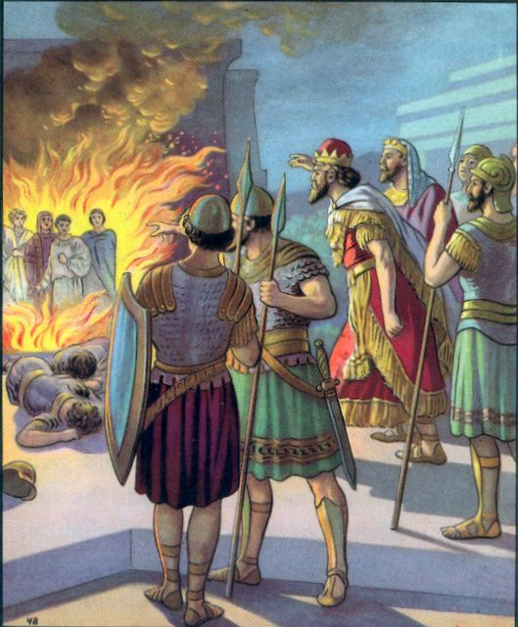
Shadrach, Meshach, and Abed-Nego
Daniel 3:15-18

Slide 10
CONTEXT
About 20 years after his famous dream, Nebuchadnezzar builds a golden statue in the plains of Dura (maybe loosely associated with the statue/image in his dream)
All people must bow down before it – or suffer the consequences

Slide 11
CONTEXT
About 20 years after his famous dream, Nebuchadnezzar builds a golden statue in the plains of Dura (maybe loosely associated with the statue/image in his dream)
All people must bow down before it – or suffer the consequences
Shadrach, Meshach, and Abed-Nego refuse to bow

Slide 12
THEIR DILEMMA
They could bow, and…
Protect their positions
Conform to everyone else
Avoid persecution

Slide 13
THEIR DILEMMA
They could bow, and…
Protect their positions
Conform to everyone else
Avoid persecution
Or, they could disobey the command, and…
Be different (2 Cor. 6:17; Matt. 5:13-16; Titus 2:14)
Insinuation – v 8-12
Interrogation – v 13-14
Intimidation – v 15-18

Slide 14
THEIR FAITH
A faith that trusts God…
Daniel 3:17 – “…our God…is able to deliver us…”
From the furnace,
From Nebuchadnezzar’s hand

Slide 15
THEIR FAITH
A faith that trusts God…
Daniel 3:17 – “…our God…is able to deliver us…”
From the furnace,
From Nebuchadnezzar’s hand
Hebrews 11:1, 6
James 2:18 – “…I will show you my faith by my works.”
1 John 5:4 – “This is the victory…our faith”

Slide 16
THEIR FAITH
… and recognizes that we don’t know all of God’s mind/ways
Daniel 3:18 – “But even if He does not…”
Isaiah 55:8-9
1 Corinthians 1:19-20, 25

Slide 17
THEIR FAITH
… and recognizes that we don’t know all of God’s mind/ways
Daniel 3:18 – “But even if He does not…”
Isaiah 55:8-9
1 Corinthians 1:19-20, 25
Stephan was killed, Saul was there
James was killed, Peter was not
Of the “inner circle,” James died about 10-15 years after Jesus, Peter & John lived long lives

Slide 18
THEIR FAITH
… and recognizes that we don’t know all of God’s mind/ways
Daniel 3:18 – “But even if He does not…”
Isaiah 55:8-9
1 Corinthians 1:19-20, 25
Stephan was killed, Saul was there
James was killed, Peter was not
Of the “inner circle,” James died about 10-15 years after Jesus, Peter & John lived long lives
Jesus was crucified, we all live

Slide 19
NEBUCHADNEZZAR
Great king, great kingdom
Daniel 2:36-38 – “head of gold” “king of kings” (cf. Jeremiah 43:10 – ”My servant”)

Slide 20
NEBUCHADNEZZAR
Great king, great kingdom
Daniel 2:36-38 – “head of gold” “king of kings” (cf. Jeremiah 43:10 – ”My servant”)
Revelation 17:14 – Jesus is the Lord of lords and King of kings
Nebuchadnezzar kept forgetting that God is greater than he was

Slide 21
NEBUCHADNEZZAR
Great king, great kingdom
Daniel 2:36-38 – “head of gold” “king of kings” (cf. Jeremiah 43:10 – ”My servant”)
Revelation 17:14 – Jesus is the Lord of lords and King of kings
Nebuchadnezzar kept forgetting that God is greater than he was
Daniel 4:28-37 – Nebuchadnezzar will have to learn the hard way that he is not God

Slide 22
THE FIERY FURNACE
Throughout history…
Brick furnaces in Egypt
Nebuchadnezzar’s furnace

Slide 23
THE FIERY FURNACE
Throughout history…
Brick furnaces in Egypt
Nebuchadnezzar’s furnace
Nero’s furnaces
Nazi furnaces

Slide 24
THE FIERY FURNACE
Throughout history…
Brick furnaces in Egypt
Nebuchadnezzar’s furnace
Nero’s furnaces
Nazi furnaces
1 Peter 4:11-13 – “fiery ordeal”,

Slide 25
THE FIERY FURNACE
Throughout history…
Brick furnaces in Egypt
Nebuchadnezzar’s furnace
Nero’s furnaces
Nazi furnaces
1 Peter 4:11-13 – “fiery ordeal”,
Or, eternally
Revelation 21:8 – “but the cowardly…”
Matthew 10:28 – “Do not fear…”

Slide 26
THE FOURTH MAN
While the fire burns off their ropes and kills the soldiers that threw them into the furnace, it does not harm them in any way
The presence of the fourth man is related to their being saved

Slide 27
THE FOURTH MAN
While the fire burns off their ropes and kills the soldiers that threw them into the furnace, it does not harm them in any way
The presence of the fourth man is related to their being saved
Isaiah 43:2 – to Israel
A foreshadowing of Christ over hellfire
1 Cor. 15:55 - Death swallowed up in victory

Slide 28
THE FOURTH MAN
Romans 8:38-39 - Nothing can separate us from God
They are delivered
In the flames v 24-25 – unbound/unharmed
From the flames v 26-27
2 Corinthians 4:17; 5:8; Philippians 1:21
After the flames v 28-30

Slide 29
CONCLUSION
Shadrach, Meshach & Abed-Nego are known for their stance against the idolatry in Babylon
While we don’t have open idolatry like that, we must make similar decisions
Conform, be transformed (Romans 12:1-2)
Strait and narrow; broad way (Matt 7:13-14)
Gather; be scattered (Luke 11:23)
Hopefully, we’ll have similar attitudes

Slide 30
Are YOU a Christian?
Hear
Believe
Repent
Confess
Be Baptized
Continue Faithfully
Romans 10:17
Mark 16:16
Acts 2:38
Acts 22:16
Mark 16:16
Hebrews 10:38

