Slide 1
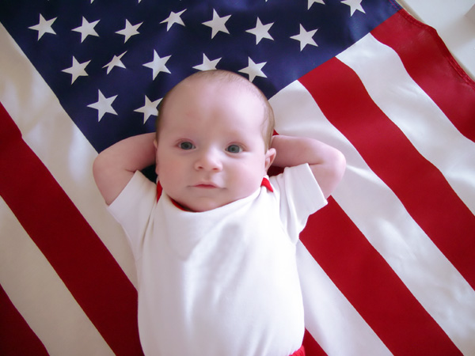
Abortion
Proverbs
6:16-17
Proverbs 6:16-19

Slide 2
INTRODUCTION
Recently, I’ve preached on some social topics
Suicide
Tattoos
Etc.

Slide 3
INTRODUCTION
Recently, I’ve preached on some social topics
Suicide
Tattoos
Etc.
Another hot topic – heated debates
Many: It’s legal (no interest in what God says)
Others: God says this; God says that; God doesn’t

Slide 4
INTRODUCTION
First, a few statistics – not many because we are all aware of this national/global tragedy

Slide 5
INTRODUCTION
First, a few statistics – not many because we are all aware of this national/global tragedy
Teaching others
Scriptures
Consequences

Slide 6
INTRODUCTION
First, a few statistics – not many because we are all aware of this national/global tragedy
Teaching others
Scriptures
Consequences
Personal applications
How does this affect me?
How can I help others?

Slide 7
A FEW STATISTICS
Worldwide abortions (approx.)
Yearly: 42 million Daily: 115,000
83% developing nations 17% developed

Slide 8
A FEW STATISTICS
Worldwide abortions (approx.)
Yearly: 42 million Daily: 115,000
83% developing nations 17% developed
America
Yearly: 1.06 million Daily: almost 3,000

Slide 9
A FEW STATISTICS
Worldwide abortions (approx.)
Yearly: 42 million Daily: 115,000
83% developing nations 17% developed
America
Yearly: 1.06 million Daily: almost 3,000
Over half of all abortions – females under 25
20-24 – 32%
Teens (15-19) – 20%
Under 15 – 1.2%

Slide 10
A FEW STATISTICS
America
Ethnicity
Black women 3X more likely than white women
Hispanics 2X more likely
Never married: over 64%

Slide 11
A FEW STATISTICS
America
Ethnicity
Black women 3X more likely than white women
Hispanics 2X more likely
Never married: over 64%
Reason
93% - Social reasons (unwanted/inconvenient)
6% - Potential health problems (mother/child)
1% - Rape/incest
Likelihood: Est. 43% of women (before age 45)

Slide 12
A FEW STATISTICS
America
Income
28.7% - Under $15,000
38% - $30,000 to 59,999

Slide 13
A FEW STATISTICS
America
Income
28.7% - Under $15,000
38% - $30,000 to 59,999
Religion (as they identify themselves)
Protestants – over 37%
Catholics – over 31%
Jewish – about 1%
None – over 27%
Note: Born again/Evangelical: 18%

Slide 14
SCRIPTURES
Exodus 21:22-25, 30
Fine: If a miscarriage, but no harm (mother/child)
Life for life: If harm does occur
Notice: baby, mother, adult male equal

Slide 15
SCRIPTURES
Exodus 21:22-25, 30
Fine: If a miscarriage, but no harm (mother/child)
Life for life: If harm does occur
Notice: baby, mother, adult male equal
Job 31:15 – God’s work in the womb

Slide 16
SCRIPTURES
Exodus 21:22-25, 30
Fine: If a miscarriage, but no harm (mother/child)
Life for life: If harm does occur
Notice: baby, mother, adult male equal
Job 31:15 – God’s work in the womb
Judges 13:7 (Samson)
“Conceive” and “give birth” tied to “a son”/”boy”
Beginning and end of process tied to result

Slide 17
SCRIPTURES
Exodus 1:15-17 – Obey God rather than man
Genesis 4:1, 25; 33:5 – God’s blessing
Eve (female) Jacob (male)
Also: Rachel, Leah, Job, Hannah, Zech/Eliz, Isaac, Abraham, Ruth, etc.

Slide 18
SCRIPTURES
Exodus 1:15-17 – Obey God rather than man
Genesis 4:1, 25; 33:5 – God’s blessing
Eve (female) Jacob (male)
Also: Rachel, Leah, Job, Hannah, Zech/Eliz, Isaac, Abraham, Ruth, etc.
Luke 1:41; 2:12
“Baby” before and after birth – no distinction
Greek “brephos” – no separate words

Slide 19
SCRIPTURES
Only wicked people arranged wide scale killing of children
Pharaoh (Exodus 1)
Child sacrifices (to Molech, Baal, etc.) (Jer 19)
Herod (Matthew 2)
Romans 1:26 – changed natural for the unnatural
Proverbs 6:16-17; Isaiah 1:15, etc.

Slide 20
SCRIPTURES
Only wicked people arranged wide scale killing of children
Pharaoh (Exodus 1)
Child sacrifices (to Moloch, Baal, etc.) (Jer 19)
Herod (Matthew 2)
Romans 1:26 – changed natural for the unnatural
Proverbs 6:16-17; Isaiah 1:15, etc.
Ephesians 5:11

Slide 21
PERSONAL APPLICATIONS
Many religious/Bible-believing/ Christians:
Recognize Bible teaching
Obey man rather than God
“It’s okay” – situation ethics

Slide 22
PERSONAL APPLICATIONS
Many religious/Bible-believing/ Christians:
Recognize Bible teaching
Obey man rather than God
“It’s okay” – situation ethics
Have the “I don’t do it, but each one must make up their own mind” mentality
Silence – God will punish those who remain silent
Pro-choice – incest/murder/rape also?

Slide 23
PERSONAL APPLICATIONS
Many religious/Bible-believing/ Christians:
Vote for pro-choice candidates
Put up signs for pro-choice candidates
Call for pro-choice candidates
Get-out-the-vote for pro-choice candidates

Slide 24
PERSONAL APPLICATIONS
Many religious/Bible-believing/ Christians:
Vote for pro-choice candidates
Put up signs for pro-choice candidates
Call for pro-choice candidates
Get-out-the-vote for pro-choice candidates
In America, we have a say in government
…and, with privilege comes responsibility

Slide 25
PERSONAL APPLICATIONS
Many religious/Bible-believing/ Christians:
Vote for pro-choice candidates
Put up signs for pro-choice candidates
Call for pro-choice candidates
Get-out-the-vote for pro-choice candidates
In America, we have a say in government
…and, with privilege comes responsibility
When God punishes the pro-choice candidate, will He then turn His Judgment to you?

Slide 26
CONCLUSION
Abortion is sin
God will punish unrepentant sinners

Slide 27
CONCLUSION
Abortion is sin
God will punish unrepentant sinners
Christians need to take a stand
Let light shine
Do not fellowship sin

Slide 28
CONCLUSION
Abortion is sin
God will punish unrepentant sinners
Christians need to take a stand
Let light shine
Do not fellowship sin
2 Corinthians 6:14; Romans 13:12
Ephesians 5:11; Acts 26:18

Slide 29
Are YOU a Christian?
Hear
Believe
Repent
Confess
Be Baptized
Continue Faithfully
Romans 10:17
Mark 16:16
Acts 2:38
Acts 22:16
Mark 16:16
Hebrews 10:38

