Slide 1
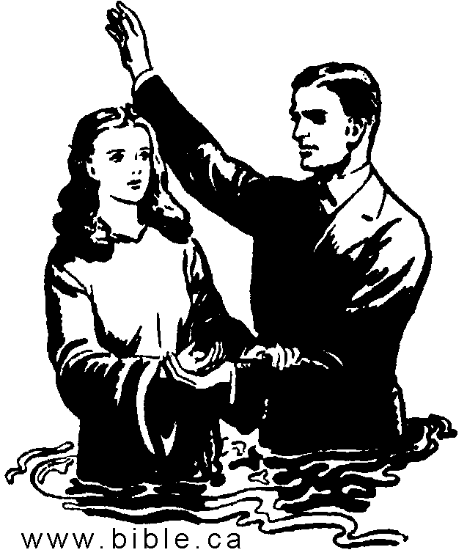
When Baptism DOESN’T Save You
Acts 19:1-7

Slide 2
INTRODUCTION
1 Peter 3:21
Context
“…Corresponding to that…” “…not the…, but…”
Plainly states it

Slide 3
INTRODUCTION
1 Peter 3:21
Context
“…Corresponding to that…” “…not the…, but…”
Plainly states it
Many denominations reject this
Like they do Mark 16:16, etc

Slide 4
INTRODUCTION
1 Peter 3:21
Context
“…Corresponding to that…” “…not the…, but…”
Plainly states it
Many denominations reject this
Like they do Mark 16:16, etc
They use Scripture against Scripture
Ephesians 2:8-9 “…works…”

Slide 5
INTRODUCTION
1 Peter 3:21
Context
“…Corresponding to that…” “…not the…, but…”
Plainly states it
Many denominations reject this
Like they do Mark 16:16, etc
They use Scripture against Scripture
Ephesians 2:8-9 “…works…”
1 Corinthians 1:17 – “For Christ did not send me to baptize…”

Slide 6
Question
Is there ever an occasion where baptism does NOT save a person?

Slide 7
Question – Answer
Is there ever an occasion where baptism does NOT save a person?
Yes, several.

Slide 8
1. Wrong baptism
“John’s baptism” (repentance)
Acts 19:1-6

Slide 9
1. Wrong baptism
“John’s baptism” (repentance)
Acts 19:1-6
John baptized many (Matthew 3:1-6)
Jesus was baptizing more (John 4:1-2)

Slide 10
1. Wrong baptism
“John’s baptism” (repentance)
Acts 19:1-6
John baptized many (Matthew 3:1-6)
Jesus was baptizing more (John 4:1-2)
NOTE: The Ephesians
Didn’t try to argue/justify their previous baptism
They were baptized correctly

Slide 11
1. Wrong baptism
“John’s baptism” (repentance)
Acts 19:1-6
John baptized many (Matthew 3:1-6)
Jesus was baptizing more (John 4:1-2)
NOTE: The Ephesians
Didn’t try to argue/justify their previous baptism
They were baptized correctly
Their sincerity was demonstrated by their actions

Slide 12
1. Wrong baptism
Many types of baptisms
Mikvah (Jewish) – still practiced
HS (1st c.) – (not the same as the gifts of the HS)
Fire (Hell) – (you don’t want this kind)
Many religions/cultures

Slide 13
1. Wrong baptism
Many types of baptisms
Mikvah (Jewish) – still practiced
HS (1st c.) – (not the same as the gifts of the HS)
Fire (Hell) – (you don’t want this kind)
Many religions/cultures
However: Ephesians 4:5
Around 60-62 AD
Other baptisms (immersions) still exist
But, for Christians, there is only one
Just as sure as there is one God, one Lord, etc.

Slide 14
2. Wrong way
Baptizo (burial, immersion, submersion)
Romans 6:3-5; Colossians 2:12 – correct way

Slide 15
2. Wrong way
Baptizo (burial, immersion, submersion)
Romans 6:3-5; Colossians 2:12 – correct way
Affusion (pouring water over the head)
Standing waist deep in water
Over infants’ heads
Neither is mentioned in the Bible

Slide 16
2. Wrong way
Baptizo (burial, immersion, submersion)
Romans 6:3-5; Colossians 2:12 – correct way
Affusion (pouring water over the head)
Standing waist deep in water
Over infants’ heads
Neither is mentioned in the Bible
Aspersion (sprinkling, usu. w/holy water)
Practiced by some denominations
Also not mentioned in the Bible

Slide 17
3. Wrong reason
Meritorious work – Ephesians 2:8-9
Work of the Law
Work of man
Rather, it is a work of God (faith)

Slide 18
3. Wrong reason
Meritorious work – Ephesians 2:8-9
Work of the Law
Work of man
Rather, it is a work of God (faith)
An “outward sign of an inward grace”
Common teaching today in denominations
Mark 16:16; Acts 2:38; 8:36-37; Titus 3:4-5, etc.

Slide 19
3. Wrong reason
Meritorious work – Ephesians 2:8-9
Work of the Law
Work of man
Rather, it is a work of God (faith)
An “outward sign of an inward grace”
Common teaching today in denominations
Mark 16:16; Acts 2:38; 8:36-37; Titus 3:4-5, etc.
Either extreme is incorrect

Slide 20
3. Wrong reason
Meritorious work – Ephesians 2:8-9
Work of the Law
Work of man
Rather, it is a work of God (faith)
An “outward sign of an inward grace”
Common teaching today in denominations
Mark 16:16; Acts 2:38; 8:36-37; Titus 3:4-5, etc.
Either extreme is incorrect
To please parents/spouse/friends, etc.

Slide 21
4. Wrong person
Unbeliever – Mark 16:16
Ignorant (never heard)-Acts 17:30; Rom. 10:10-17
Hard heart – Matt. 13:14-15; John 12:48; Eph. 4:18

Slide 22
4. Wrong person
Unbeliever – Mark 16:16
Ignorant (never heard)-Acts 17:30; Rom. 10:10-17
Hard heart – Matt. 13:14-15; John 12:48; Eph. 4:18
Unrepentant – Acts 2:38

Slide 23
4. Wrong person
Unbeliever – Mark 16:16
Ignorant (never heard)-Acts 17:30; Rom. 10:10-17
Hard heart – Matt. 13:14-15; John 12:48; Eph. 4:18
Unrepentant – Acts 2:38
Unconfessing – Acts 8:36-37

Slide 24
4. Wrong person
Unbeliever – Mark 16:16
Ignorant (never heard)-Acts 17:30; Rom. 10:10-17
Hard heart – Matt. 13:14-15; John 12:48; Eph. 4:18
Unrepentant – Acts 2:38
Unconfessing – Acts 8:36-37
Infant, etc.
Not found in the Bible
Notice Jeremiah 31:34; Hebrews 8:11

Slide 25
4. Wrong person
Unbeliever – Mark 16:16
Ignorant (never heard)-Acts 17:30; Rom. 10:10-17
Hard heart – Matt. 13:14-15; John 12:48; Eph. 4:18
Unrepentant – Acts 2:38
Unconfessing – Acts 8:36-37
Infant, etc.
Not found in the Bible
Notice Jeremiah 31:34; Hebrews 8:11
Someone forced/coerced/bribed

Slide 26
Addendum
We have focused on baptisms that are of no use in saving the sinner
There is another category that should be mentioned
Baptism does not guarantee salvation to someone who returns to a sinful lifestyle
There are at least 30 passages that teach that a Christian can so sin as to die and go to Hell
Baptism does not force God to save you

Slide 27
CONCLUSION
God says that baptism (immersion) saves you
Scriptural baptism saves you scripturally
A burial in water for the forgiveness of your sins
Romans 6:3-4; 1 Peter 3:21, etc.
Unscriptural “baptism” is a counterfeit and has no power to save
Wrong baptism, wrong way, wrong person, etc.
Satan has many corruptions/counterfeits
You can be sincere and still be wrong

Slide 28
Are YOU a Christian?
Hear
Believe
Repent
Confess
Be Baptized
Continue Faithfully
Romans 10:17
Mark 16:16
Acts 2:38
Acts 22:16
Mark 16:16
Hebrews 10:38

