Slide 1
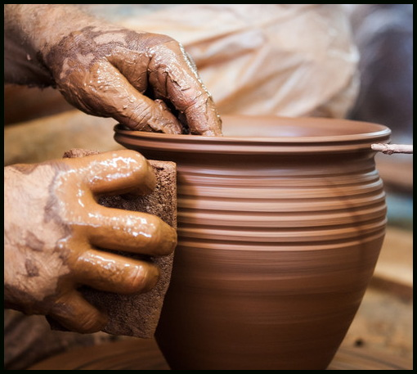
Useful To The Master
2 Timothy 2:14-21

Slide 2
INTRODUCTION
Since the creation, God has used mankind to do His will

Slide 3
INTRODUCTION
Since the creation, God has used mankind to do His will
He didn’t just pick blindly
Some already possessed the qualities needed
Some were “diamonds in the rough”
Some were looking to serve God
Others were not

Slide 4
INTRODUCTION
Since the creation, God has used mankind to do His will
He didn’t just pick blindly
Some already possessed the qualities needed
Some were “diamonds in the rough”
Some were looking to serve God
Others were not
Let’s look at a few

Slide 5
Noah
Faithful in the midst of wickedness
Genesis 6:1-8

Slide 6
Noah
Faithful in the midst of wickedness
Genesis 6:1-8
He/family were the only ones – none to fall back on
Wickedness was worse than any we have known
His righteousness found favor in God’s eyes (v 8)

Slide 7
Noah
Faithful in the midst of wickedness
Genesis 6:1-8
He/family were the only ones – none to fall back on
Wickedness was worse than any we have known
His righteousness found favor in God’s eyes (v 8)
Lot had similar opportunity, but failed
Preacher of righteousness (2 Peter 2:5)
Saved himself and his family (Hebrews 11:7)

Slide 8
Abraham
A friend of God - James 2:23
cf 2 Chronicles 20:7; Isaiah 41:8 – 3x total

Slide 9
Abraham
A friend of God - James 2:23
cf 2 Chronicles 20:7; Isaiah 41:8 – 3x total
Faithful (Hebrews 11:8-10), not sinless
Cared about others – Genesis 18:22-32
Genesis 18:19 – chosen to instruct children, etc.

Slide 10
Abraham
A friend of God - James 2:23
cf 2 Chronicles 20:7; Isaiah 41:8 – 3x total
Faithful (Hebrews 11:8-10), not sinless
Cared about others – Genesis 18:22-32
Genesis 18:19 – chosen to instruct children, etc.
We can be God’s friends, also
John 15:14 – do His commandments
James 4:4 – too many fall in “enemy” category

Slide 11
Joseph
Evangelism in adversity
Genesis 39:9 – Mrs. Potiphar
Genesis 40:8 – Butler and Baker
Genesis 41:16, 25, 28, 32, 38-40 – Pharaoh

Slide 12
Joseph
Evangelism in adversity
Genesis 39:9 – Mrs. Potiphar
Genesis 40:8 – Butler and Baker
Genesis 41:16, 25, 28, 32, 38-40 – Pharaoh
Genesis 41:51-52 – his wife/children
Genesis 43:23 – his steward

Slide 13
Joseph
Evangelism in adversity
Genesis 39:9 – Mrs. Potiphar
Genesis 40:8 – Butler and Baker
Genesis 41:16, 25, 28, 32, 38-40 – Pharaoh
Genesis 41:51-52 – his wife/children
Genesis 43:23 – his steward
Genesis 42:18; 43:29; 45:5-9 – his brothers

Slide 14
Pharaoh (Exodus)
Hardening a heart
Exodus 5:2 – willful ignorance (denial)

Slide 15
Pharaoh (Exodus)
Hardening a heart
Exodus 5:2 – willful ignorance (denial)
God said “LET THEM GO!”
Pharaoh said “No!” - and his heart was hardened
Again and again this happened
At any time, Pharaoh could have said “Yes.”

Slide 16
Pharaoh (Exodus)
Hardening a heart
Exodus 5:2 – willful ignorance (denial)
God said “LET THEM GO!”
Pharaoh said “No!” - and his heart was hardened
Again and again this happened
At any time, Pharaoh could have said “Yes.”
The same principle applies to every person throughout the ages, right down to us.
Jews (Hebrews 3:8)
Christians (Hebrews 3:15)

Slide 17
John the Baptist
Fearless teacher
Malachi 4:5 cf Luke 1:17

Slide 18
John the Baptist
Fearless teacher
Malachi 4:5 cf Luke 1:17
Mark 9:11-13
Matthew 11:7-11
Matthew 3:7-12

Slide 19
John the Baptist
Fearless teacher
Malachi 4:5 cf Luke 1:17
Mark 9:11-13
Matthew 11:7-11
Matthew 3:7-12
Mark 6:17-18

Slide 20
Benefits
Name written in the book of life
Luke 10:20
Philippians 4:3

Slide 21
Benefits
Name written in the book of life
Luke 10:20
Philippians 4:3
Entrance into heaven
2 Peter 1:11

Slide 22
Benefits
Name written in the book of life
Luke 10:20
Philippians 4:3
Entrance into heaven
2 Peter 1:11
Eternal rest
Hebrews 4:1-11

Slide 23
(Your Name Here)
Will you be considered a worker that need not be ashamed?
…a useful vessel for the Master?
…a good and faithful servant?

Slide 24
(Your Name Here)
Will you be considered a worker that need not be ashamed?
…a useful vessel for the Master?
…a good and faithful servant?
Don’t be surprised on the Judgment
Matthew 25:35-45
Matthew 7:21-23

Slide 25
(Your Name Here)
Will you be considered a worker that need not be ashamed?
…a useful vessel for the Master?
…a good and faithful servant?
Don’t be surprised on the Judgment
Matthew 25:35-45
Matthew 7:21-23
Will God use you as a good example?
…or, a bad example?

Slide 26
Are YOU a Christian?
Hear
Believe
Repent
Confess
Be Baptized
Continue Faithfully
Romans 10:17
Mark 16:16
Acts 2:38
Acts 22:16
Mark 16:16
Hebrews 10:38

