Slide 1
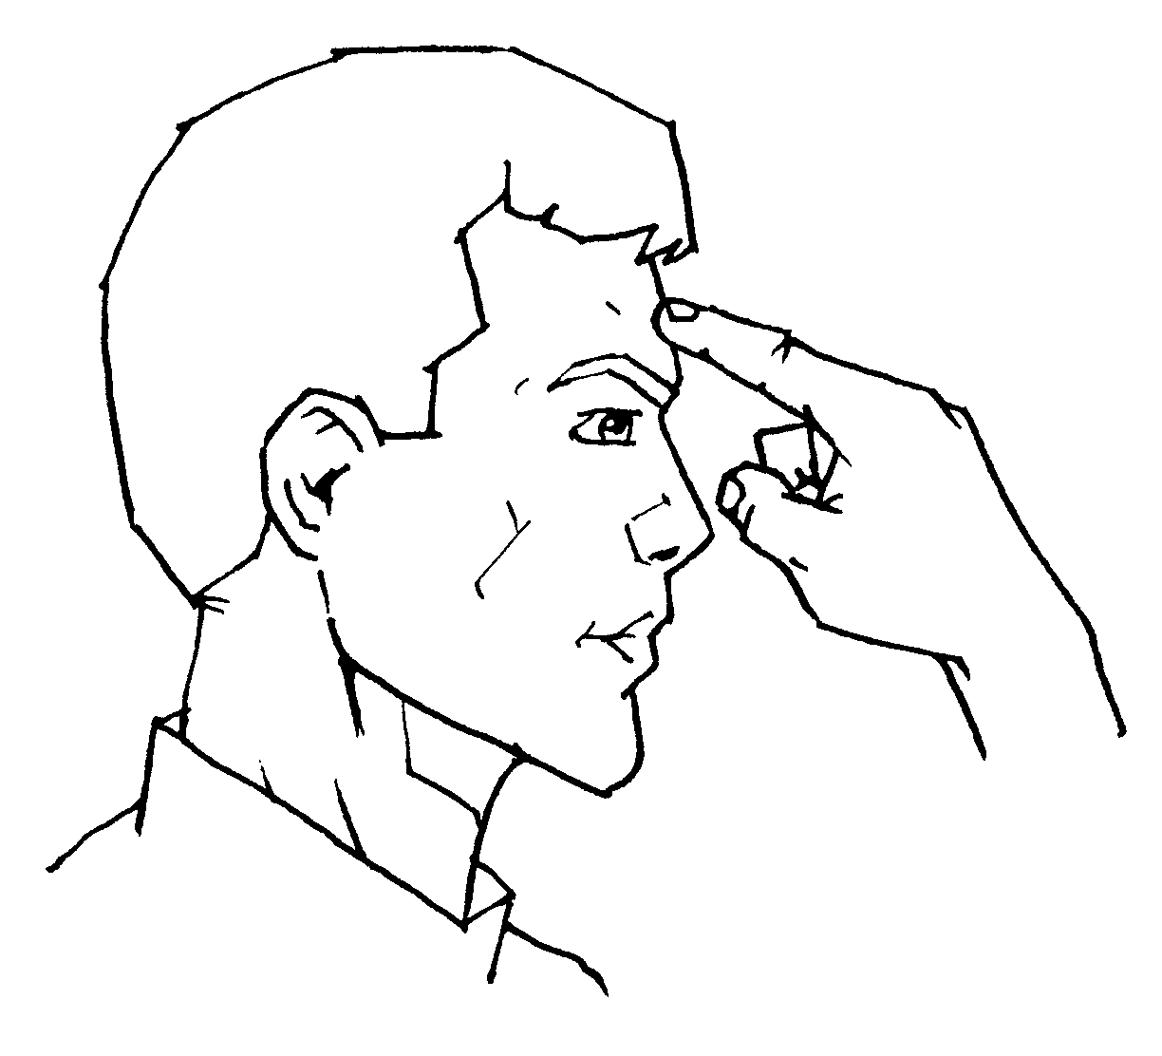
Narrow-minded
John 14:1-6

Slide 2
INTRODUCTION
Have you ever been called “narrow-minded”?
Probably not a compliment
Or, intolerant
Or, self-righteous, etc

Slide 3
INTRODUCTION
Have you ever been called “narrow-minded”?
Probably not a compliment
Or, intolerant
Or, self-righteous, etc
Narrow- or broad-minded in our society/age
Politically, conservative/liberal
Religiously, intolerant/tolerant
Pharisees/Sadducees
Unenlightened/enlightened
Socially, financially, etc.

Slide 4
INTRODUCTION
The phrase “narrow-minded” has negative connotations-lacking tolerance/breadth of view

Slide 5
INTRODUCTION
The phrase “narrow-minded” has negative connotations-lacking tolerance/breadth of view
What kind of attitude should we, as Christians, have
…toward social issues?
…toward spiritual issues?

Slide 6
INTRODUCTION
The phrase “narrow-minded” has negative connotations-lacking tolerance/breadth of view
What kind of attitude should we, as Christians, have
…toward social issues?
…toward spiritual issues?
Is there ever a right time to be narrow-minded?

Slide 7
BROAD-MINDED
God is broad-minded
John 3:16 – His love
Acts 2:39 – His promised blessings
2 Peter 3:9 – His patience

Slide 8
BROAD-MINDED
God is broad-minded
John 3:16 – His love
Acts 2:39 – His promised blessings
2 Peter 3:9 – His patience
HOWEVER:
1 Jn 2:15 – His love is available, but never forced
Ephesians 1:3 – All blessings are in Christ
2 Peter 3:7 – His patience is limited

Slide 9
JESUS
Let’s notice Jesus’ attitude
…regarding false teachers
…regarding His authority
…regarding worship
…regarding discipleship (following Him)
…regarding salvation

Slide 10
1. FALSE TEACHERS
Jesus
Matthew 7:15-23
Matthew 23
Revelation 2:6 (Nicolaitans), 2:14 (Balaam), 2:15 (Nicolaitans ), 2:20 (Jezebel), etc.

Slide 11
1. FALSE TEACHERS
Jesus
Matthew 7:15-23
Matthew 23
Revelation 2:6 (Nicolaitans), 2:14 (Balaam), 2:15 (Nicolaitans ), 2:20 (Jezebel), etc.
His followers
Acts 13:8-11 – Elymas the magician stricken blind
Acts 16:16-18 - Paul rebukes the slave girl’s demon
Galatians 2:11-13 – Paul opposed Peter
Jude 10-13 – False teachers

Slide 12
2. HIS AUTHORITY
Jesus
Matthew 5 – “But, I say to you…”
Matthew 7:28-29 – “…as one having authority.”
Matthew 9:6 – “…authority on earth to forgive…”
Matthew 28:18 – In heaven and on earth

Slide 13
2. HIS AUTHORITY
Jesus
Matthew 5 – “But, I say to you…”
Matthew 7:28-29 – “…as one having authority.”
Matthew 9:6 – “…authority on earth to forgive…”
Matthew 28:18 – In heaven and on earth
His followers
Acts 5:29 – “…obey God rather than men.”

Slide 14
3. WORSHIP
Matthew 4:10 – God only
Acts 10:25-26 – not those who bring the message
Revelation 19:10 – not angels

Slide 15
3. WORSHIP
Matthew 4:10 – God only
Acts 10:25-26 – not those who bring the message
Revelation 19:10 – not angels
John 4:24
In spirit – emotion, enthusiasm, from the heart
Not hypocritical/wandering mind/etc
In truth – God has revealed all truth necessary
Not will-worship/vain worship/etc.

Slide 16
3. WORSHIP
Matthew 4:10 – God only
Acts 10:25-26 – not those who bring the message
Revelation 19:10 – not angels
John 4:24
In spirit – emotion, enthusiasm, from the heart
Not hypocritical/wandering mind/etc
In truth – God has revealed all truth necessary
Not will-worship/vain worship/etc.
Not only Whom, but also how

Slide 17
4. DISCIPLESHIP
God comes first
Matthew 16:24 – Not self
Matthew 10:37-39 – Not family
Luke 14:27 – Count the cost
2 Timothy 3:12 – Persecution
Romans 6:6 – old self/new man

Slide 18
4. DISCIPLESHIP
God comes first
Matthew 16:24 – Not self
Matthew 10:37-39 – Not family
Luke 14:27 – Count the cost
2 Timothy 3:12 – Persecution
Romans 6:6 – old self/new man
Salvation may be free to us, but discipleship is costly

Slide 19
5. SALVATION
John 14:1-6 – Jesus is the way/truth/life
Matthew 7:13-14 – not many will choose the narrow way
Matthew 19:21 – Follow Jesus
Acts 4:12 – Salvation in no one else

Slide 20
5. SALVATION
John 14:1-6 – Jesus is the way/truth/life
Matthew 7:13-14 – not many will choose the narrow way
Matthew 19:21 – Follow Jesus
Acts 4:12 – Salvation in no one else
God paid the price for our redemption, now it’s up to us to be transformed into the likeness of His Son

Slide 21
WHICH DO YOU CHOOSE?
We are told to “be tolerant” of false practices in the world and among brethren – but God does not tolerate false teachers.

Slide 22
WHICH DO YOU CHOOSE?
We are told to “be tolerant” of false practices in the world and among brethren – but God does not tolerate false teachers.
We’re told that we need to be accepting of the authority of men and creeds of men – but Jesus was very explicit about His authority.

Slide 23
WHICH DO YOU CHOOSE?
We are told to “be tolerant” of false practices in the world and among brethren – but God does not tolerate false teachers.
We’re told that we need to be accepting of the authority of men and creeds of men – but Jesus was very explicit about His authority.
We see people worshipping everything from earth, animals, men, self, angels, even Satan – yet we are to worship God alone, and as He has authorized.

Slide 24
WHICH DO YOU CHOOSE?
The world tells us that we can keep the old self and change Christianity instead – but the Bible teaches that discipleship is costly. That we need to change from the old man to the new and that it won’t always be easy.

Slide 25
WHICH DO YOU CHOOSE?
The world tells us that we can keep the old self and change Christianity instead – but the Bible teaches that discipleship is costly. That we need to change from the old man to the new and that it won’t always be easy.
The world is on the broad way of feel-good religion – but the Holy Spirit reveals the way of salvation. Over 70% of people feel they will go to heaven, but few are interested in what the Bible teaches about it. Many are religious leaders!

Slide 26
CONCLUSION
Sometimes, God wants us to be broad-minded
And, sometimes, God wants us to be “narrow-minded”
Many times, a combination of the two is what is correct
We may have a tendency toward one/other
Only by walking according to His revealed will can we be pleasing to Him

Slide 27
Are YOU a Christian?
Hear
Believe
Repent
Confess
Be Baptized
Continue Faithfully
Romans 10:17
Mark 16:16
Acts 2:38
Acts 22:16
Mark 16:16
Hebrews 10:38

