Slide 1
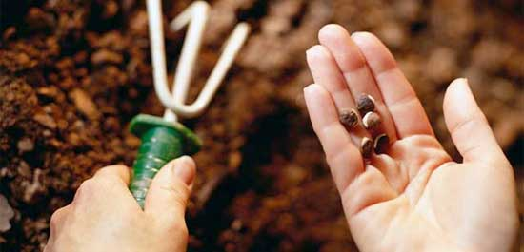
I planted,

Slide 2
I planted, Apollos watered…

Slide 3
I planted, Apollos watered…

Slide 4
INTRODUCTION
Paul was writing to the brethren in Corinth – in the southern part of Greece
Wealthy
Commercial
Proud
Thriving

Slide 5
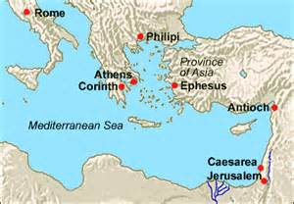
INTRODUCTION

Slide 6
INTRODUCTION
Paul was writing to the brethren in Corinth – in the southern part of Greece
Wealthy
Commercial
Proud
Thriving
No dominant religion
Sects, Temples, Shrines, etc.

Slide 7
INTRODUCTION
Paul was writing to the brethren in Corinth – in the southern part of Greece
Wealthy
Commercial
Proud
Thriving
No dominant religion
Sects, Temples, Shrines, etc.
Many problems that had to be dealt with

Slide 8
1 Corinthians 1:10-14
(I am of) Paul –
An apostle
Equal to the others
But frequently having to defend his apostleship

Slide 9
1 Corinthians 1:10-14
(I am of) Paul –
An apostle
Equal to the others
But frequently having to defend his apostleship
(I am of) Cephas –
Peter, also an Apostle
A recognized leader in the church
However, there is no record of him ever being at Corinth

Slide 10
1 Corinthians 1:10-14
(I am of) Apollos –
An Alexandrian Jew
Eloquent, a hard worker, not an Apostle
He had taught at Corinth
No known desire to return

Slide 11
1 Corinthians 1:10-14
(I am of) Apollos –
An Alexandrian Jew
Eloquent, a hard worker, not an Apostle
He had taught at Corinth
No known desire to return
(I am of) Jesus –
Our Lord
Head over the church
Sects are wrong; no matter whom you put as the head of the party

Slide 12
I PLANTED…
The Parable of the Soils (Mark 4; Luke 8) –
Plants everywhere
Some fail to sprout, some are choked, some whither
Only one of the 4 soils bears much fruit

Slide 13
I PLANTED…
The Parable of the Soils (Mark 4; Luke 8) –
Plants everywhere
Some fail to sprout, some are choked, some whither
Only one of the 4 soils bears much fruit
Purity of seeds – Leviticus 19:19; Deut. 22:9, etc.

Slide 14
I PLANTED…
The Parable of the Soils (Mark 4; Luke 8) –
Plants everywhere
Some fail to sprout, some are choked, some whither
Only one of the 4 soils bears much fruit
Purity of seeds – Leviticus 19:19; Deut. 22:9, etc.
1 Peter 1:23 – the seed is the word of God

Slide 15
I PLANTED…
The Parable of the Soils (Mark 4; Luke 8) –
Plants everywhere
Some fail to sprout, some are choked, some whither
Only one of the 4 soils bears much fruit
Purity of seeds – Leviticus 19:19; Deut. 22:9, etc.
1 Peter 1:23 – the seed is the word of God
Notice Revelation 14:6-7 – Angels are/were involved in the spreading of the Gospel

Slide 16
SOWING THE SEED
Matthew 28:18-20 – The Great Commission, Jesus sent His disciples out to preach, baptize, teach
Mark 16:15-16 – Necessary for salvation

Slide 17
SOWING THE SEED
Matthew 28:18-20 – The Great Commission, Jesus sent His disciples out to preach, baptize, teach
Mark 16:15-16 – Necessary for salvation
2 Corinthians 4:7 – We have this treasure in earthen vessels

Slide 18
SOWING THE SEED
Matthew 28:18-20 – The Great Commission, Jesus sent His disciples out to preach, baptize, teach
Mark 16:15-16 – Necessary for salvation
2 Corinthians 4:7 – We have this treasure in earthen vessels
1 Timothy 1:11 – Entrusted to Paul
2 Timothy 2:2 – As Timothy was taught, teach

Slide 19
APOLLOS WATERED…
He followed Paul as a teacher at Corinth
Acts 18:1
Acts 19:1

Slide 20
APOLLOS WATERED…
He followed Paul as a teacher at Corinth
Acts 18:1
Acts 19:1
For me:
Jeff Smelser
Ross Cross
Billy Boyd…
(You probably recall who your “Paul and Apollos” were)

Slide 21
APOLLOS WATERED…
This doesn’t mean that
Paul somehow failed
Or, that Apollos was somehow superior

Slide 22
APOLLOS WATERED…
This doesn’t mean that
Paul somehow failed
Or, that Apollos was somehow superior
Growth will take time-you may not be there
Others may build on previous work
Different people/abilities/personalities, but the same God

Slide 23
GOD
Supplies

Slide 24
GOD
Supplies
The Foundation – Jesus, the Chief Cornerstone
The message – Gospel
The power – Philippians 1:6

Slide 25
GOD
Supplies
The Foundation – Jesus, the Chief Cornerstone
The message – Gospel
The power – Philippians 1:6
The focus – Revelation 14:7
The glory – Revelation 14:7
The Judgment – Revelation 14:7

Slide 26
GOD
Supplies
The Foundation – Jesus, the Chief Cornerstone
The message – Gospel
The power – Philippians 1:6
The focus – Revelation 14:7
The glory – Revelation 14:7
The Judgment – Revelation 14:7
He is the “All in all”
1 Corinthians 3:5, 7
Ephesians 4:6

Slide 27
APPLICATION
We are called to evangelize
Not just in far away lands
At home, at work, at school
Not everyone can be/wants to be an evangelist

Slide 28
APPLICATION
We are called to evangelize
Not just in far away lands
At home, at work, at school
Not everyone can be/wants to be an evangelist
We must be willing to share in their work
Prayer – the most powerful resource we have
Finances – personal & congregational

Slide 29
APPLICATION
We are called to evangelize
Not just in far away lands
At home, at work, at school
Not everyone can be/wants to be an evangelist
We must be willing to share in their work
Prayer – the most powerful resource we have
Finances – personal & congregational
We will share in the reward

Slide 30
I planted, Apollos watered…
GOD
Gave The Growth!

Slide 31
Are YOU a Christian?
Hear
Believe
Repent
Confess
Be Baptized
Continue Faithfully
Romans 10:17
Mark 16:16
Acts 2:38
Acts 22:16
Mark 16:16
Hebrews 10:38

