Slide 1
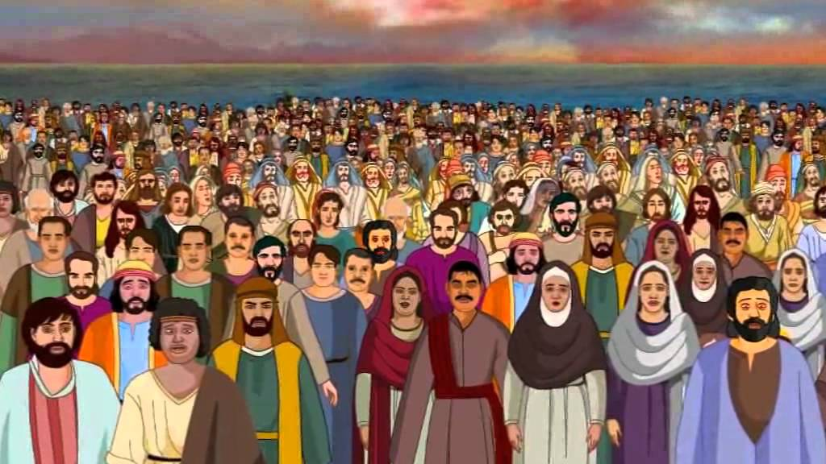
Feeding the 4,000
Matthew 15:32-38

Slide 2
INTRODUCTION
Most of us know what it’s like to be a younger sibling
Having even younger siblings doesn’t really change your position to your bigger siblings

Slide 3
INTRODUCTION
Most of us know what it’s like to be a younger sibling
Having even younger siblings doesn’t really change your position to your bigger siblings
They get privileges first (dinner table, bike, D/L)
They get noticed more/first
You must “wait your turn”
Etc.

Slide 4
INTRODUCTION
Most of us know what it’s like to be a younger sibling
Having even younger siblings doesn’t really change your position to your bigger siblings
They get privileges first (dinner table, bike, D/L)
They get noticed more/first
You must “wait your turn”
Etc.
Today, we will study the “little brother” of the feeding of the 5000 – the feeding of the 4000

Slide 5
INTRODUCTION
It has been noted that at important times in Jesus’ ministry, He feeds the people
Beginning (John 2 – Cana)

Slide 6
INTRODUCTION
It has been noted that at important times in Jesus’ ministry, He feeds the people
Beginning (John 2 – Cana)
Height (Mark 6 & 8)
End (Matthew 26 – Lord’s Supper instituted)

Slide 7
INTRODUCTION
It has been noted that at important times in Jesus’ ministry, He feeds the people
Beginning (John 2 – Cana)
Height (Mark 6 & 8)
End (Matthew 26 – Lord’s Supper instituted)
After the resurrection – (John 21 – by the Sea)

Slide 8
INTRODUCTION
It has been noted that at important times in Jesus’ ministry, He feeds the people
Beginning (John 2 – Cana)
Height (Mark 6 & 8)
End (Matthew 26 – Lord’s Supper instituted)
After the resurrection – (John 21 – by the Sea)
Questions come to mind
Why include both accounts?
…in the same gospel(s) – Matthew/Mark?

Slide 9
SIMILARITIES
The similarities are many
Many people
Following Jesus (healings both times)
Tired, hungry (Jesus’ compassion)

Slide 10
SIMILARITIES
The similarities are many
Many people
Following Jesus (healings both times)
Tired, hungry (Jesus’ compassion)
Disciples questioned/included
Lessons (Mark 8:17-20)
Bread, fish – prayer
Leftovers are collected

Slide 11
SIMILARITIES
The similarities are many
Many people
Following Jesus (healings both times)
Tired, hungry (Jesus’ compassion)
Disciples questioned/included
Lessons (Mark 8:17-20)
Bread, fish – prayer
Leftovers are collected
Because of this, many overlook the 4000

Slide 12
DIFFERENCES
Quantity - 5000
Quantity - 4000

Slide 13
DIFFERENCES
Quantity - 5000
The only pre-resurrection miracle in all four gospels
Quantity - 4000
Only recorded in Matthew and Mark

Slide 14
DIFFERENCES
Quantity - 5000
The only pre-resurrection miracle in all four gospels
Bethsaida – Jewish
Nearby “Go, buy…”
Quantity - 4000
Only recorded in Matthew and Mark
Gerasenes – Gentile
Far “…lest they faint.”

Slide 15
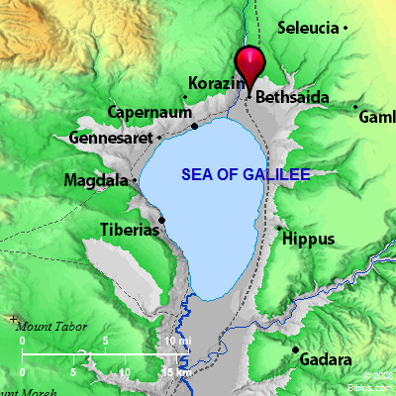

Slide 16
DIFFERENCES
Quantity - 5000
The only pre-resurrection miracle in all four gospels
Bethsaida – Jewish
Nearby “Go, buy…”
12 baskets of leftovers (word is for hand basket) 12 tribes of Israel
Quantity - 4000
Only recorded in Matthew and Mark
Gerasenes – Gentile
Far “…lest they faint.”
7 baskets of leftovers (big basket-Paul-Acts 9) Acts 13:19; Deut 7:1

Slide 17
DIFFERENCES
Quantity - 5000
The only pre-resurrection miracle in all four gospels
Bethsaida – Jewish
Nearby “Go, buy…”
12 baskets of leftovers (word is for hand basket) 12 tribes of Israel
Storm afterward
1 day
Quantity - 4000
Only recorded in Matthew and Mark
Gerasenes – Gentile
Far “…lest they faint.”
7 baskets of leftovers (big basket-Paul-Acts 9) Acts 13:19; Deut 7:1
No storm
3 days

Slide 18
Question 1
It’s only been a few months, why don’t the disciples trust Him?
Bigger crowd (5000)/less loaves (5)

Slide 19
Question 1
It’s only been a few months, why don’t the disciples trust Him?
Bigger crowd (5000)/less loaves (5)
Notice Mark 8:17-20
“Do you not yet see or understand?” (vv 17, 20)

Slide 20
Question 1
It’s only been a few months, why don’t the disciples trust Him?
Bigger crowd (5000)/less loaves (5)
Notice Mark 8:17-20
“Do you not yet see or understand?” (vv 17, 20)
(cause) “…hardened heart?” (vv 17b-18a)
(solution) “…remember…” (vv 18b-20)
Is it because these are Gentiles (undesirables)?

Slide 21
Question 1
It’s only been a few months, why don’t the disciples trust Him?
Bigger crowd (5000)/less loaves (5)
Notice Mark 8:17-20
“Do you not yet see or understand?” (vv 17, 20)
(cause) “…hardened heart?” (vv 17b-18a)
(solution) “…remember…” (vv 18b-20)
Is it because these are Gentiles (undesirables)?
Bigger question: We have all of the necessary miracles recorded; why don’t WE trust Him?

Slide 22
Question 1
Doubt
Forgetfulness
Israel – food, miracles, battles, etc.
Provoking, covenant, etc.
Skepticism
Worries, “this is different,” etc.

Slide 23
Question 1
Doubt
Forgetfulness
Israel – food, miracles, battles, etc.
Provoking, covenant, etc.
Skepticism
Worries, “this is different,” etc.
Words mean “suspended”, “in the air,” etc.
Compare Ephesians 4:14
Not nec. an absence of, but a qualified, faith

Slide 24
Question 2
Why did He ask the disciples what to do?
They see problems; He sees solutions

Slide 25
Question 2
Why did He ask the disciples what to do?
They see problems; He sees solutions
Their best is not enough (a teaching moment)
He uses their meager means to meet His will

Slide 26
Question 2
Why did He ask the disciples what to do?
They see problems; He sees solutions
Their best is not enough (a teaching moment)
He uses their meager means to meet His will
He does His part (miracle); they do what is assigned to them

Slide 27
Question 2
Why did He ask the disciples what to do?
They see problems; He sees solutions
Their best is not enough (a teaching moment)
He uses their meager means to meet His will
He does His part (miracle); they do what is assigned to them
Notice: God still does this today. He does His part; we do what He has assigned us.

Slide 28
Question 3
Why bread & fish both times?
Practical
By the Sea of Galilee – fish/fishermen
Bread = carbs (instant energy)
Fish = protein (staying power)

Slide 29
Question 3
Why bread & fish both times?
Practical
By the Sea of Galilee – fish/fishermen
Bread = carbs (instant energy)
Fish = protein (staying power)
Spiritual
Associate to Manna – then to Christ
Same food whether Jew (1st) or Gentile (afterward)

Slide 30
Question 3
Why bread & fish both times?
Practical
By the Sea of Galilee – fish/fishermen
Bread = carbs (instant energy)
Fish = protein (staying power)
Spiritual
Associate to Manna – then to Christ
Same food whether Jew (1st) or Gentile (afterward)
God’s word (Word) is our nourishment now and for the “long haul”

Slide 31
CONCLUSION
Jesus is often recorded as doing the same (similar) things more than once
Cleansing the temple
Sermon on the mount
Healing/Feeding a multitude
On this occasion, Jesus wanted them to move their thinking from material nutrition…
…to spiritual.
Whether Jew or Gentile, all may come to Him

Slide 32
Are YOU a Christian?
Hear
Believe
Repent
Confess
Be Baptized
Continue Faithfully
Romans 10:17
Mark 16:16
Acts 2:38
Acts 22:16
Mark 16:16
Hebrews 10:38

