Slide 1
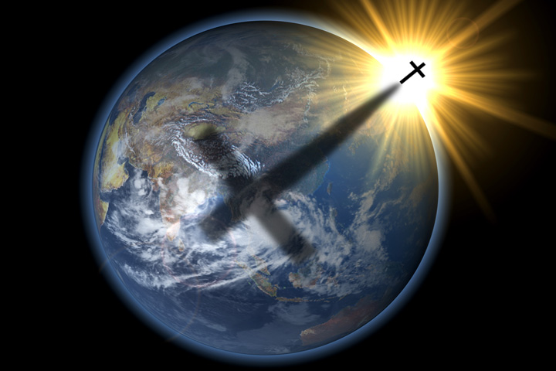
Back to Basics –The Cross
Galatians 6:12-14

Slide 2
INTRODUCTION
No symbol is as easily identifiable with Christianity as is the cross

Slide 3
INTRODUCTION
No symbol is as easily identifiable with Christianity as is the cross
Used in songs, poems, books, comics, pictures, even by those who don’t believe in the one, true God

Slide 4
INTRODUCTION
No symbol is as easily identifiable with Christianity as is the cross
Used in songs, poems, books, comics, pictures, even by those who don’t believe in the one, true God
Different possible configurations:
X

Slide 5
INTRODUCTION
No symbol is as easily identifiable with Christianity as is the cross
Used in songs, poems, books, comics, pictures, even by those who don’t believe in the one, true God
Different possible configurations:
X T

Slide 6
INTRODUCTION
No symbol is as easily identifiable with Christianity as is the cross
Used in songs, poems, books, comics, pictures, even by those who don’t believe in the one, true God
Different possible configurations:
X T t

Slide 7
INTRODUCTION
No symbol is as easily identifiable with Christianity as is the cross
Used in songs, poems, books, comics, pictures, even by those who don’t believe in the one, true God
Different possible configurations:
X l T t

Slide 8
INTRODUCTION
No symbol is as easily identifiable with Christianity as is the cross
Used in songs, poems, books, comics, pictures, even by those who don’t believe in the one, true God
Different possible configurations
The cross itself it not so important as WHAT HAPPENED on the cross (metonymy)

Slide 9
Figures of Speech
Metaphor – A figure of speech where something is not called by its own name, but by something different, yet similar to it
“He is such a hog” or “I am the bread of life”
Fishing for information

Slide 10
Figures of Speech
Metaphor – A figure of speech where something is not called by its own name, but by something different, yet similar to it
“He is such a hog” or “I am the bread of life”
Fishing for information
Metonymy – A figure of speech where something is not called by its own name, but by something closely associated with it
“Crown” for royalty or “cup” for grape juice
Fishing for pearls

Slide 11
The Cross
Some believe that the cross itself has power
Crucifix
Sign of the cross
Decorations, buildings, etc. in the form of a cross

Slide 12
The Cross
Some believe that the cross itself has power
Crucifix – Sign of the cross
Decorations, buildings, etc. in the form of a cross
The cross was a cruel instrument of death for the worst criminal offenders in Roman times
Hebrews 12:2 – Shameful (cf Galatians 3:13)
Slow and torturous
Flogging, etc associated with it
Sun and elements
Taunts – very public

Slide 13
What Happened At the Cross?
All Flesh was re-united
Ephesians 2:14-16 – The two flesh (Jew & Gentile) had been separated by the Law of Moses.
1 Corinthians 10:32 – On the cross, God made both groups into one new group – the church

Slide 14
What Happened At the Cross?
All Flesh was re-united
Ephesians 2:14-16 – The two flesh (Jew & Gentile) had been separated by the Law of Moses.
1 Corinthians 10:32 – On the cross, God made both groups into one new group – the church
Old Covenant/ New Covenant
Colossians 2:14-15 – Nailed OT to the cross
Hebrews 8:7, 13

Slide 15
What Happened At the Cross?
All Flesh was re-united
Old Covenant/New Covenant

Slide 16
What Happened At the Cross?
Atonement for sins (2 Corinthians 5:21)

Slide 17
What Happened At the Cross?
Atonement for sins (2 Corinthians 5:21)
Isaiah 59:1-2 Sin separated us from God
Heb. 10:4 – The blood of bulls and goats…
“He paid a debt He didn’t owe, because we owed a debt we couldn’t pay.”

Slide 18
What Happened At the Cross?
Atonement for sins (2 Corinthians 5:21)
Isaiah 59:1-2 Sin separated us from God
Heb. 10:4 – The blood of bulls and goats…
“He paid a debt He didn’t owe, because we owed a debt we couldn’t pay.”
Prophecy was fulfilled (Acts 2:23; Matt 16:21)

Slide 19
What Happened At the Cross?
Atonement for sins (2 Corinthians 5:21)
Isaiah 59:1-2 Sin separated us from God
Heb. 10:4 – The blood of bulls and goats…
“He paid a debt He didn’t owe, because we owed a debt we couldn’t pay.”
Prophecy was fulfilled (Acts 2:23; Matt 16:21)
Psalm 22 (pierced hands/feet), 34 (no broken bones), 69 (gall/vinegar), Is. 53 (suffering servant)
Proof of inspiration of the Bible and that Jesus was the Messiah

Slide 20
What Happened At the Cross?
All Flesh was re-united
Old Covenant/New Covenant
Atonement for sins
Prophecy was fulfilled

Slide 21
What Happened At the Cross?
God demonstrates His love for us
Romans 5:8 – God demonstrates His love for us…
John 15:13 – Greater love has no one…

Slide 22
What Happened At the Cross?
God demonstrates His love for us
Romans 5:8 – God demonstrates His love for us…
John 15:13 – Greater love has no one…
Jesus drew all people to Himself
John 12:32-33; cf 3:14; 8:28

Slide 23
What Happened At the Cross?
God demonstrates His love for us
Romans 5:8 – God demonstrates His love for us…
John 15:13 – Greater love has no one…
Jesus drew all people to Himself
John 12:32-33; cf 3:14; 8:28
Jesus bruised Satan on the head (Gen 3:15)
The devil bruised Jesus on the heel (suffer/die)
Jesus bruised him on the head

Slide 24
What Happened At the Cross?
All Flesh was re-united
Old Covenant/New Covenant
Atonement for sins
Prophecy was fulfilled
God demonstrates His love for us
Jesus drew all people to Himself
Jesus bruised Satan on the head

Slide 25
The Word (Message) of the Cross
1 Corinthians 1:18, 23 – The gospel of Christ
1 Corinthians 1:21; Romans 1:16 – God’s power to save
1 Corinthians 2:2 – Paul to Corinthians
Contrast to worldly wisdom, NOT to church truths

Slide 26
The Word (Message) of the Cross
1 Corinthians 1:18, 23 – The gospel of Christ
1 Corinthians 1:21; Romans 1:16 – God’s power to save
1 Corinthians 2:2 – Paul to Corinthians
Contrast to worldly wisdom, NOT to church truths
Romans 3:21-26 – It reveals to us:
Romans 1:17 – The righteousness of God
Acts 2:37 – What we must do to receive forgiveness
Romans 10:14 – Preaching is mandatory

Slide 27
The Word (Message) of the Cross
What does it include?
Sin – popular & unpopular; accepted/heinous
The plan of salvation
Principles of scriptural authority
Organization/work of the church-His body; kingdom
Prophecy – OT & NT
Acts 20:27 – The whole counsel of God

Slide 28
What Do YOU See?
Soldiers
John 19:23-24 – Some Roman soldiers saw a chance to get a robe for free
Matthew 27:54 – At least one Roman had to declare Jesus the “Son of God”

Slide 29
What Do YOU See?
Soldiers
John 19:23-24 – Some Roman soldiers saw a chance to get a robe for free
Matthew 27:54 – At least one Roman had to declare Jesus the “Son of God”
Criminals
Luke 23:39 – One, without believing, saw someone to help himself
Luke 23:40-43 – Another, believing, saw the hope of Heaven

Slide 30
What Do YOU See?
Eyes of love
Luke 23:50-53 – Joseph of Arimathea saw someone to be lovingly laid to rest
God saw the cruel death of His only begotten Son

Slide 31
What Do YOU See?
Eyes of love
Luke 23:50-53 – Joseph of Arimathea saw someone to be lovingly laid to rest
God saw the cruel death of His only begotten Son
Others
John 19:6-7 – A trouble maker worthy of death
Luke 23:35 – Some were simply gawkers
John 19:31 – Some were more worried about the Sabbath day

Slide 32
What Do YOU See?
Also:
Satan, Judas, the Apostles, Mary, Mary, and Mary

Slide 33
What Do YOU See?
Also:
Satan, Judas, the Apostles, Mary, Mary, and Mary
What do you see?
A historical figure
Someone who got in deeper than he could handle
A crazy man
A good man
The only-begotten, redeeming Son of God
No one can answer that for you

Slide 34
A Paradox
A cause for great sorrow
Depth and depravity of sin
Pain and torture of an innocent person – for me

Slide 35
A Paradox
A cause for great sorrow
Depth and depravity of sin
Pain and torture of an innocent person – for me
A cause for great joy
Depth of God’s love, grace and mercy
Chance for a new beginning
2 Corinthians 5:21 – …Him who knew no sin…
1 Peter 2:24 – …might live for righteousness…

Slide 36
Are YOU a Christian?
Hear
Believe
Repent
Confess
Be Baptized
Continue Faithfully
Romans 10:17
Mark 16:16
Acts 2:38
Acts 22:16
Mark 16:16
Hebrews 10:38

