Slide 1
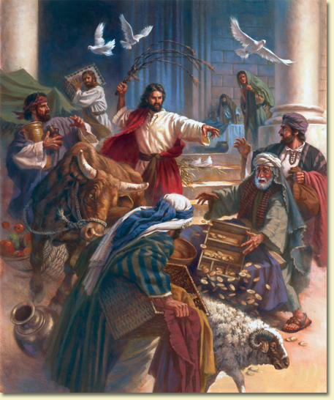
The Anger of Jesus
Mark 3:1-6

Slide 2
INTRODUCTION
Jesus demonstrates to us the mind of God.
John 1:18 – “No one has seen God at any time…”
John 7:16-53 – “My teaching is not My own…”

Slide 3
INTRODUCTION
Jesus demonstrates to us the mind of God.
John 1:18 – “No one has seen God at any time…”
John 7:16-53 – “My teaching is not My own…”
John 8:26 – “…these I speak to the world.”
John 8:28 – “…as the Father instructed…”

Slide 4
INTRODUCTION
Jesus demonstrates to us the mind of God.
John 1:18 – “No one has seen God at any time…”
John 7:16-53 – “My teaching is not My own…”
John 8:26 – “…these I speak to the world.”
John 8:28 – “…as the Father instructed…”
John 14:7-10 – “He who has seen Me…”

Slide 5
INTRODUCTION
Jesus demonstrates to us the mind of God.
John 1:18 – “No one has seen God at any time…”
John 7:16-53 – “My teaching is not My own…”
John 8:26 – “…these I speak to the world.”
John 8:28 – “…as the Father instructed…”
John 14:7-10 – “He who has seen Me…”
1 Corinthians 2:16
Context: vv 10-15; quotes Isaiah 40:13
Then, “…the mind of Christ.”

Slide 6
INTRODUCTION
As we study the Scriptures, we see how Jesus dealt with different situations.
Tears
Temptations
Prayer life
Silence

Slide 7
INTRODUCTION
As we study the Scriptures, we see how Jesus dealt with different situations.
Tears
Temptations
Prayer life
Silence
The Scriptures tells us of at least three times that Jesus became angry – we’ll look at these three occasions found in the gospel of Mark

Slide 8
1. Mark 3:1-6
The hardness of their hearts

Slide 9
1. Mark 3:1-6
The hardness of their hearts
Their attitude
V 2 – watching/heal…Sabbath/accuse Him

Slide 10
1. Mark 3:1-6
The hardness of their hearts
Their attitude
V 2 – watching/heal…Sabbath/accuse Him
Their inaction
They couldn’t heal him
Yet, they didn’t want him healed, except by their rules

Slide 11
1. Mark 3:1-6
The hardness of their hearts
Their attitude
V 2 – watching/heal…Sabbath/accuse Him
Their inaction
They couldn’t heal him
Yet, they didn’t want him healed, except by their rules
Their hardness of heart
Hard heartedness produces more hard heartedness
Ex. Pharaoh, Herod, Pharisees
The result: they plotted to “destroy Him.”

Slide 12
2. Mark 8:31-33
Rejecting His mission

Slide 13
2. Mark 8:31-33
Rejecting His mission
The subject of His rebuke
Jesus could see who was really behind the words
He’s not saying Peter IS Satan, but being used by him

Slide 14
2. Mark 8:31-33
Rejecting His mission
The subject of His rebuke
Jesus could see who was really behind the words
He’s not saying Peter IS Satan, but being used by him
Peter had confessed Christ (cf Matt 16:17)
We may be used by the devil when “doing good”

Slide 15
2. Mark 8:31-33
Rejecting His mission
The subject of His rebuke
Jesus could see who was really behind the words
He’s not saying Peter IS Satan, but being used by him
Peter had confessed Christ (cf Matt 16:17)
We may be used by the devil when “doing good”
The reason
V 31 – Jesus declares the coming events (necessary)
Jesus wasn’t looking forward to it (Mark 14:34-36)

Slide 16
2. Mark 8:31-33
Rejecting His mission
The subject of His rebuke
Jesus could see who was really behind the words
He’s not saying Peter IS Satan, but being used by him
Peter had confessed Christ (cf Matt 16:17)
We may be used by the devil when “doing good”
The reason
V 31 – Jesus declares the coming events (necessary)
Jesus wasn’t looking forward to it (Mark 14:34-36)
The devil knows this
Satan’s “words of comfort” were really discouraging

Slide 17
3. Mark 11:15-18
Disrespect for God

Slide 18
3. Mark 11:15-18
Disrespect for God
The occasion most commonly thought of
First three of the 10 commandments teach respect for God in thought, deed, and word
Disrespect for God is the basis for other sins

Slide 19
3. Mark 11:15-18
Disrespect for God
The occasion most commonly thought of
First three of the 10 commandments teach respect for God in thought, deed, and word
Disrespect for God is the basis for other sins
Possibly, the second time He had to do this
Jews were to bring their sacrifices
Due to long distances, brought money instead

Slide 20
3. Mark 11:15-18
Disrespect for God
The occasion most commonly thought of
First three of the 10 commandments teach respect for God in thought, deed, and word
Disrespect for God is the basis for other sins
Possibly, the second time He had to do this
Jews were to bring their sacrifices
Due to long distances, brought money instead
The temple became a “mall”/”flea market”

Slide 21
The Anger of Jesus
Motivation
Not arguments, pride/selfishness, but zeal (John 2:17)

Slide 22
The Anger of Jesus
Motivation
Not arguments, pride/selfishness, but zeal (John 2:17)
Focus
Not innocent bystanders
Not God
Not weaknesses
But, sinful behavior/injustices

Slide 23
The Anger of Jesus
Motivation
Not arguments, pride/selfishness, but zeal (John 2:17)
Focus
Not innocent bystanders
Not God
Not weaknesses
But, sinful behavior/injustices
Attitude
Not hatred, but grief (Mark 3:5), love, etc.

Slide 24
The Anger of Jesus
Control
Never out of control (temple tantrum)
The purpose was to cleanse/teach; not hurt

Slide 25
The Anger of Jesus
Control
Never out of control (temple tantrum)
The purpose was to cleanse/teach; not hurt
Duration
No grudges
Ephesians 4:26

Slide 26
The Anger of Jesus
Control
Never out of control (temple tantrum)
The purpose was to cleanse/teach; not hurt
Duration
No grudges
Ephesians 4:26
Results
Accomplish the will of God
Not vent frustrations

Slide 27
CONCLUSION
The wrath of God can be seen throughout the Bible
Jesus demonstrates the wrath of God in His life/ministry
We can learn from this aspect of His life

Slide 28
Are YOU a Christian?
Hear
Believe
Repent
Confess
Be Baptized
Continue Faithfully
Romans 10:17
Mark 16:16
Acts 2:38
Acts 22:16
Mark 16:16
Hebrews 10:38

