Slide 1
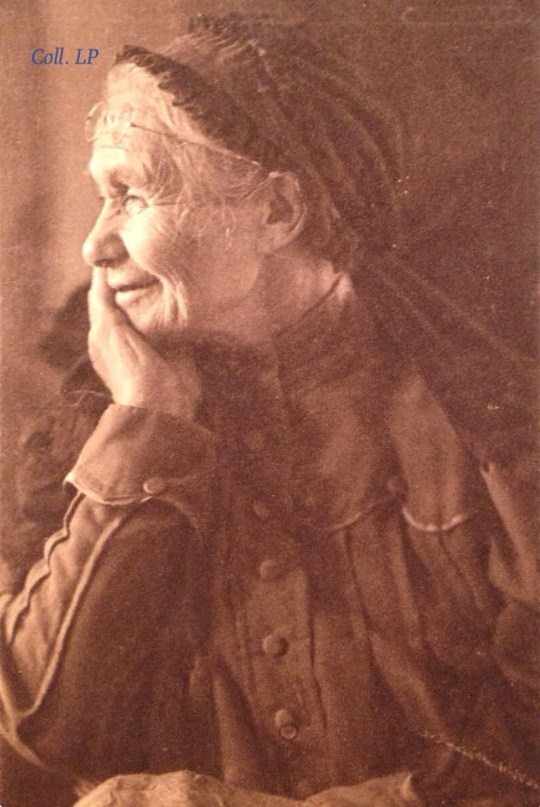
“…his mother and mine.”
Romans 16:13

Slide 2
INTRODUCTION
The Bible gives us many examples of God- fearing mothers.

Slide 3
INTRODUCTION
The Bible gives us many examples of God- fearing mothers.
God created a position in the family that is pivotal in importance for the raising of godly people
He gave this responsibility to mothers

Slide 4
INTRODUCTION
The Bible gives us many examples of God- fearing mothers.
God created a position in the family that is pivotal in importance for the raising of godly people
He gave this responsibility to mothers
Often paradoxical
Exalted-yet lowly
Important goals-yet often menial
Authoritative-yet looked down upon by society

Slide 5
INTRODUCTION
Many of us take (or took) our mothers for granted
Many don’t realize until too late what God tells us in His word – that a godly mother is a blessing

Slide 6
INTRODUCTION
Many of us take (or took) our mothers for granted
Many don’t realize until too late what God tells us in His word – that a godly mother is a blessing
Today, we will focus on some mothers in the Scriptures
Although they don’t do it for the praise, let them know how much you appreciate them

Slide 7
Romans 16:13
Context: End of epistle – greetings
In our culture – greetings are at the beginning

Slide 8
Romans 16:13
Context: End of epistle – greetings
In our culture – greetings are at the beginning
Who are these people?
V5 – How did Epaenetus get to be the first convert?
V6 – Which Mary?
V7 – How are Andronicus and Junias “outstanding…”
V8 – How is Ampliatus Paul’s beloved?
V9 – Urbanus (fellow worker)? Stachys (beloved)?
V10 – Apelles (approved)? Household of Aristobulus?
V11 – Herodion (kinsman)? Household of Narcissus?
V12 – Tryphaena & Tryphosa? Persis (beloved)?

Slide 9
Romans 16:13
“Greet Rufus, a choice man in the Lord,
Common name among slaves
Mark 15:21 – son of Simon of Cyrene (?)
Alexander?

Slide 10
Romans 16:13
“Greet Rufus, a choice man in the Lord,
Common name among slaves
Mark 15:21 – son of Simon of Cyrene (?)
Alexander?
…also his mother and mine.”
What events caused Paul to say this?
How did she serve him/protect him/care for him?
The bond must have been strong
He says it of no one else

Slide 11
Mary
Luke 1:26-32

Slide 12
Mary
Luke 1:26-32
Often elevated to be equal, or even ABOVE, God
Called the “Mother of God”

Slide 13
Mary
Luke 1:26-32
Often elevated to be equal, or even ABOVE, God
Called the “Mother of God”
While these are religious errors, there is scriptural authority for considering Mary as a great woman of the Bible

Slide 14
Mary
She was steadfast in her faith

Slide 15
Mary
She was steadfast in her faith
Named Him Jesus
Had Him circumcised
Presented Him in the temple with the offering

Slide 16
Mary
She was steadfast in her faith
Named Him Jesus
Had Him circumcised
Presented Him in the temple with the offering
Feast of the Passover yearly
Treasured events in her heart

Slide 17
Mary
She was steadfast in her faith
Named Him Jesus
Had Him circumcised
Presented Him in the temple with the offering
Feast of the Passover yearly
Treasured events in her heart
Went to Egypt to protect her baby
She was at the cross

Slide 18
Lois, Eunice
2 Timothy 1:5-7

Slide 19
Lois, Eunice
2 Timothy 1:5-7
Timothy was a great help to Paul
He was faithful to God and was growing to be a gospel preacher

Slide 20
Lois, Eunice
2 Timothy 1:5-7
Timothy was a great help to Paul
He was faithful to God and was growing to be a gospel preacher
His love of the truth was instilled in him by his mother and grandmother
While our faith must be our own, the love of God can be shared with our children and received from our parents

Slide 21
Hannah
1 Samuel 1
Hannah was barren

Slide 22
Hannah
1 Samuel 1
Hannah was barren
However, she did not blame, or stop worshipping, God
She was persistent in her prayers and petitions

Slide 23
Hannah
1 Samuel 1
Hannah was barren
However, she did not blame, or stop worshipping, God
She was persistent in her prayers and petitions
She dedicated her son to the Lord, literally
She was still supportive of him

Slide 24
Jochebed
Exodus 2
God’s laws are above civil laws

Slide 25
Jochebed
Exodus 2
God’s laws are above civil laws
Only God could arrange for her to protect her son, teach and care for him, and get paid for it – right under Pharaoh’s nose

Slide 26
Jochebed
Exodus 2
God’s laws are above civil laws
Only God could arrange for her to protect her son, teach and care for him, and get paid for it – right under Pharaoh’s nose
She taught him to love God’s people
Hebrews 11:23-25

Slide 27
CONCLUSION
The closest thing on earth to God’s love is a mother’s love
God chose a special mother for His Son
The Bible is filled with examples of mothers who loved God and lived godly lives
Naomi, Ruth, etc.
These will be covered in future lessons

Slide 28
Are YOU a Christian?
Hear
Believe
Repent
Confess
Be Baptized
Continue Faithfully
Romans 10:17
Mark 16:16
Acts 2:38
Acts 22:16
Mark 16:16
Hebrews 10:38

