Slide 1
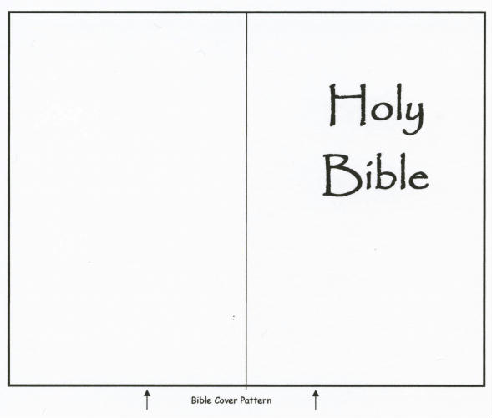
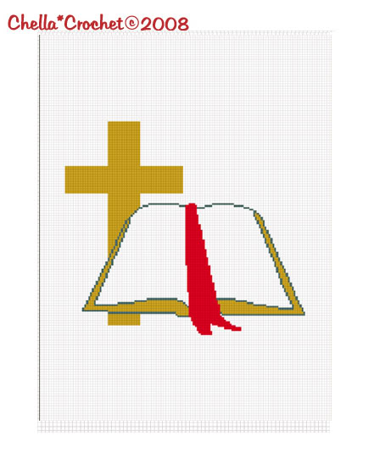
Follow the Pattern…
Philippians 3:7-17
April 10, 2016 AM

Slide 2
INTRODUCTION
We recognize the need and usefulness of patterns in our lives
Sewing patterns
Martial arts (katas)
Cosmetic surgery

Slide 3
INTRODUCTION
We recognize the need and usefulness of patterns in our lives
Sewing patterns
Martial arts (katas)
Cosmetic surgery
Medicine, crime, puzzles, nature, cosmos, etc.

Slide 4
INTRODUCTION
We recognize the need and usefulness of patterns in our lives
Sewing patterns
Martial arts (katas)
Cosmetic surgery
Medicine, crime, puzzles, nature, cosmos, etc.
God has always used patterns
Romans 1:18-32 - Nature

Slide 5
INTRODUCTION
We recognize the need and usefulness of patterns in our lives
Sewing patterns
Martial arts (katas)
Cosmetic surgery
Medicine, crime, puzzles, nature, cosmos, etc.
God has always used patterns
Romans 1:18-32 - Nature
Hebrews 8:4-5 (cf Acts 7:44) – Old Testament
Philippians 3:16-17 – New Testament

Slide 6
Original words used
Summimetes (Greek)
To bring to the same form as some other person or thing; to conform

Slide 7
Original words used
Summimetes (Greek)
To bring to the same form as some other person or thing; to conform
Tupos (“type”)
The mark of a blow; then a stamp-image of a die
A figure; a copy, an image
A pattern or a model
A type, prefiguring someone/something

Slide 8
Original words used
Summimetes (Greek)
To bring to the same form as some other person or thing; to conform
Tupos (“type”)
The mark of a blow; then a stamp-image of a die
A figure; a copy, an image
A pattern or a model
A type, prefiguring someone/something
Words have meanings – even in a foreign language

Slide 9
The command
The New Testament demands…
An example
A precedent
Or a pattern
…to direct our behavior as the followers of Christ (Christians).

Slide 10
The command
We are called to be imitators, not innovators!
Ephesians 5:1 – Be imitators of God

Slide 11
The command
We are called to be imitators, not innovators!
Ephesians 5:1 – Be imitators of God
1 Corinthians 4:16 – Be imitators of me…
1 Corinthians 11:1 – Be imitators of me, as I am of Christ (JESUS LEADS; we follow)

Slide 12
The command
We are called to be imitators, not innovators!
Ephesians 5:1 – Be imitators of God
1 Corinthians 4:16 – Be imitators of me…
1 Corinthians 11:1 – Be imitators of me, as I am of Christ (JESUS LEADS; we follow)
Philippians 3:17; 4:9 – (received, heard, seen)

Slide 13
The command
We are called to be imitators, not innovators!
Ephesians 5:1 – Be imitators of God
1 Corinthians 4:16 – Be imitators of me…
1 Corinthians 11:1 – Be imitators of me, as I am of Christ (JESUS LEADS; we follow)
Philippians 3:17; 4:9 – (received, heard, seen)
1 Thessalonians 1:6 – …us, and of the Lord
1 Thessalonians 2:14 - imitators of the churches
2 Thessalonians 3:9 - …offer ourselves as a model

Slide 14
The command
We are called to be imitators, not innovators!
Ephesians 5:1 – Be imitators of God
1 Corinthians 4:16 – Be imitators of me…
1 Corinthians 11:1 – Be imitators of me, as I am of Christ (JESUS LEADS; we follow)
Philippians 3:17; 4:9 – (received, heard, seen)
1 Thessalonians 1:6 – …us, and of the Lord
1 Thessalonians 2:14 - imitators of the churches
2 Thessalonians 3:9 - …offer ourselves as a model
Hebrews 6:12 – …imitators of those… (cf 13:7)

Slide 15
The command
We are called to be imitators, not innovators!
Ephesians 5:1 – Be imitators of God
1 Corinthians 4:16 – Be imitators of me…
1 Corinthians 11:1 – Be imitators of me, as I am of Christ (JESUS LEADS; we follow)
Philippians 3:17; 4:9 – (received, heard, seen)
1 Thessalonians 1:6 – …us, and of the Lord
1 Thessalonians 2:14 - imitators of the churches
2 Thessalonians 3:9 - …offer ourselves as a model
Hebrews 6:12 – …imitators of those… (cf 13:7)

Slide 16
Why do we NEED patterns?
God’s ways are not our ways
Isaiah 55:8-9
1 Corinthians 2:11-13

Slide 17
Why do we NEED patterns?
God’s ways are not our ways
Isaiah 55:8-9
1 Corinthians 2:11-13
Mankind is not good at choosing the right way by himself
Isaiah 65:2
Judges 17:6; 21:25 – no King, everyone did…

Slide 18
Why do we NEED patterns?
God’s ways are not our ways
Isaiah 55:8-9
1 Corinthians 2:11-13
Mankind is not good at choosing the right way by himself
Isaiah 65:2
Judges 17:6; 21:25 – no King, everyone did…
Proverbs 14:12 – it seems right…
Jeremiah 10:23 – not in himself

Slide 19
Negative Examples
Sometimes, we need to stay away from some attitude, action, etc.
Acts 5:1-11 – Ananias and Saphira (individuals)
1 Corinthians 5 – Neglecting to discipline (church)

Slide 20
Negative Examples
Sometimes, we need to stay away from some attitude, action, etc.
Acts 5:1-11 – Ananias and Saphira (individuals)
1 Corinthians 5 – Neglecting to discipline (church)
We see how God deals with sin
In our lives
On Judgment Day

Slide 21
Generic Authority
Sometimes God gives us a command, then let’s us choose the details of some aspects
Matthew 28:18-20 – “Go…”
Where, how far
Mode - Car, walk, plane, horse, etc.

Slide 22
Generic Authority
Sometimes God gives us a command, then let’s us choose the details of some aspects
Matthew 28:18-20 – “Go…”
Where, how far
Mode - Car, walk, plane, horse, etc.
Assemble
House, synagogue, building
Rent, borrow, buy

Slide 23
Generic Authority
Sometimes God gives us a command, then let’s us choose the details of some aspects
Matthew 28:18-20 – “Go…”
Where, how far
Mode - Car, walk, plane, horse, etc.
Assemble
House, synagogue, building
Rent, borrow, buy
Sing
Hymnbooks, song leader, etc.

Slide 24
CONCLUSION
When the need for an example is ignored… eventually the commands are also.
– Jerry Blount
God has always given us examples, patterns, etc.
He expects us to follow them
When we choose our own way when God has given us a pattern, we tell God, with pride, that our thoughts are equal/higher than His

Slide 25
Are YOU a Christian?
Hear
Believe
Repent
Confess
Be Baptized
Continue Faithfully
Romans 10:17
Mark 16:16
Acts 2:38
Acts 22:16
Mark 16:16
Hebrews 10:38

