Slide 1
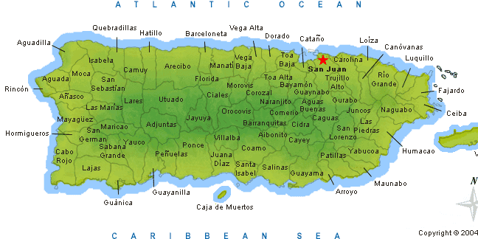
Report – Puerto Rico
Acts 15:30-36

Slide 2
INTRODUCTION

Slide 3
INTRODUCTION

Slide 4
INTRODUCTION

Slide 5
INTRODUCTION
30
100 mi.

Slide 6
INTRODUCTION
30
100 mi.

Slide 7
INTRODUCTION
30
100 mi.

Slide 8
INTRODUCTION
30
100 mi.

Slide 9
CHRISTIANS

Slide 10
CHRISTIANS

Slide 11
CHRISTIANS

Slide 12
CHRISTIANS

Slide 13
CHRISTIANS

Slide 14
CHRISTIANS

Slide 15
CHRISTIANS

Slide 16
Monday, February 15
7:30 AM – Boarded flight to PR
2:10 PM (PR time) – Arrived at San Juan
4 PM – Met up with Caleb Westbrook and Isaac Muñoz, rented a car and headed to Ponce
5:30 PM – Arrived at the place where we were to stay, unpacked, grabbed a sandwich “to go,” left for La Gloria

Slide 18
Monday, February 15
7:05 PM – Got carsick due to winding roads
Very first night!
Reminded of that every day for the remainder
7:07 PM – Caleb preached on “Our Responsibility of Obedience” – 35 attend
9:30 PM – Headed back to Ponce
10:30 PM – Arrived
11 PM – Went to bed

Slide 19
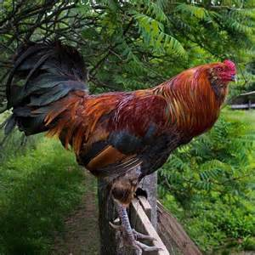

Slide 20
La Gloria – 1st night

Slide 21
Tuesday, February 16
6 AM – Woke up, tried to shower
No pressure
Had to “scoop bathe” in shower
No fun – (brought back memories)
8 AM – Headed out
Breakfast
Office Max (make copies of inv., tracts, etc.)
Met with brethren at Plaza

Slide 22
Flamboyán Tree

Slide 23
Tuesday, February 16
9:45 AM – Arrived at the main plaza of Ponce
Passed out several hundred flyers, inv., tracts
Brethren joined us
Headed back to the building
Noon – Had lunch at Pollo Tropical
Near the building
Some brethren joined us
Good discussion about the work, issues, etc.
Afterward, went back to Office Max

Slide 24
Tuesday, February 16
3 PM – Arrived back at the apartment
Cleaned up
Got ready
4:30 PM – Left for La Gloria
7 PM – I preached on “Our Responsibility Toward Repentance” – 23 attended
9:45 PM – Left to go to the apartment
11:30 PM – Go to bed

Slide 25
Wednesday, February 17
6 AM – Got up, still very little water pressure
9:30 AM – Met up with some of the young members of La Gloria
Went “house to house”
Visited a wayward member and her family
Noon – Had lunch with brethren
2 PM – Head back to Ponce
2:45 – Went to visit an ailing, older brother at the hospital in Ponce

Slide 26
Wednesday, February 17
3:45 PM – Left for La Gloria, had dinner with the brethren who own the house where they meet – had good conversation
7 PM – Isaac preached on “Our Responsibility to the Lost” – 30 attended
(More discussions afterward)
9:15 PM – Headed back to Ponce
10:05 PM – Arrived, tried to shower
11:15 PM – Go to bed

Slide 27
Thurs/Fri – Feb. 18-19
Same (I have a detailed report available to any who are intersted)

Slide 28
SEISMIC ACTIVITY

Slide 29
CONCLUSION

Slide 30
Are YOU a Christian?
Hear
Believe
Repent
Confess
Be Baptized
Continue Faithfully
Romans 10:17
Mark 16:16
Acts 2:38
Acts 22:16
Mark 16:16
Hebrews 10:38

