Slide 1
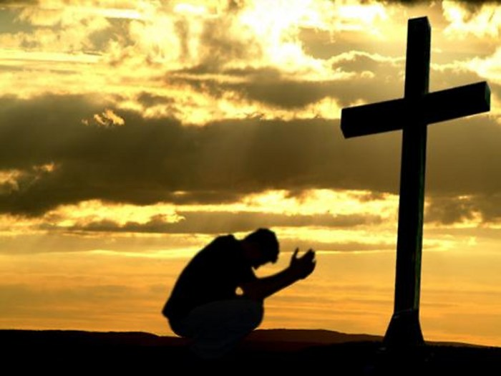
Obeying The Gospel
Acts 2:32-37

Slide 2
INTRODUCTION
Often said, (but not a cliché) – “Obey the Gospel”

Slide 3
INTRODUCTION
Often said, (but not a cliché) – “Obey the Gospel”
“Obey” – that’s our part

Slide 4
INTRODUCTION
Often said, (but not a cliché) – “Obey the Gospel”
“Obey” – that’s our part
“the” – Definite article (the Law, the soldier, etc.)
Not just any
But a specific

Slide 5
INTRODUCTION
Often said, (but not a cliché) – “Obey the Gospel”
“Obey” – that’s our part
“the” – Definite article (the Law, the soldier, etc.)
Not just any
But a specific
“Gospel” – God’s message

Slide 6
INTRODUCTION
Often said, (but not a cliché) – “Obey the Gospel”
“Obey” – that’s our part
“the” – Definite article (the Law, the soldier, etc.)
Not just any
But a specific
“Gospel” – God’s message
It is so simple, yet so profound

Slide 7
Are YOU a Christian?
Hear
Believe
Repent
Confess
Be Baptized
Continue Faithfully
Romans 10:17
Mark 16:16
Acts 2:38
Acts 22:16
Mark 16:16
Hebrews 10:38

Slide 8
Peter and Paul
1 Peter 4:17
As opposed to “the household of God”
v 18 – Godless man/sinner

Slide 9
Peter and Paul
1 Peter 4:17
As opposed to “the household of God”
v 18 – Godless man/sinner
2 Thessalonians 1:7-9
Ignorant – “those who do not know God”
Rebellious – “…who do not obey the gospel…”

Slide 10
Peter and Paul
1 Peter 4:17
As opposed to “the household of God”
v 18 – Godless man/sinner
2 Thessalonians 1:7-9
Ignorant – “those who do not know God”
Rebellious – “…who do not obey the gospel…”
Eternal destruction, away from:
The presence of the Lord
The glory of His power

Slide 11
THE Gospel
Many gospels are available to us
Gal. 1:6-9 – a perversion regardless of source
Man, even an Apostle – “we”
Not human – “an angel”
2 Cor. 11:4 – another Jesus, diff spirit/gospel
Of Judas, Thomas, Mary, etc. (Luke 1:1-4)

Slide 12
THE Gospel
Many gospels are available to us
Gal. 1:6-9 – a perversion regardless of source
Man, even an Apostle – “we”
Not human – “an angel”
2 Cor. 11:4 – another Jesus, diff spirit/gospel
Of Judas, Thomas, Mary, etc. (Luke 1:1-4)
THE Gospel (1 Corinthians 15:1-4)
Able to save (cf Romans 1:16)
Death, burial, resurrection

Slide 13
How Do I Obey? – Faith
Hebrews 11:1 – definition
assurance, conviction
v 6 – necessity
exists, rewards those who seek Him

Slide 14
How Do I Obey? – Faith
Hebrews 11:1 – definition
assurance, conviction
v 6 – necessity
exists, rewards those who seek Him
Romans 10:10-17
Applies to everyone
Faith comes by hearing
The word of Christ

Slide 15
How Do I Obey? – Fruits
Repent
Acts 2:38
Pierced to the heart (believed) – v 37
Q? – What shall we do?
Change of direction (way, heart, purpose)
Note: “Sinner’s prayer” origin – 18th c.

Slide 16
How Do I Obey? – Fruits
Repent
Acts 2:38
Pierced to the heart (believed) – v 37
Q? – What shall we do?
Change of direction (way, heart, purpose)
Note: “Sinner’s prayer” origin – 18th c.
Confess
Acts 8:38 – preached Jesus, “What prevents…”
Acts 22:16 – (Saul) – calling on His name

Slide 17
How Do I Obey? – New Birth
Baptism – Mark 16:16
Has believed (past tense)
Has been baptized (past tense)
…shall be saved (future tense)

Slide 18
How Do I Obey? – New Birth
Baptism – Mark 16:16
Has believed (past tense)
Has been baptized (past tense)
…shall be saved (future tense)
Romans 6:1-4
Death, burial, resurrection
Remember 1 Cor. 15:1-4?
The gospel (good news) is reenacted through baptism

Slide 19
How Do I Obey? – New Birth
Baptism – Mark 16:16
Has believed (past tense)
Has been baptized (past tense)
…shall be saved (future tense)
Romans 6:1-4
Death, burial, resurrection
Remember 1 Cor. 15:1-4?
The gospel (good news) is reenacted through baptism
1 Peter 3:21 – Baptism does now save you

Slide 20
How Do I Obey? – New Life
Continue faithfully
Hebrews 10:38-39
Baptism is the beginning (new birth), not the end, of the Christian life
Matthew 28:18-20

Slide 21
How Do I Obey? – New Life
Continue faithfully
Hebrews 10:38-39
Baptism is the beginning (new birth), not the end, of the Christian life
Matthew 28:18-20
Ephesians 2:19-21 – built up, growing
Ephesians 4:15 – in all aspects

Slide 22
How Do I Obey? – New Life
Continue faithfully
Hebrews 10:38-39
Baptism is the beginning (new birth), not the end, of the Christian life
Matthew 28:18-20
Ephesians 2:19-21 – built up, growing
Ephesians 4:15 – in all aspects
2 Timothy 4:7-8 – crown of righteousness

Slide 23
CONCLUSION
Words have meaning
Biblical words have biblical meaning
God has defined them for us
As such, they are our standard
This leaves out
Our interpretations
Our definitions
Our “spin”
It does require our obedience

Slide 24
CONCLUSION
God did His part; He sent His Son
Pay the price
Destroy the works of Satan/the flesh
Show us the way
Springtime – beginning of new life
What must I do to have a new life?
2 Corinthians 6:2
TODAY!

Slide 25
Are YOU a Christian?
Hear
Believe
Repent
Confess
Be Baptized
Continue Faithfully
Romans 10:17
Mark 16:16
Acts 2:38
Acts 22:16
Mark 16:16
Hebrews 10:38

