Slide 1
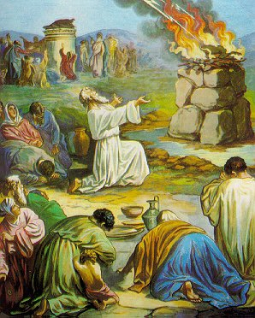
Lessons From Mount Carmel
1 Kings 18:16-46

Slide 2
INTRODUCTION
CONTEXT: Elijah – Introduced in 17:1

Slide 3
INTRODUCTION
CONTEXT: Elijah – Introduced in 17:1
He appears to Ahab to declare that there would be a drought from God – The total time isn’t told
(3 ½ years of drought – “no dew or rain”)

Slide 4
INTRODUCTION
CONTEXT: Elijah – Introduced in 17:1
He appears to Ahab to declare that there would be a drought from God – The total time isn’t told
(3 ½ years of drought – “no dew or rain”)
Elijah is sent to the Brook Cherith “east of the Jordan” where he is miraculously fed by Ravens

Slide 5
INTRODUCTION
CONTEXT: Elijah – Introduced in 17:1
He appears to Ahab to declare that there would be a drought from God – The total time isn’t told
(3 ½ years of drought – “no dew or rain”)
Elijah is sent to the Brook Cherith “east of the Jordan” where he is miraculously fed by Ravens
Eventually, the waters dry up. He then is told to leave to Zarephath, where he stays with a widow and her son and performs miracles-Luke 4:24-26

Slide 6
INTRODUCTION
CONTEXT: Elijah – Introduced in 17:1
He appears to Ahab to declare that there would be a drought from God – The total time isn’t told
(3 ½ years of drought – “no dew or rain”)
Elijah is sent to the Brook Cherith “east of the Jordan” where he is miraculously fed by Ravens
Eventually, the waters dry up. He then is told to leave to Zarephath, where he stays with a widow and her son and performs miracles-Luke 4:24-26
In the 3rd year of the drought, he is sent back.

Slide 7
INTRODUCTION
CONTEXT: Ahab – (1 Kings 16:29-33)

Slide 8
INTRODUCTION
CONTEXT: Ahab – (1 Kings 16:29-33)
Son of Omri, previous king of Israel.
He reigned 22 years over Israel in Samaria.
He married Jezebel, daughter of Ethbaal, king of the Sidonians.

Slide 9
INTRODUCTION
CONTEXT: Ahab – (1 Kings 16:29-33)
Son of Omri, previous king of Israel.
He reigned 22 years over Israel in Samaria.
He married Jezebel, daughter of Ethbaal, king of the Sidonians.
An evil king (v. 29), “more (evil) than all who were before him” (the previous “record holder” was his own father, Omri)
…with an equally (more) evil wife, Jezebel

Slide 10
INTRODUCTION
CONTEXT: Baal & Asherah (Ashtoreth)
idols, male and female, that were worshipped; many times together.

Slide 11
INTRODUCTION
CONTEXT: Baal & Asherah (Ashtoreth)
idols, male and female, that were worshipped; many times together.
Baal (master, lord) was the principle idol of the Canaanites.
He was believed to control the rising/setting of the sun, the seasons, and even the rain.

Slide 12
INTRODUCTION
CONTEXT: Baal & Asherah (Ashtoreth)
idols, male and female, that were worshipped; many times together.
Baal (master, lord) was the principle idol of the Canaanites.
He was believed to control the rising/setting of the sun, the seasons, and even the rain.
Asherah was the consort of Baal and was worshipped partly through prostitution.

Slide 13
INTRODUCTION
CONTEXT: Mount Carmel
A 1500 foot, limestone mountain, part of a range by the same name in northern Israel that stretches from the Mediterranean Sea southeast about 24 miles to approximately Jenin on the West Bank.

Slide 14
INTRODUCTION
CONTEXT: Mount Carmel
A 1500 foot, limestone mountain, part of a range by the same name in northern Israel that stretches from the Mediterranean Sea southeast about 24 miles to approximately Jenin on the West Bank.
It is never mentioned in the New Testament

Slide 15
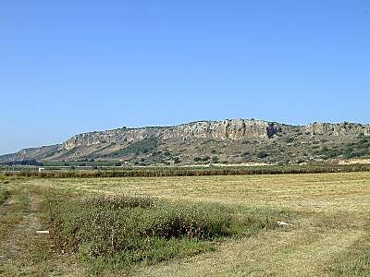

Slide 16
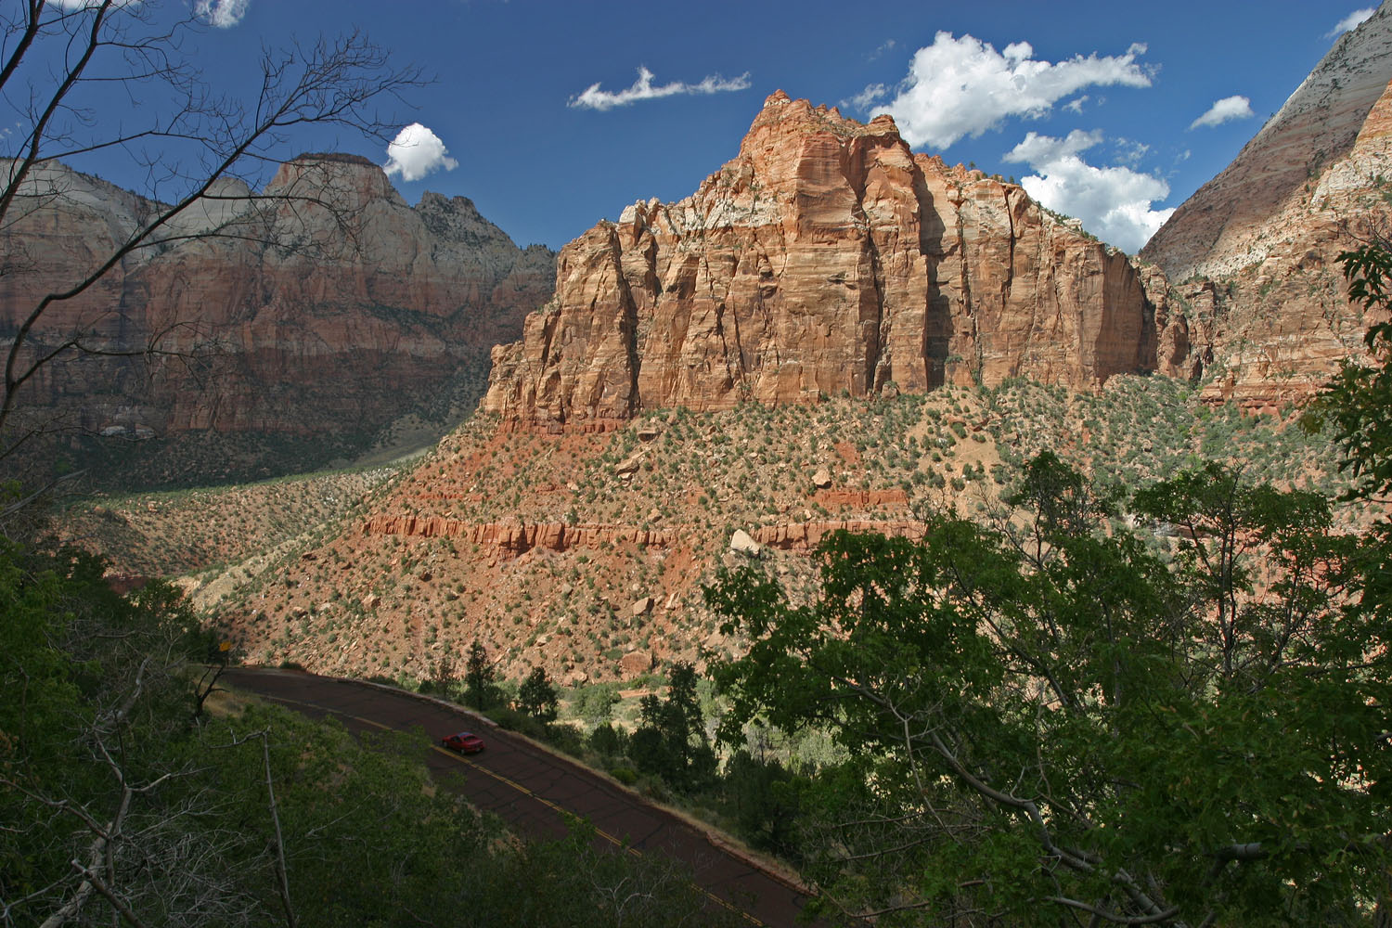

Slide 17
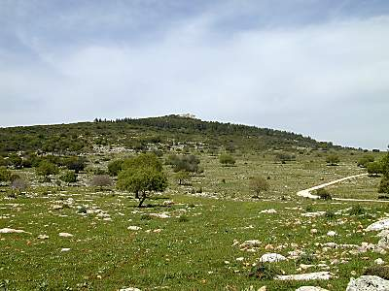

Slide 18
1. One On GOD’S Side Is A Majority
Ahab (king), Jezebel (queen), 450 prophets of Baal, 400 prophets of Asherah (no show?), plus the nation of Israel vs. Elijah (w/God).

Slide 19
1. One On GOD’S Side Is A Majority
Ahab (king), Jezebel (queen), 450 prophets of Baal, 400 prophets of Asherah (no show?), plus the nation of Israel vs. Elijah (w/God).
Also: Elisha, Gideon, Paul, Jesus
Many times (difficult times) it may be just you and your God.

Slide 20
1. One On GOD’S Side Is A Majority
Ahab (king), Jezebel (queen), 450 prophets of Baal, 400 prophets of Asherah (no show?), plus the nation of Israel vs. Elijah (w/God).
Also: Elisha, Gideon, Paul, Jesus
Many times (difficult times) it may be just you and your God.
When you find yourself walking with the majority, look around-make sure that you’re still on the strait and narrow.

Slide 21
1. One On GOD’S Side Is A Majority
There is a desperate need for faithful brethren who will stand against heresy and apostasy.

Slide 22
1. One On GOD’S Side Is A Majority
There is a desperate need for faithful brethren who will stand against heresy and apostasy.
There is a need for Christians to confirm our allegiance to the Lord and to determine where we really stand when it comes to being on the Lord's side.

Slide 23
1. One On GOD’S Side Is A Majority
We must be willing to triumph over the evil that surrounds us and be a separate people for the glory of the Lord.

Slide 24
1. One On GOD’S Side Is A Majority
We must be willing to triumph over the evil that surrounds us and be a separate people for the glory of the Lord.
We must be willing to renew our commitment to the Lord and place Him above all other pursuits, interests and loyalties.

Slide 25
2. Blaming others
V 17 –
Ahab still can’t conceive that this could be his fault.
“troubler” is from the same root as “snake”

Slide 26
2. Blaming others
V 17 –
Ahab still can’t conceive that this could be his fault.
“troubler” is from the same root as “snake”
V 18 –
Elijah sets the blame squarely where it should be.

Slide 27
3. On the fence
V 21 –
Many warnings:
Matthew 6:24 – Two masters
Matthew 12:30 – Gathers or scatters
Galatians 5:4 – Justification by OT
James 4:4 – You adulteresses!
Revelation 3:15-16; et. al. – Hot/cold

Slide 28
4. The Challenge
V 23-37 –
God will give you yet another chance to come to Him

Slide 29
4. The Challenge
V 23-37 –
God will give you yet another chance to come to Him
Actually, God shouldn’t have had to prove anything. The Baal idols had never actually done anything.
Many times, we take without question what someone says/writes – then question God!

Slide 30
5. The results
V 39-41 –
The people finally wake up
Earlier, they were on the fence
“The LORD, He is God…”

Slide 31
5. The results
V 39-41 –
The people finally wake up
Earlier, they were on the fence
“The LORD, He is God…”
Prophets of Baal killed
Seems evil
Compare to cancer

Slide 32
5. The results
V 39-41 –
The people finally wake up
Earlier, they were on the fence
“The LORD, He is God…”
Prophets of Baal killed
Seems evil
Compare to cancer
Rain comes

Slide 33
Three Frogs On A Log
3 Frogs are on a log. 2 decide to jump off. How many are left on the log?

Slide 34
Three Frogs On A Log
3 Frogs are on a log. 2 decide to jump off. How many are left on the log?
A: 3 are still on there. Deciding is not the same as doing. Although it is an important first step, until those 2 actually jump off, they are still there.

Slide 35
Three Frogs On A Log
3 Frogs are on a log. 2 decide to jump off. How many are left on the log?
A: 3 are still on there. Deciding is not the same as doing. Although it is an important first step, until those 2 actually jump off, they are still there.
We say and we sing that we have decided to follow Jesus. But, do we stand around waiting for others to do the work?

Slide 36
Three Frogs On A Log
3 Frogs are on a log. 2 decide to jump off. How many are left on the log?
A: 3 are still on there. Deciding is not the same as doing. Although it is an important first step, until those 2 actually jump off, they are still there.
We say and we sing that we have decided to follow Jesus. But, do we stand around waiting for others to do the work?
How close are we following?

Slide 37
CONCLUSION
Elijah was a man with a nature like ours-Jas 5
We can learn so much from the account of Elijah at Mount Carmel
God’s providence
Our convictions
The deceitfulness of sin
The need for spiritual purity
The consequences of evil
Let’s decide to do…then, DO!

Slide 38
Are YOU a Christian?
Hear
Believe
Repent
Confess
Be Baptized
Continue Faithfully
Romans 10:17
Mark 16:16
Acts 2:38
Acts 22:16
Mark 16:16
Hebrews 10:38

