Slide 1
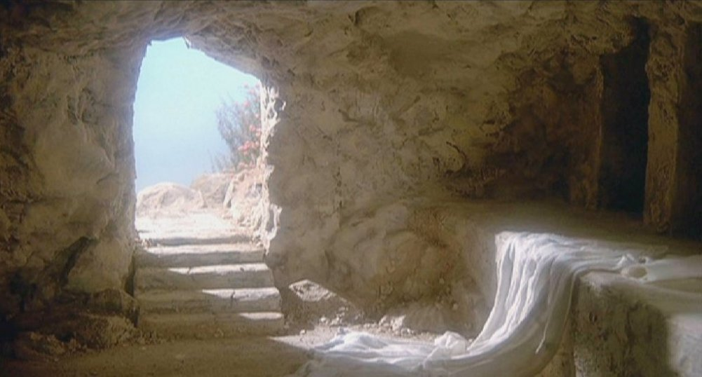
“He is not here. He has risen.”
Matthew 28:1-7

Slide 2
QUESTION
What is one of the most important differences between Christianity and other religions?

Slide 3
QUESTION
What is one of the most important differences between Christianity and other religions?
ANSWER
Jesus lives!
(Buddha, Mohammed, Joseph Smith, etc. all died)

Slide 4
Harry Houdini
Harry Houdini was an escape artist
All kinds of ways were used to hold him.
Burying him in a coffin; he’d get out
Sewing him up in canvas bags; he’d escape
Throwing him in the river; he’d come up
Handcuffs, planes, coffins, straitjackets, etc.

Slide 5
Harry Houdini
Harry Houdini was an escape artist
All kinds of ways were used to hold him.
Burying him in a coffin; he’d get out
Sewing him up in canvas bags; he’d escape
Throwing him in the river; he’d come up
Handcuffs, planes, coffins, straitjackets, etc.
I read on the internet that his biographer said he could “escape from anything, except your memory.”

Slide 6
Harry Houdini
Yet there came a day when he died

Slide 7
Harry Houdini
Yet there came a day when he died
…and he could not escape.

Slide 8
Harry Houdini
Yet there came a day when he died
…and he could not escape.
His tricks didn’t work
Harry Houdini could not escape death

Slide 9
Harry Houdini
Yet there came a day when he died
…and he could not escape.
His tricks didn’t work
Harry Houdini could not escape death
Many claimed he would (he was an agnostic)
People had faith he would
Many mediums claimed he had sent a message
Fans still gather at various sites, almost 90 years later

Slide 10
Harry Houdini
Yet there came a day when he died
…and he could not escape.
His tricks didn’t work
Harry Houdini could not escape death
Many claimed he would (he was an agnostic)
People had faith he would
Many mediums claimed he had sent a message
Fans still gather at various sites, almost 90 years later
Harry Houdini couldn’t, but Jesus did

Slide 11
INTRODUCTION
Today’s topic is usually associated with Easter Sunday, annually

Slide 12
INTRODUCTION
Today’s topic is usually associated with Easter Sunday, annually
But, it’s an event we celebrate every week with the Lord’s Supper

Slide 13
INTRODUCTION
Today’s topic is usually associated with Easter Sunday, annually
But, it’s an event we celebrate every week with the Lord’s Supper
Songs: - ex. “Because He Lives”

Slide 14
INTRODUCTION
Today’s topic is usually associated with Easter Sunday, annually
But, it’s an event we celebrate every week with the Lord’s Supper
Songs: - ex. “Because He Lives”
It’s been on my mind for several weeks now
The event
The consequences
The application

Slide 15
Its importance
The resurrection is central to Christianity – they stand or fall together

Slide 16
Its importance
The resurrection is central to Christianity – they stand or fall together
Prophecy
If the prophecies failed, the prophets failed
Deuteronomy 18:18-22 – “the test of a prophet”
Jesus spoke of His resurrection many times

Slide 17
Its importance
The resurrection is central to Christianity – they stand or fall together
Prophecy
If the prophecies failed, the prophets failed
Deuteronomy 18:18-22 – “the test of a prophet”
Jesus spoke of His resurrection many times
Witnesses
If the resurrection is false, the witnesses lied
God, HS – Romans 1:4
Angel – Matthew 28:5-6
Disciples/Apostles – 1 Corinthians 15:1-4; Luke 1, etc.

Slide 18
Its importance
The resurrection is central to Christianity – they stand or fall together
Prophecy
Witnesses
Bible

Slide 19
Its importance
The resurrection is central to Christianity – they stand or fall together
Prophecy
Witnesses
Bible
If the resurrection is untrue, the Bible is unreliable
John 17:17 – “Your word is truth.”
Jos. Smith, Mary B. Eddy, Chas Russell, Satan correct

Slide 20
Its importance
The resurrection is central to Christianity – they stand or fall together
Prophecy
Witnesses
Bible
If the resurrection is untrue, the Bible is unreliable
John 17:17 – “Your word is truth.”
Jos. Smith, Mary B. Eddy, Chas Russell, Satan correct
Too many people fail to see this – they try to explain away its reality

Slide 21
God’s power
The resurrection demonstrates God’s power
To believe in one is to believe in the other

Slide 22
God’s power
The resurrection demonstrates God’s power
To believe in one is to believe in the other
God IS life – His power is absolute
Any “god” who doesn’t have this power is not worthy of worship/faith

Slide 23
God’s power
The resurrection demonstrates God’s power
To believe in one is to believe in the other
God IS life – His power is absolute
Any “god” who doesn’t have this power is not worthy of worship/faith
Only God can remove the sting of death (1 Co. 15)

Slide 24
God’s power
The resurrection demonstrates God’s power
To believe in one is to believe in the other
God IS life – His power is absolute
Any “god” who doesn’t have this power is not worthy of worship/faith
Only God can remove the sting of death (1 Co. 15)
Jesus: John 1:4; 11:25; 14:6, etc
Notice: In the Bible, no one ever dies in the presence of Jesus

Slide 25
God’s power
The resurrection demonstrates God’s power
To believe in one is to believe in the other
God IS life – His power is absolute
Any “god” who doesn’t have this power is not worthy of worship/faith
Only God can remove the sting of death (1 Co. 15)
Jesus: John 1:4; 11:25; 14:6, etc
Notice: In the Bible, no one ever dies in the presence of Jesus
The 3x He deals with dead people, they come to life

Slide 26
1 Corinthians 15
v 12 – Some in Corinth believed, and taught, that there was no resurrection
Sadducees’ influence? – Acts 23:8
Pagan Influence? – Acts 17:32

Slide 27
1 Corinthians 15
v 12 – Some in Corinth believed, and taught, that there was no resurrection
v 13 – this must include Christ

Slide 28
1 Corinthians 15
v 12 – Some in Corinth believed, and taught, that there was no resurrection
v 13 – this must include Christ
v 14 – vain (void, useless, empty, worthless)
Preaching Christ would be senseless
Faith in Christ would be useless

Slide 29
1 Corinthians 15
v 12 – Some in Corinth believed, and taught, that there was no resurrection
v 13 – this must include Christ
v 14 – vain (void, useless, empty, worthless)
Preaching Christ would be senseless
Faith in Christ would be useless
v 15 – False witnesses
False witnesses do not help a cause
They hinder it

Slide 30
1 Corinthians 15
v 16 – repeats v 13

Slide 31
1 Corinthians 15
v 16 – repeats v 13
v 17 – You are still in your sins (no one has been redeemed because Jesus did not overcome death)

Slide 32
1 Corinthians 15
v 16 – repeats v 13
v 17 – You are still in your sins (no one has been redeemed because Jesus did not overcome death)
v 18 – all believers who have died have perished

Slide 33
1 Corinthians 15
v 16 – repeats v 13
v 17 – You are still in your sins (no one has been redeemed because Jesus did not overcome death)
v 18 – all believers who have died have perished
v 19 – Christians are to be pitied

Slide 34
1 Corinthians 15
v 16 – repeats v 13
v 17 – You are still in your sins (no one has been redeemed because Jesus did not overcome death)
v 18 – all believers who have died have perished
v 19 – Christians are to be pitied
v 20 – But, since Jesus WAS resurrected, and is the first fruit, we have the hope

Slide 35
The transformations
“He is not here. He is risen” makes all the difference.

Slide 36
The transformations
“He is not here. He is risen” makes all the difference.
Despair turns to delight (the women, Apostles, etc)

Slide 37
The transformations
“He is not here. He is risen” makes all the difference.
Despair turns to delight (the women, Apostles, etc)
Defeat to victory (over sin, death, Satan)

Slide 38
The transformations
“He is not here. He is risen” makes all the difference.
Despair turns to delight (the women, Apostles, etc)
Defeat to victory (over sin, death, Satan)
Cowardice to courage (most were martyred)

Slide 39
The transformations
“He is not here. He is risen” makes all the difference.
Despair turns to delight (the women, Apostles, etc)
Defeat to victory (over sin, death, Satan)
Cowardice to courage (most were martyred)
Hopelessness to absolute assurance.

Slide 40
The transformations
“He is not here. He is risen” makes all the difference.
Despair turns to delight (the women, Apostles, etc)
Defeat to victory (over sin, death, Satan)
Cowardice to courage (most were martyred)
Hopelessness to absolute assurance.
It transformed Paul

Slide 41
The transformations
“He is not here. He is risen” makes all the difference.
Despair turns to delight (the women, Apostles, etc)
Defeat to victory (over sin, death, Satan)
Cowardice to courage (most were martyred)
Hopelessness to absolute assurance.
It transformed Paul
It transformed Jews and Gentiles

Slide 42
The transformations
“He is not here. He is risen” makes all the difference.
Despair turns to delight (the women, Apostles, etc)
Defeat to victory (over sin, death, Satan)
Cowardice to courage (most were martyred)
Hopelessness to absolute assurance.
It transformed Paul
It transformed Jews and Gentiles
It transformed me (and each of you)

Slide 43
An application
It was a surprise to those who witnessed it.
A pleasant surprise

Slide 44
An application
It was a surprise to those who witnessed it.
A pleasant surprise
The Scriptures prophesied it
Jesus spoke of it

Slide 45
An application
It was a surprise to those who witnessed it.
A pleasant surprise
The Scriptures prophesied it
Jesus spoke of it
But, they weren’t living like they believed it

Slide 46
An application
It was a surprise to those who witnessed it.
A pleasant surprise
The Scriptures prophesied it
Jesus spoke of it
But, they weren’t living like they believed it
The same Jesus, at the right hand of God, said He will come again

Slide 47
An application
It was a surprise to those who witnessed it.
A pleasant surprise
The Scriptures prophesied it
Jesus spoke of it
But, they weren’t living like they believed it
The same Jesus, at the right hand of God, said He will come again
Are we living like we believe it?
Will it be a surprise in spite of all the warnings?

Slide 48
An application
It was a surprise to those who witnessed it.
A pleasant surprise
The Scriptures prophesied it
Jesus spoke of it
But, they weren’t living like they believed it
The same Jesus, at the right hand of God, said He will come again
Are we living like we believe it?
Will it be a surprise in spite of all the warnings?
2 Peter 3:10-14 – manner of conduct…

Slide 49
CONCLUSION
“He is risen.” has many implications

Slide 50
CONCLUSION
“He is risen.” has many implications
It is central to our faith
Our hope
Our assembly
God, angels, prophets, other witnesses, Bible

Slide 51
CONCLUSION
“He is risen.” has many implications
It is central to our faith
Our hope
Our assembly
God, angels, prophets, other witnesses, Bible
1 Corinthians 15:19 –
“If we have hoped in Christ in this life only, we are of all men most to be pitied.”

Slide 52
Are YOU a Christian?
Hear
Believe
Repent
Confess
Be Baptized
Continue Faithfully
Romans 10:17
Mark 16:16
Acts 2:38
Acts 22:16
Mark 16:16
Hebrews 10:38

