Slide 1
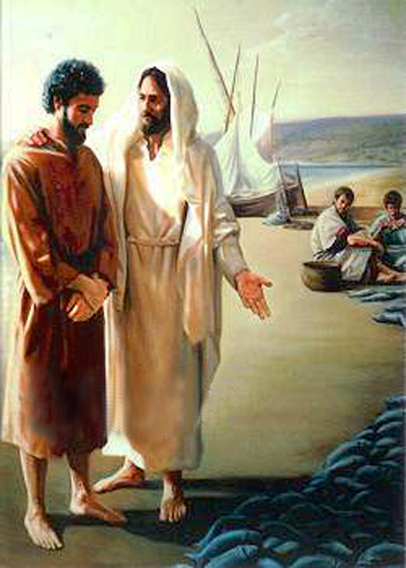
“Do you love Me more than these?”
John
21:12-17

Slide 2
INTRODUCTION
Imagine
You just had breakfast with the risen Savior

Slide 3
INTRODUCTION
Imagine
You just had breakfast with the risen Savior
He rose from the dead, like He said He would
He had shown Himself

Slide 4
INTRODUCTION
Imagine
You just had breakfast with the risen Savior
He rose from the dead, like He said He would
He had shown Himself
He had told you to go to Galilee and wait for Him
You, and several others, are fishing the whole night

Slide 5
INTRODUCTION
Imagine
You just had breakfast with the risen Savior
He rose from the dead, like He said He would
He had shown Himself
He had told you to go to Galilee and wait for Him
You, and several others, are fishing the whole night
You catch nothing all night
At daybreak, when He guides you, you catch a lot

Slide 6
INTRODUCTION
Imagine
You just had breakfast with the risen Savior
He rose from the dead, like He said He would
He had shown Himself
He had told you to go to Galilee and wait for Him
You, and several others, are fishing the whole night
You catch nothing all night
At daybreak, when He guides you, you catch a lot
You just had breakfast with the risen Savior!
How cool is that!
You had had the Last Supper, but not the last breakfast

Slide 7
INTRODUCTION
Now, imagine

Slide 8
INTRODUCTION
Now, imagine
After all have eaten (possibly, quieted down)
Jesus asks you “Do you love Me more than these?”

Slide 9
INTRODUCTION
Now, imagine
After all have eaten (possibly, quieted down)
Jesus asks you “Do you love Me more than these?”
These fishes (and, by extension, fishing) – referencing the Great Commission

Slide 10
INTRODUCTION
Now, imagine
After all have eaten (possibly, quieted down)
Jesus asks you “Do you love Me more than these?”
These fishes (and, by extension, fishing) – referencing the Great Commission
These other disciples – referencing (your) declaration of greater love than the others (foot washing, sword, jumping out of boat, etc.)

Slide 11
INTRODUCTION
Now, imagine
After all have eaten (possibly, quieted down)
Jesus asks you “Do you love Me more than these?”
These fishes (and, by extension, fishing) – referencing the Great Commission
These other disciples – referencing (your) declaration of greater love than the others (foot washing, sword, jumping out of boat, etc.)
3x He asks – and you answer

Slide 12
“Love”
In the Greek language:
Agape – God’s love for man; very strong - 1 Cor. 13
Phileo – Brotherly, between equals-”Philadelphia”

Slide 13
“Love”
In the Greek language:
Agape – God’s love for man; very strong - 1 Cor. 13
Phileo – Brotherly, between equals-”Philadelphia”
Storge – Familial (parents/children)-not used in NT
Eros – Passionate, intimate, fleshly – “erotic”

Slide 14
“Love”
In the Greek language:
Agape – God’s love for man; very strong - 1 Cor. 13
Phileo – Brotherly, between equals-”Philadelphia”
Storge – Familial (parents/children)-not used in NT
Eros – Passionate, intimate, fleshly – “erotic”
Jesus to Peter (you?)
First time: Agapan? (strong) – Philein (weaker)
Second time : Agapan? (strong) – Philein (weaker)
Third time: Philein? (weaker) – Philein (weaker)

Slide 15
A Few More Things
Notice that Jesus will come down to our level without leaving His (Philippians 2:5-11, etc.)

Slide 16
A Few More Things
Notice that Jesus will come down to our level without leaving His (Philippians 2:5-11, etc.)
Jesus expects us to start where we are, but not stay where we are

Slide 17
A Few More Things
Notice that Jesus will come down to our level without leaving His (Philippians 2:5-11, etc.)
Jesus expects us to start where we are, but not stay where we are
Jesus brings to our remembrance:
Fishermen vs. fishers of men
Torn nets (Mt. 4; Lk. 5) vs. unbreakable nets

Slide 18
A Few More Things
Notice that Jesus will come down to our level without leaving His (Philippians 2:5-11, etc.)
Jesus expects us to start where we are, but not stay where we are
Jesus brings to our remembrance:
Fishermen vs. fishers of men
Torn nets (Mt. 4; Lk. 5) vs. unbreakable nets
Miraculous feeding of the people
Peter’s 3-fold denial – now, 3-fold affirmation

Slide 19
A Few More Things
Notice that Jesus will come down to our level without leaving His (Philippians 2:5-11, etc.)
Jesus expects us to start where we are, but not stay where we are
Jesus brings to our remembrance:
Fishermen vs. fishers of men
Torn nets (Mt. 4; Lk. 5) vs. unbreakable nets
Miraculous feeding of the people
Peter’s 3-fold denial – now, 3-fold affirmation
Prove it – Fruits of repentance (2 Cor. 7:10-11)

Slide 20
Application
The question “Do you love Me?”
Is tremendously important to us today
Is extremely applicable to you and me

Slide 21
Application
The question “Do you love Me?”
Is tremendously important to us today
Is extremely applicable to you and me
Being a “child of God” is not automatically equal to being a faithful child of God

Slide 22
Application
The question “Do you love Me?”
Is tremendously important to us today
Is extremely applicable to you and me
Being a “child of God” is not automatically equal to being a faithful child of God
We need to examine ourselves
Using God’s standard (His word – the Bible)
Using God’s example (His Word – Jesus)

Slide 23
Application
The question “Do you love Me?”
Is tremendously important to us today
Is extremely applicable to you and me
Being a “child of God” is not automatically equal to being a faithful child of God
We need to examine ourselves
Using God’s standard (His word – the Bible)
Using God’s example (His Word – Jesus)
We need to let our actions equal our profession

Slide 24
Application
The question “Do you love Me?”
Is tremendously important to us today
Is extremely applicable to you and me
Being a “child of God” is not automatically equal to being a faithful child of God
We need to examine ourselves
Using God’s standard (His word – the Bible)
Using God’s example (His Word – Jesus)
We need to let our actions equal our profession
We need to ask ourselves “Do I love Him more…?”

Slide 25
A Faithful Child of God…
Has come to God
Called of God – Hears
Accepts God’s call – Believes
Gives faith action – Repents
Confesses Him with his mouth (from the heart)
Is buried/resurrected with Him in baptism
Knowing that none of this earns him anything – Ephesians 2:8-9

Slide 26
A Faithful Child of God…
Is faithful to God (Acts 2:42-47)
Assembles (Hebrews 10:25)
Prays always (1 Thessalonians 5:17)
Shares the Gospel with others (teaches)
Verbally (Hebrews 5:12, etc.)
Non-verbally (1 Peter 3)
Grow (Ephesians 4)
Does what is good (James 4; Matthew 25, etc.)

Slide 27
A Faithful Child of God…
Loves God more than “these”
Mark 12:30 (Deut. 6:5) – Greatest Commandment

Slide 28
A Faithful Child of God…
Loves God more than “these”
Mark 12:30 (Deut. 6:5) – Greatest Commandment
Active – 1 Cor. 15:58; 2 Cor. 5:11)
Our best – John 14:15; 1 John 5:3

Slide 29
A Faithful Child of God…
Loves God more than “these”
Mark 12:30 (Deut. 6:5) – Greatest Commandment
Active – 1 Cor. 15:58; 2 Cor. 5:11)
Our best – John 14:15; 1 John 5:3
Not leftovers
Minutes/Days
Money
Prayers
Etc.

Slide 30
Loving God “more than these”
Guides your actions
Lost are seen through God’s eyes
Enemies are potential/future Christians

Slide 31
Loving God “more than these”
Guides your actions
Lost are seen through God’s eyes
Enemies are potential/future Christians
Sets your standards
Not by popularity, worldly standards
Not according to your own standard

Slide 32
Loving God “more than these”
Guides your actions
Lost are seen through God’s eyes
Enemies are potential/future Christians
Sets your standards
Not by popularity, worldly standards
Not according to your own standard
Defines your relationship with God

Slide 33
Loving God “more than these”
Guides your actions
Lost are seen through God’s eyes
Enemies are potential/future Christians
Sets your standards
Not by popularity, worldly standards
Not according to your own standard
Defines your relationship with God
Prioritizes your life

Slide 34
Your light
Lets your light shine towards God
Lets your light shine among the brethren

Slide 35
Your light
Lets your light shine towards God
Lets your light shine among the brethren
Lets your light shine for your family
Spouse
Children
Extended family
Shine a light to others

Slide 36
CONCLUSION
Jesus asked Peter what Peter needed to consider
He gave him a chance to repent, re-affirm
He gave him a new starting point and a direction

Slide 37
CONCLUSION
Jesus asked Peter what Peter needed to consider
He gave him a chance to repent, re-affirm
He gave him a new starting point and a direction
We need to consider these things also
Do I love Jesus more than…”
Am I willing to prove it?
Will I stop excusing present actions with past failures?

Slide 38
Are YOU a Christian?
Hear
Believe
Repent
Confess
Be Baptized
Continue Faithfully
Romans 10:17
Mark 16:16
Acts 2:38
Acts 22:16
Mark 16:16
Hebrews 10:38

