Slide 1
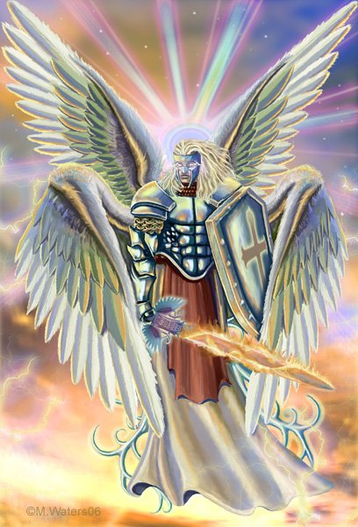
Angels

Slide 2
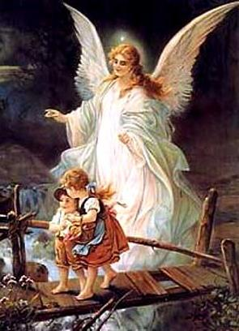
Angels

Slide 3
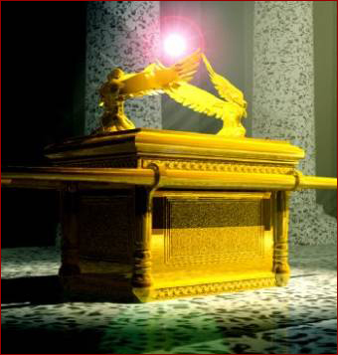
Angels

Slide 4
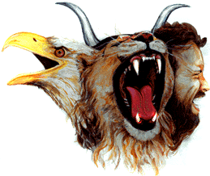
Angels

Slide 5
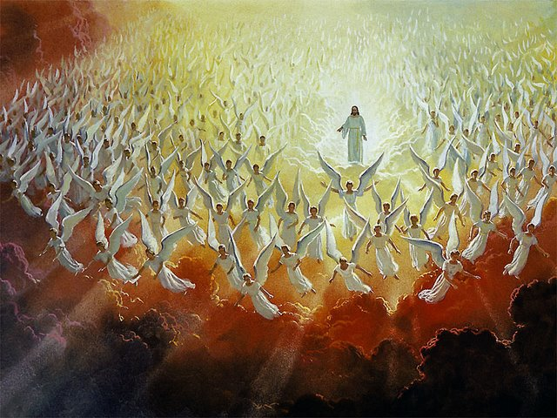

Slide 6
Angels
Daniel 10:5-9

Slide 7
INTRODUCTION
Today’s topic is quite popular in our culture
Books, TV
Articles., testimonials, etc.
Much interest

Slide 8
INTRODUCTION
Today’s topic is quite popular in our culture
Books, TV
Articles., testimonials, etc.
Much interest
However, there is a lot of misinformation
Opinions/Myths - sincere or not
Angelology/Certified Spiritual Counselor

Slide 9
INTRODUCTION
Angelology
Angels in all Your Relationships Clearing the Way for Guidance Dreaming With the Angels How We Met Our Angels How to Ask Your Angel Healing With the Angels Working with Angels in Groups Living with Angels

Slide 10
INTRODUCTION
Today’s topic is quite popular in our culture
Books, TV
Articles., testimonials, etc.
Much interest
However, there is a lot of misinformation
Opinions/Myths - sincere or not
Angelology/Certified Spiritual Counselor
What does God say?
The only reliable source

Slide 11
BASICS
Definition of “angel”
Messenger, in Hebrew & Greek

Slide 12
BASICS
Definition of “angel”
Messenger, in Hebrew & Greek
Messengers of God’s will – Hebrews 2:2
Verbal (Gen. 16:7; Acts 27:23-24)
Actions (1 Kings 19:5-6 – Elijah)

Slide 13
BASICS
Definition of “angel”
Messenger, in Hebrew & Greek
Messengers of God’s will – Hebrews 2:2
Verbal (Gen. 16:7; Acts 27:23-24)
Actions (1 Kings 19:5-6 – Elijah)
They serve God
Often, in helping mankind
Sometimes, in punishing us
Genesis 3:24 (Eden); 19:12-15 – Sodom/Gomorrah)
1 Chronicles 21:15-16

Slide 14
BASICS
Created, spiritual beings – Hebrews 1:14
Colossians 1:16-17 – all…in heavens, earth
Hebrews 2:7 – higher order than man

Slide 15
BASICS
Created, spiritual beings – Hebrews 1:14
Colossians 1:16-17 – all…in heavens, earth
Hebrews 2:7 – higher order than man
Innumerable
Revelation 5:11
Hebrews 12:22

Slide 16
BASICS
Created, spiritual beings – Hebrews 1:14
Colossians 1:16-17 – all…in heavens, earth
Hebrews 2:7 – higher order than man
Innumerable
Revelation 5:11
Hebrews 12:22
Powerful
2 Kings 19:35 – 185,000 in one night
Revelation 8 – Plagues, etc.

Slide 17
BASICS
However…
They are not equal to God
Holy, (not Holy, Holy, Holy) – Matthew 24:31
Chosen (elect) – 1 Timothy 5:21
Limited in knowledge (Matthew 24:36)
Limited in understanding (1 Peter 1:12)
Not to be worshipped
Colossians 2:18
Revelation 19:10; 22:9
Not to be prayed to

Slide 18
NAMES
Many occurrences of interaction
However, only 3 named
Michael, the archangel (Jude 9)
Gabriel (Daniel 8:16, 9:20-21; Luke 1:19, 26)
Satan – the devil, the accuser

Slide 19
NAMES
Many occurrences of interaction
However, only 3 named
Michael, the archangel (Jude 9)
Gabriel (Daniel 8:16, 9:20-21; Luke 1:19, 26)
Satan – the devil, the accuser
Ranks
Apparently, different levels, responsibilities
Arch-angel – (“chief”; “over”) – Michael
Cherub(im) – above the mercy seat, guard Eden
Seraph(im) – in God’s presence

Slide 20
MINISTERING SPIRITS
Hebrews 1:14; 13:2

Slide 21
MINISTERING SPIRITS
Hebrews 1:14; 13:2
Different levels
Countries – Daniel 10:13
Churches – Revelation 2 & 3
Individuals – Matthew 18:10; Acts 12:15

Slide 22
MINISTERING SPIRITS
Hebrews 1:14; 13:2
Different levels
Countries – Daniel 10:13
Churches – Revelation 2 & 3
Individuals – Matthew 18:10; Acts 12:15
They care about us
Luke 15:10

Slide 23
FREE WILL
Like mankind

Slide 24
FREE WILL
Like mankind
Some chose to sin – 2 Peter 2:4
Matthew 25:41 – Hell is prepared for them
1 Corinthians 6:3 – Judged

Slide 25
FREE WILL
Like mankind
Some chose to sin – 2 Peter 2:4
Matthew 25:41 – Hell is prepared for them
1 Corinthians 6:3 – Judged
Allied themselves with Satan
Matthew 25:41; 12:24

Slide 26
FREE WILL
Like mankind
Some chose to sin – 2 Peter 2:4
Matthew 25:41 – Hell is prepared for them
1 Corinthians 6:3 – Judged
Allied themselves with Satan
Matthew 25:41; 12:24
No plan of salvation for them – Hebrews 2:16
Why?
Only guesses

Slide 27
CONCLUSION
This has been a brief study
Could easily be a complete Bible study class
Or a series in a Gospel Meeting
The Bible has much to say
However, it is not near enough to satisfy many people’s curiosity
Myths/Opinions
Obsession/ worship
Let’s resist that tendency

Slide 28
Are YOU a Christian?
Hear
Believe
Repent
Confess
Be Baptized
Continue Faithfully
Romans 10:17
Mark 16:16
Acts 2:38
Acts 22:16
Mark 16:16
Hebrews 10:38

