Slide 1
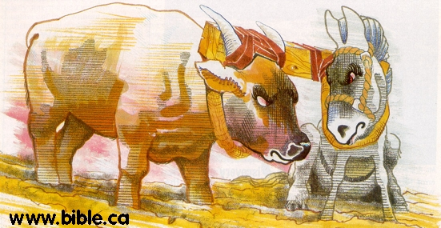
Unequally Yoked
2 Corinthians 6:14-18

Slide 2
INTRODUCTION
God has always admonished His people to be careful not to be unequally yoked to those who are of a different mind.

Slide 3
INTRODUCTION
God has always admonished His people to be careful not to be unequally yoked to those who are of a different mind.
Or, to things that would tend to draw us away from Him.

Slide 4
INTRODUCTION
God has always admonished His people to be careful not to be unequally yoked to those who are of a different mind.
Or, to things that would tend to draw us away from Him.
Those who come to God must separate themselves from the world (become “holy” – separated/sanctified) – 1 Peter 1:14-16

Slide 5
Genesis 12
¹Now the LORD said to Abram, "Go forth from your country, And from your relatives And from your father's house, To the land which I will show you; ²And I will make you a great nation, And I will bless you, And make your name great; And so you shall be a blessing; ³And I will bless those who bless you, And the one who curses you I will curse And in you all the families of the earth will be blessed."

Slide 6
Deuteronomy 22:10
Miscellaneous (sundry) laws

Slide 7
Deuteronomy 22:10
Miscellaneous (sundry) laws
“You shall not plow with an ox and a donkey together. “

Slide 8
Deuteronomy 22:10
Miscellaneous (sundry) laws
“You shall not plow with an ox and a donkey together. “
Clean/unclean
Work “ethics”, abilities, goals

Slide 9
Deuteronomy 22:10
Miscellaneous (sundry) laws
“You shall not plow with an ox and a donkey together. “
Clean/unclean
Work “ethics”, abilities, goals
Although the Old Law is no longer in force, many NT passages show that the principles behind those laws are just as true today.

Slide 10
New Testament Passages
Matt. 6:24 – Cannot serve two masters

Slide 11
New Testament Passages
Matt. 6:24 – Cannot serve two masters
Romans 16:17 – Turn away from them

Slide 12
New Testament Passages
Matt. 6:24 – Cannot serve two masters
Romans 16:17 – Turn away from them
1 Corinthians 5:9-11 – In the church

Slide 13
New Testament Passages
Matt. 6:24 – Cannot serve two masters
Romans 16:17 – Turn away from them
1 Corinthians 5:9-11 – In the church
Ephesians 5:7-17 – Do not participate

Slide 14
New Testament Passages
Matt. 6:24 – Cannot serve two masters
Romans 16:17 – Turn away from them
1 Corinthians 5:9-11 – In the church
Ephesians 5:7-17 – Do not participate
2 Thessalonians 3:6 – Keep away

Slide 15
New Testament Passages
Matt. 6:24 – Cannot serve two masters
Romans 16:17 – Turn away from them
1 Corinthians 5:9-11 – In the church
Ephesians 5:7-17 – Do not participate
2 Thessalonians 3:6 – Keep away
1 Corinthians 15:33 – Be not deceived: “Bad company corrupts good morals.”

Slide 16
We Are Yoked to Jesus
Matthew 11:28-30
28 "Come to Me, all who are weary and heavy-laden, and I will give you rest.
29 "Take My yoke upon you and learn from Me, for I am gentle and humble in heart, and YOU WILL FIND REST FOR YOUR SOULS.
30 "For My yoke is easy and My burden is light."

Slide 17
2 Corinthians 6:14-18
The principle of unequal yoking has many applications

Slide 18
2 Corinthians 6:14-18
The principle of unequal yoking has many applications
In business

Slide 19
2 Corinthians 6:14-18
The principle of unequal yoking has many applications
In business
In friendships

Slide 20
2 Corinthians 6:14-18
The principle of unequal yoking has many applications
In business
In friendships
In the church

Slide 21
2 Corinthians 6:14-18
The principle of unequal yoking has many applications
In business
In friendships
In the church
In marriage (Note: although many times used for marriage, this would be a misuse of this verse – consider v 16 “…come out from their midst…”, and other verses, such as 1 Corinthians 7:12-13

Slide 22
2 Corinthians 6:14-18
We ARE to let our light shine in the world Matthew 5:14-16

Slide 23
2 Corinthians 6:14-18
We ARE to let our light shine in the world Matthew 5:14-16
We must GO OUT into all the world Matthew 28:18-20; Mark 16:15-16
We cannot HIDE from the world John 17:15; 1 Corinthians 5:9-11

Slide 24
2 Corinthians 6:14-18
We ARE to let our light shine in the world Matthew 5:14-16
We must GO OUT into all the world Matthew 28:18-20; Mark 16:15-16
We cannot HIDE from the world John 17:15; 1 Corinthians 5:9-11
Q? How do we reconcile these passages?

Slide 25
2 Corinthians 6:14-18
We ARE to let our light shine in the world Matthew 5:14-16
We must GO OUT into all the world Matthew 28:18-20; Mark 16:15-16
We cannot HIDE from the world John 17:15; 1 Corinthians 5:9-11
Q? How do we reconcile these passages?
A: “Unequal yoke” refers to the weaker one.

Slide 26
GOD You

Slide 27
GOD You

Slide 28
Questions to Ask Yourself
Are brethren starting to “bother” you about some new activity or relationship?

Slide 29
Questions to Ask Yourself
Are brethren starting to “bother” you about some new activity or relationship?
Do you have to keep explaining your actions to those close to you?

Slide 30
Questions to Ask Yourself
Are brethren starting to “bother” you about some new activity or relationship?
Do you have to keep explaining your actions to those close to you?
Do you question yourself (conscience)?

Slide 31
Questions to Ask Yourself
Are brethren starting to “bother” you about some new activity or relationship?
Do you have to keep explaining your actions to those close to you?
Do you question yourself (conscience)?
Do you feel that you have to “tone down” your “Christianity” around some friends or in certain places or situations?

Slide 32
Questions to Ask Yourself
Are there Scriptures that you see “in a new light”?

Slide 33
Questions to Ask Yourself
Are there Scriptures that you see “in a new light”?
Have you decided that you will not “judge” anyone else, just like you wouldn’t like to be judged (I’m ok, you’re ok)? – Misuse of Mt. 7

Slide 34
Questions to Ask Yourself
Are there Scriptures that you see “in a new light”?
Have you decided that you will not “judge” anyone else, just like you wouldn’t like to be judged (I’m ok, you’re ok)? – Misuse of Mt. 7
Are gatherings of Christians b-o-r-ING!, while hanging out with “the guys” is fun?

Slide 35
Questions to Ask Yourself
Are there Scriptures that you see “in a new light”?
Have you decided that you will not “judge” anyone else, just like you wouldn’t like to be judged (I’m ok, you’re ok)? – Misuse of Mt. 7
Are gatherings of Christians b-o-r-ING!, while hanging out with “the guys” is fun?
Do you say “Those Scriptures don’t apply in this situation.”?

Slide 36
WARNING!!!
Answering any/all of those questions in the affirmative means that you are in real, eternal danger!

Slide 37
WARNING!!!
Answering any/all of those questions in the affirmative means that you are in real, eternal danger!
Step away from the situation
Re-assess your condition
Recognize the danger
Repent of your sin

Slide 38
WARNING!!!
Answering any/all of those questions in the affirmative means that you are in real, eternal danger!
Step away from the situation
Re-assess your condition
Recognize the danger
Repent of your sin
Only then can you re-unite with Christ!

Slide 39
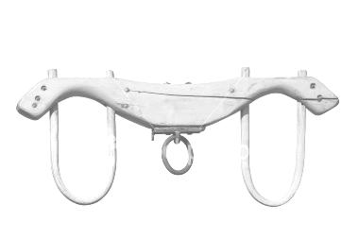
CONCLUSION
Ask Yourself: “Am I influencing them or is it the other way around?”
We must go out into the world and let our (God’s) light shine in the darkness.
In order to do that, we must be yoked to Jesus, not the world.

Slide 40
Are YOU a Christian?
Hear
Believe
Repent
Confess
Be Baptized
Continue Faithfully
Romans 10:17
Mark 16:16
Acts 2:38
Acts 22:16
Mark 16:16
Hebrews 10:38

