Slide 1
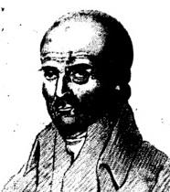
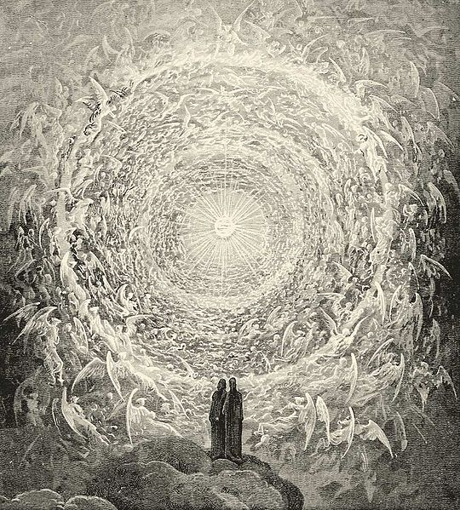
On Zion’s Glorious Summit
Hebrews
12:18-24

Slide 2
INTRODUCTION
We sing songs in the assembly that are
Written to glorify God
And edify man
We sometimes sing hymns without full understanding of words/thoughts

Slide 3
INTRODUCTION
We sing songs in the assembly that are
Written to glorify God
And edify man
We sometimes sing hymns without full understanding of words/thoughts
It is good that we sometimes go over those songs and closely examine what we are saying in our singing

Slide 4
INTRODUCTION
Today’s song is very popular
It has become well used as an invitation song
Have you thought about the words as you’ve sang it?

Slide 5
INTRODUCTION
Today’s song is very popular
It has become well used as an invitation song
Have you thought about the words as you’ve sang it?
In our songbooks “Songs of Faith and Praise”, it is song #227
Usually sung with great passion

Slide 6
INTRODUCTION
Today’s song is very popular
It has become well used as an invitation song
Have you thought about the words as you’ve sang it?
In our songbooks “Songs of Faith and Praise”, it is song #227
Usually sung with great passion
Written in 1803 by John Kent (1766-1843)
The music is by Robert Skene

Slide 7
John Kent
As a working shipwright (someone that builds/repairs ships), his opportunities for getting the education/practice needed for writing hymns were limited.
He went blind by 60, which ended his writing

Slide 8
John Kent
As a working shipwright (someone that builds/repairs ships), his opportunities for getting the education/practice needed for writing hymns were limited.
He went blind by 60, which ended his writing
His hymns are strongly worded, very earnest and simple

Slide 9
John Kent
As a working shipwright (someone that builds/repairs ships), his opportunities for getting the education/practice needed for writing hymns were limited.
He went blind by 60, which ended his writing
His hymns are strongly worded, very earnest and simple
…and intensely Calvinistic.
This has restricted their use by many

Slide 10
2 Passages
Hebrews 11-12
Chapter 11 – Great heroes of Faith, despite great difficulties in their lives
Chapter 12 – These same people are now “a great cloud of witnesses, cheering us on

Slide 11
2 Passages
Hebrews 11-12
Chapter 11 – Great heroes of Faith, despite great difficulties in their lives
Chapter 12 – These same people are now “a great cloud of witnesses, cheering us on
Revelation
The faithful are in Heaven
They rest from their trials, their labors, their life
They sing songs of praise
We can be where they are

Slide 12
Verse 1
Notice: Written in the past tense

Slide 13
Verse 1
Notice: Written in the past tense
Revelation 14:1-3

Slide 14
Verse 1
Notice: Written in the past tense
Revelation 14:1-3
On Zion's glorious summit stood A num'rous host redeemed by blood! They hymned their King in strains divine I heard the song and strove to join I heard the song and strove to join

Slide 15
Verse 1
Notice: Written in the past tense
Revelation 14:1-3
On Zion's glorious summit stood A num'rous host redeemed by blood! They hymned their King in strains divine I heard the song and strove to join I heard the song and strove to join
(The ending is repeated for emphasis)

Slide 16
Verse 2
Notice: Written in the present tense

Slide 17
Verse 2
Notice: Written in the present tense
Here all who suffered sword or flame For truth or Jesus' lovely name Shout vict'ry now and hail the Lamb And bow before the great I AM And bow before the great I AM

Slide 18
Verse 2
Notice: Written in the present tense
Here all who suffered sword or flame For truth or Jesus' lovely name Shout vict'ry now and hail the Lamb And bow before the great I AM And bow before the great I AM
The English word “martyr” is merely a transliteration of the Greek word “martur” (witness).
To early Christians they were often the same

Slide 19
Verse 2
Here, the word “sword” represents death generally because of your Christianity
Romans 13:4; Revelation 20:4; 1 Peter 4:14, 16

Slide 20
Verse 2
Here, the word “sword” represents death generally because of your Christianity
Romans 13:4; Revelation 20:4; 1 Peter 4:14, 16
Whereas “flame” represents those who are martyred by torture
Nero

Slide 21
Verse 2
Here, the word “sword” represents death generally because of your Christianity
Romans 13:4; Revelation 20:4; 1 Peter 4:14, 16
Whereas “flame” represents those who are martyred by torture
Nero
The victory is ours to shout, the glory belongs to the Lamb, before whom all knees must bend (Philippians 2:9-11)

Slide 22
Verse 3
Notice: Written in the future tense

Slide 23
Verse 3
Notice: Written in the future tense
While everlasting ages roll Eternal love shall feast their soul And scenes of bliss, for ever new Rise in succession to their view Rise in succession to their view

Slide 24
Verse 3
Notice: Written in the future tense
While everlasting ages roll Eternal love shall feast their soul And scenes of bliss, for ever new Rise in succession to their view Rise in succession to their view
Their reward is eternal in Heaven
Eternal love
Eternal rest
Eternal day

Slide 25
Sanctus
Literally: “Holy”
Beginning and ending
(Sung after the last verse)

Slide 26
Sanctus
Literally: “Holy”
Beginning and ending
(Sung after the last verse)
Holy, holy, holy Lord God of hosts, on high adored! Who like me Thy praise should sing O Almighty King! Holy, Holy, Holy

Slide 27
Sanctus
Literally: “Holy”
Beginning and ending
(Sung after the last verse)
Holy, holy, holy Lord God of hosts, on high adored! Who like me Thy praise should sing O Almighty King! Holy, Holy, Holy
Thrice-holy God
I can be included in that scene

Slide 28
CONCLUSION
John Kent wrote many hymns, but this is one of his most famous
He certainly “got it right”
There is a reason we usually sing it with such passion
It prepares our minds for Heaven
It reminds us of the reward waiting for us
It helps us endure our crosses

Slide 29
Are YOU a Christian?
Hear
Believe
Repent
Confess
Be Baptized
Continue Faithfully
Romans 10:17
Mark 16:16
Acts 2:38
Acts 22:16
Mark 16:16
Hebrews 10:38

