Slide 1
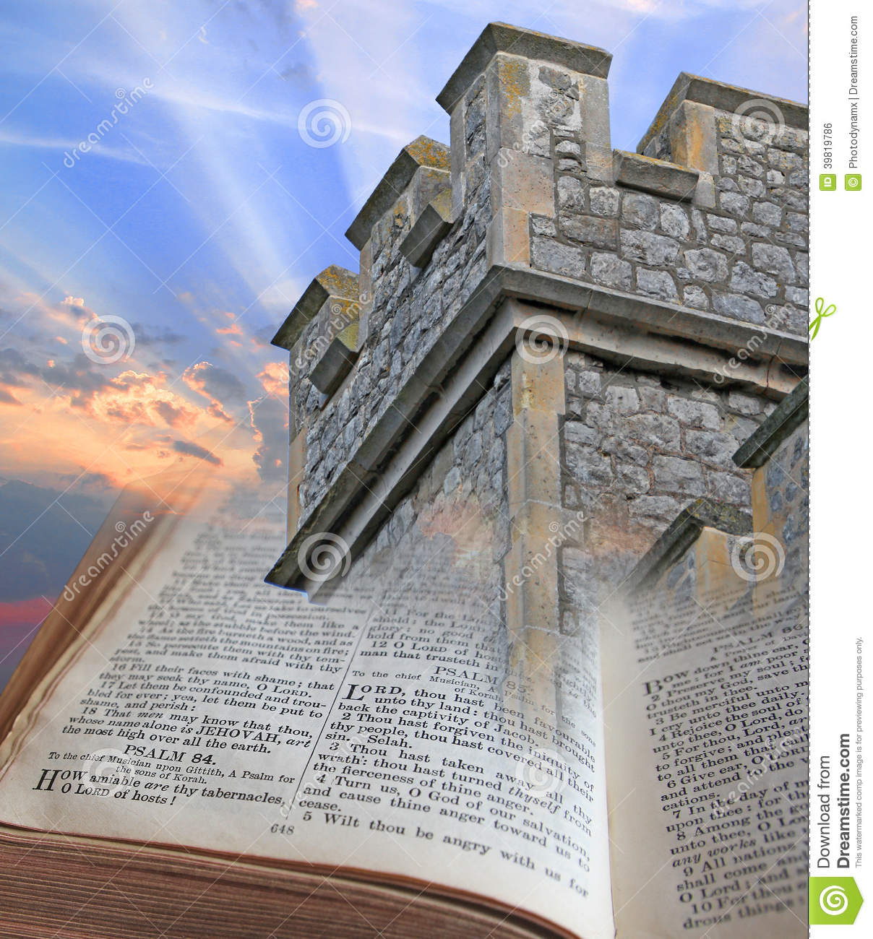
Psalm 91 – Security
Psalm 91:1-4

Slide 2
INTRODUCTION
How would you wage battle (and hope to win) against someone…
Much stronger than you?

Slide 3
INTRODUCTION
How would you wage battle (and hope to win) against someone…
Much stronger than you?
More experienced than you?
Better equipped than you?

Slide 4
INTRODUCTION
How would you wage battle (and hope to win) against someone…
Much stronger than you?
More experienced than you?
Better equipped than you?
With more helpers than you?
Who doesn’t care about fighting fair?

Slide 5
INTRODUCTION
How would you wage battle (and hope to win) against someone…
Much stronger than you?
More experienced than you?
Better equipped than you?
With more helpers than you?
Who doesn’t care about fighting fair?
You make sure that you’re faithfully in the Lord’s army!
Just ask David – 1 Samuel 17:45ff

Slide 6
Verses 1-4 – Intro Thoughts
We must choose the protection of God
It isn’t accidental if we dwell in His shelter
Psalm 27:1-5 – David

Slide 7
Verses 1-4 – Intro Thoughts
We must choose the protection of God
It isn’t accidental if we dwell in His shelter
Psalm 27:1-5 – David
No one stumbles into Heaven
This choice must be made before the dangers

Slide 8
Verses 1-4 – Intro Thoughts
We must choose the protection of God
It isn’t accidental if we dwell in His shelter
Psalm 27:1-5 – David
No one stumbles into Heaven
This choice must be made before the dangers
The “secret place” is a private, secluded, intimate place (Matthew 6:5-6) that is surely not known by the enemy

Slide 9
Verses 1-4 – Intro Thoughts
We must choose the protection of God
It isn’t accidental if we dwell in His shelter
Psalm 27:1-5 – David
No one stumbles into Heaven
This choice must be made before the dangers
The “secret place” is a private, secluded, intimate place (Matthew 6:5-6) that is surely not known by the enemy
“El Elyon”
God Most High

Slide 10
Verses 1-4 – Intro Thoughts
We must choose the protection of God
To dwell in His shadow is to live under His protection – as of a mighty tree
Psalm 15; 37:3 – we please Him

Slide 11
Verses 1-4 – Intro Thoughts
We must choose the protection of God
To dwell in His shadow is to live under His protection – as of a mighty tree
Psalm 15; 37:3 – we please Him
We must confess Him
“I will say…
Action, attitude, etc. never eliminate the need for confession
My refuge…my fortress…my God…whom I trust

Slide 12
Verses 1-4 – Intro Thoughts
He delivers us
From traps – as a fowler (compare Psalm 124:7-8)
From death (same root word as in fifth plague)
Notice that the refuge has gone from
Hidden places
To “wings”

Slide 13
Verses 1-4 – Intro Thoughts
He delivers us
From traps – as a fowler (compare Psalm 124:7-8)
From death (same root word as in fifth plague)
Notice that the refuge has gone from
Hidden places
To “wings”
His faithfulness is a shield/bulwark
2 Timothy 2:11-13
Ephesians 6:16?

Slide 14
Verses 5-8 – No Fear
Things will still happen
Day and night
All around you
In your neighborhood and on the news
Matthew 10:28

Slide 15
Verses 5-8 – No Fear
Things will still happen
Day and night
All around you
In your neighborhood and on the news
Matthew 10:28
If the enemy never seems to sleep, don’t fear – God surely doesn’t – Psalm 121:4

Slide 16
Verses 5-8 – No Fear
Things will still happen
Day and night
All around you
In your neighborhood and on the news
Matthew 10:28
If the enemy never seems to sleep, don’t fear – God surely doesn’t – Psalm 121:4
If the enemy works in the dark – God sees in it as well as in light – Psalm 139:11-12

Slide 17
Verses 5-8 – No Fear
Things will still happen
Day and night
All around you
In your neighborhood and on the news
Matthew 10:28
If the enemy never seems to sleep, don’t fear – God surely doesn’t – Psalm 121:4
If the enemy works in the dark – God sees in it as well as in light – Psalm 139:11-12
1 John 4:18 – Perfect love casts out fear

Slide 18
Verses 9-13 – Aid
Verse 9 – Reiterates the closeness to God
Verse 10 – the promise is personal and for your home

Slide 19
Verses 9-13 – Aid
Verse 9 – Reiterates the closeness to God
Verse 10 – the promise is personal and for your home
Verses 11-12 – a Messianic “gem” is found as we dig into this Psalm
God’s angels protect His creation
They especially were part of Jesus’ mission on earth

Slide 20
Verses 14-16 – Promises
God speaks directly in this last section
He says “I will” 6 times in these verses
Because…
He has loved Me
Known My name
It is only fitting that this psalm ends with a reference to salvation

Slide 21
CONCLUSION
This Psalm, like so much of the Scriptures, is profound
The more you dig, the more you find
With all the dangers around us, we need to get familiar with it
We are being attacked from terrorists
From our own government
Spiritually and carnally – God is our refuge

Slide 22
Are YOU a Christian?
Hear
Believe
Repent
Confess
Be Baptized
Continue Faithfully
Romans 10:17
Mark 16:16
Acts 2:38
Acts 22:16
Mark 16:16
Hebrews 10:38

