Slide 1
Back to Basics-First Things First
2 Corinthians 8:1-5

Slide 2
INTRODUCTION
“First Things First”
Have you ever used this phrase with someone?
Or, had it used on you?

Slide 3
INTRODUCTION
“First Things First”
Have you ever used this phrase with someone?
Or, had it used on you?
It just means
Don’t get ahead of yourself, you should prioritize, put things in order, think things through…

Slide 4
INTRODUCTION
“First Things First”
Have you ever used this phrase with someone?
Or, had it used on you?
It just means
Don’t get ahead of yourself, you should prioritize, put things in order, think things through…
Some reasons
Too much enthusiasm
Not enough information
Immaturity, etc.

Slide 5
INTRODUCTION
God has much to say about this in the Bible
Things must be done at their proper time
And, in their proper order

Slide 6
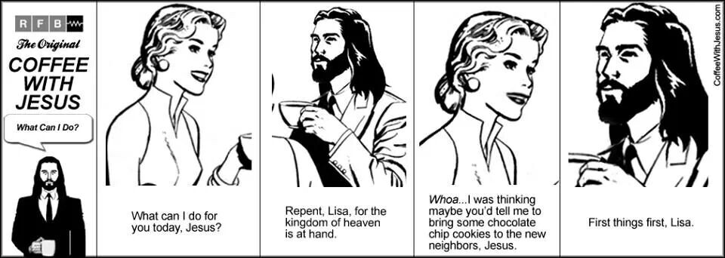
INTRODUCTION
God has much to say about this in the Bible
Things must be done at their proper time
And, in their proper order

Slide 7
INTRODUCTION
God has much to say about this in the Bible
Things must be done at their proper time
And, in their proper order
We, as Christians, need to consider these things
It’ll make our lives easier
We’ll have less frustration
We’ll be a good example for others

Slide 8
Jesus, Our Example
In His youth
Luke 2:41-49 – The family had fulfilled their resp.
Jesus chose to first spend time in the temple

Slide 9
Jesus, Our Example
In His youth
Luke 2:41-49 – The family had fulfilled their resp.
Jesus chose to first spend time in the temple
In His Life
Ministry – John 4:34; 6:38
Sacrifice – Luke 9:51; Matthew 26:39, 42

Slide 10
Jesus, Our Example
In His youth
Luke 2:41-49 – The family had fulfilled their resp.
Jesus chose to first spend time in the temple
In His Life
Ministry – John 4:34; 6:38
Sacrifice – Luke 9:51; Matthew 26:39, 42
In His Death
Hebrews 12:2, etc.

Slide 11
Christians
As Christians, you’re not your own; God is 1st
1 Cor 6:19-20 – you have been bought w/a price
Matt 6:33, 2 Cor. 8:5 – Command/results
You’ve declared God first in your life, now behave like it!

Slide 12
Christians
As Christians, you’re not your own; God is 1st
1 Cor 6:19-20 – you have been bought w/a price
Matt 6:33, 2 Cor. 8:5 – Command/results
You’ve declared God first in your life, now behave like it!
Give God your will first
2 Corinthians 8:12
OT ex: Exodus 35:5; 2 Chr. 29:5 (1 Sam 16:7)

Slide 13
Christians
Clean first the inside
1 Peter 1:22-23 – By obeying the word
Matt 23:26 – Not from the outside in
Phil 4:8; 1 Tim 5:22 – Keep yourself that way

Slide 14
Christians
Clean first the inside
1 Peter 1:22-23 – By obeying the word
Matt 23:26 – Not from the outside in
Phil 4:8; 1 Tim 5:22 – Keep yourself that way
Before you can help others, first…
Matt 7:3 – Speck/log (looking)
Matt 7:4 – Saying
Matt 7:5 – Acting

Slide 15
Christians
Before you “bring your offering,” first…
Matt 5:23-26 (The only place in Scripture…)
For your own good
Romans 12:18 – …with all men.

Slide 16
Christians
Before you “bring your offering,” first…
Matt 5:23-26 (The only place in Scripture…)
For your own good
Romans 12:18 – …with all men.
In prayers, first…
1 Timothy 2:1-4 - …all men…
…Including leaders…so that
Enemies – Matthew 5:44

Slide 17
Christians
John 1:40-42 – He found first…
Notice: first after following Him (verse 39)
This must be a top priority for us, even today
1 Timothy 4:16; 2 Timothy 2:2

Slide 18
Christians
John 1:40-42 – He found first…
Notice: first after following Him (verse 39)
This must be a top priority for us, even today
1 Timothy 4:16; 2 Timothy 2:2
In our responsibilities (1 Timothy 5:3-8)
With our own family
In our jobs (2 Thessalonians 3:10)
Ephesians 4:28 etc.

Slide 19
CONCLUSION
We could go on and on
You’ll see a pattern/progression here
Spiritual before material
Others before self
God above all
Ask yourself “Am I putting first things first?”

Slide 20
CONCLUSION
We could go on and on
You’ll see a pattern/progression here
Spiritual before material
Others before self
God above all
Ask yourself “Am I putting first things first?”
Grow through practice (Hebrews 5:13-14)
Good v bad is relatively easy
Good v Better is often more difficult

Slide 21
Are YOU a Christian?
Hear
Believe
Repent
Confess
Be Baptized
Continue Faithfully
Romans 10:17
Mark 16:16
Acts 2:38
Acts 22:16
Mark 16:16
Hebrews 10:38

