Slide 1
Pornography: Trapped in The Net

Slide 2
The Facts of Life
        Where did you learn the facts of life? From God? (Everything God made is “good”.)
        From the world? (Satan tried to make “good” things perverted.)

Slide 3
First listen to God on this:
Works of the flesh (Gal. 5:19-21)
Without natural affection (Rom. 1:31,32)
Looking to lust (Matt. 5:27-30)
Eyes full of adultery…cannot cease from sin (II Pet. 2:14)
“Evil men and seducers shall was worse and worse.” (II Tim. 3:13)
“Entice unsteadfast souls” (II Peter 2:12-22)

Slide 4
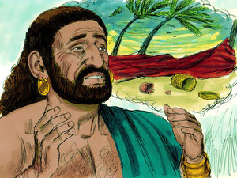
Job’s covenant
Job 31:1-4 – “I have made a covenant with my eyes not to look upon a maiden.”

Slide 5

10 Types of internet Related
Sex Addicts (After Patrick Carnes, Ph.D.)
Fantasy Sex
Seductive Role Sex
Voyeuristic Sex
Intrusive Sex
Exhibitionism
Sex Trading
Anonymous Sex
Paying For Sex (Prostitution)
Pain Exchange
Exploitive Sex

Slide 6

Internet/Porn Addiction Criteria
Frequent viewing for longer periods than intended
Repeated, unsuccessful attempts to stop, cut back or control behavior
Irritability off-line during period of attempted abstinence

Slide 7

Internet /Porn Addiction Criteria
Escalating sexual behavior-more intense and higher risk
Deceive family and friends to protect internet activity
Committing Illegal Acts online
Jeopardizing or losing relationships, job, education or career

Slide 8
Myths/Denial about Pornography
Justifies Sex with Self and lust
Doesn’t hurt anyone, even me
Helps stimulate marital sex
It’s not real life
Can stop whenever I want
No consequences
Just a game-virtual reality
Satisfies curiosity

Slide 9
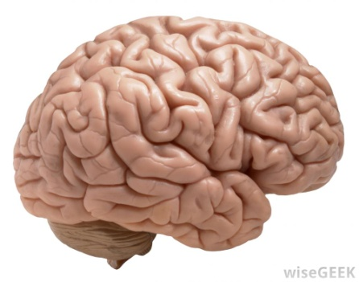
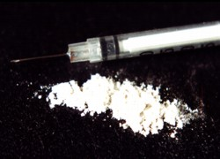
Did you also know…
Viewing pornography releases the same chemicals into your brain that heroin or cocaine does (Hyde& Christenson, 2010).
Consistent exposure to pornography can rewire the brain (Hilton, 2010).
Patients with cybersex/online pornography addictions report a level of stimulation that is difficult to replicate in real life with real people (Carnes & Carnes, 2010)
A study of youth between the ages of 10 and 17 concluded that there is a significant relationship between frequent porn use and feelings of loneliness and major depression
(Ybarra & Mitchell, 2009).

Slide 10
Addicted to Pornography?
Unhealthy Signs
Husband demands wife to be in a certain physical position for intercourse
  Re-enactment (replay) of pornographic materials
  Have X-Rated (XXX) video for sex
Husband demands wife to wear a certain kind of lingerie (“To seduce-tease him”)
  He buys specific pieces of underwear, stockings
Husband is distracted by flash backs of pornographic images while love-making

Slide 11
Addicted to Pornography?
Unhealthy Signs
Sex with Self after marriage (decreased desires)
  Sexual “Anorexia” “Indifference”
Very few or no male friendships
Gets enraged easily or numb emotionally
  Polarized emotional expression vs. full-range
    Happy to sad vs. anger to numbness
    Numbness to dissociated vs. euphoria to numbness
Rigidity & inflexibility
Telling half-truths and lies to cover-up

Slide 12
Addicted to Pornography?
Unhealthy Signs
Compulsive (Uncontrolled) “Cyber-Porn” use
  Chat Room visits online at work or after bedtime
  Rendezvous-meetings via chat room & email
  Sex for hire experiences: Strip Clubs, Prostitutes
Compulsive (Ritualistic) “Tele-Porn “ use
  Astoundingly high phone bills
Unexplained hotel bills, sex toys, wigs & underwear found in storage or trunk of car
Financial-legal problems: Bankruptcy

Slide 13
Role of Pornography
Safe Relationships
Power over the image
No rejection
Replaces real relationships-too difficult/complex
Stimulation because real life is stressful, difficult, boring, or unhappy

Slide 14
Addiction Cycle
Craving-Tension
Visual Triggers
Pain Repression
Let Down
The Vow
Fantasy
Hunt
Connection
Action
Fulfillment
Addiction Cycle

Slide 15
The Inner Conflict of Addiction
The addicted person is ambivalent because:
Sexual Addiction is both pleasurable and destructive
Sexual Addiction is accepted by the non-Christian world but not by God
Sexual Addiction is pleasurable and yet over time takes over the mind’s neurotransmitters
The sex addict can justify their use of pornography and yet know in their heart it is wrong for them

Slide 16
Impact of Pornography
Danger to Society
  86% of CONVICTED RAPISTS confessed to regular exposure to pornography
  57% of CONVICTED RAPISTS tried to re-enact pornographic images
  51% of male STUDENTS exposed to violent pornography indicated likelihood of raping women

Slide 17
Impact of Pornography
Degrading
  Devalues the “act” of marriage
  Void of Relationship
  Humiliating Sex Acts
  Education/Training in perversion & deviant conduct

Slide 18
Impact of Pornography
Damaging To Marriage
  Creates unrealistic demands on wife/husband
  Compare images to wife/husband’s body
  Anger with wife/husband
  Pornographic image relationship takes place of intimacy with wife/husband
  Decreased interest in sexual fulfillment with wife/husband
  Can decrease interest in sex with marriage partner

Slide 19
Impact of Pornography
Destructive to the User
  Can lead to social isolation
  Loss of family
  Loss of job
  Increased instances of depression
  Increased paranoia

Slide 20
Impact of Pornography
Destructive to Users
4 Step progression
  Addiction-Stimulant
  Escalation-Increased Around Potential
  Desensitization-Dulled Senses
  Acting out sexually-Increased Activity

Slide 21

The Role of Sex With Self
Self Soothing
Release of Tension
Release of Stress
Means to alter a bad mood
A way to punish someone
An escape from difficult relationships
An escape from boredom
Chasing the orgasmic high

Slide 22
Spiritual Impact
God intends sexual expression to be only in the marriage relationship
Sexuality is not a selfish act, it’s purpose is to build up the marriage relationship
Pornography is a form of infidelity/adultery against a marital partner

Slide 23
Spiritual Impact
Porn and self stimulation are disrespectful uses of the temple of the Holy Spirit (Rom. 12:1-2, Gen. 38:9)
Self stimulation is devaluing the seed of life
Porn and self stimulation increase guilt and shame in relating to God

Slide 24
Spiritual Impact
“For this is the will of God, even your sanctification, that you abstain from fornication; that each one of you know how to possess himself of his own vessel and sanctification and honor, not in the passion of lust, even as the Gentiles who know not God; that no man transgress and wrong his brother in the matter: because the Lord is an avenger in all these things, as we forewarned you.” (1 Thessalonians 4:3-6)

Slide 25
Spiritual Impact
“Flee fornication, every sin that a man does is without the body; but he that commits fornication sins against his own body…” 1 Corinthians 6:18
Turn to Matthew 5:27-32, especially verses 29-30 (note the progression from lust to divorce)

Slide 26
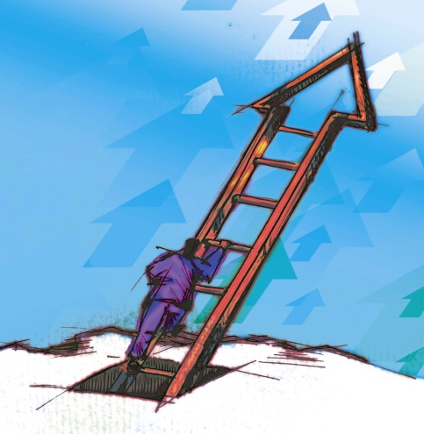
Impact of Pornography
Destructive to Users
4 Step progression
  Addiction-Stimulant
  Escalation-Increased Around Potential
  Desensitization-Dulled Senses
  Acting out sexually-Increased Activity

Slide 27

Pornography Impact on Women in Marriage

Slide 28


The Spiritual Union of Marriage
GOD
One Spirit
One Flesh

Slide 29


The Other Woman
Husband Pornography Wife

Slide 30


Infidelity/The Affair
GOD
Divided
Spirit
Porn Image

Slide 31
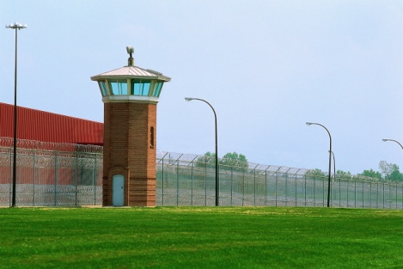


The Unknown
Prison

Slide 32
Stages of Healing
Shock
Grief
Repair
Growth
(Source: Patrick Carnes, PhD; Melvin w. Wong, PhD)

Slide 33
Level 1 of Addiction
Acting Out
  Mind can easily access images to re-live
  Pornography, fantasy and sex with self
  Preoccupation with protecting personal time
Relationship Intrusion
  Few friendships
  Husbands compare wife to idol of pornography
  Same sex relationships only with those of attraction (only few measure up)

Slide 34
Level 2 of Addiction
Gets enraged easily or numb emotionally
  Polarized emotional expression vs. full-range
    Happy to sad vs. anger to numbness
    Numbness to dissociated vs. euphoria to numbness
Rigidity & inflexibility
Compulsive acting out
Telling half-truths and lies to cover-up acting out

Slide 35
Level 2 of Addiction (cont)
Sex with self after marriage (decreased desires)
  Sexual “anorexia” indifference”
Very few or no male friendships
Spending 10% or more of income on stimulants (cyber porn, phone porn)

Slide 36
Level 3 of Addiction
Compulsive (Uncontrolled) “Cyber Porn” use
  Chat Room visits online at work or after bedtime
  Rendezvous-meetings via chat room & email
  Sex for hire experiences: Strip Clubs, Prostitution
Compulsive (Ritualistic) “Tele-Porn” use
  Astoundingly high phone bills

Slide 37
Level 3 of Addiction
Unexplained hotel bills, condoms, wigs & underwear found in storage or trunk of car
Loss of job due to acting out in office
Financial-legal problems: Bankruptcy

Slide 38
Addictions Tend to Travel Together
Chemical Dependency (42%)
Eating Disorders (38%)
Compulsive Working (28%)
Compulsive Spending (26%)
Compulsive Gambling (5%)

Slide 39

Why Sexual Addiction?
Needs for Arousal
Life is Boring
Gambling
Sex
Stimulant Drugs
High-Risk Behaviors

Slide 40

Why Sexual Addiction?
Needs for Satiation
Life is Not Satisfying-Unhappy
Sex
Over-Eating (Bulimia-Binging)
Depressant Drugs (Marijuana)
Narcotic Drugs (Anesthetic effect)
Alcohol

Slide 41
Why Sexual Addiction?
Needs for Fantasy
Reality is too Hard: Need a Quick Escape
Voyeuristic Sex: Intelligent fantasy & Routine
Psychedelic Drugs: LSD
Marijuana
Mystic/Artistic
Preoccupation

Slide 42
The Addiction
(Modified from Patrick Carnes, Ph.D. & Steven Arterburn, M.S.)
Craving –tension-urge to get emotionally intimate with others
Visual Triggers-Mental-Emotional-
Pain Repression with immediate Sexual Longing

Slide 43
The Addiction
(Modified from Patrick Carnes, Ph.D. & Steven Arterburn, M.S.)
Fantasy Development-Planning Begins (The Thrill begins)
The Hunt (The Intrigue)

Slide 44
The Addiction
(Modified from Patrick Carnes, Ph.D. & Steven Arterburn, M.S.)
The Connection “Rush” Altered state of awareness
The Act Under-Control: Impulsivity: Binge
The Fulfillment Orgasm: Feeling Dissociation

Slide 45
The Addiction
(Modified from Patrick Carnes, Ph.D. & Steven Arterburn, M.S.)
The Let-Down Self-Blame: Numbness
The Vow Over-Control: Compulsivity: Rigidity
The Cycle Returns again (Deprivation Sets-In)

Slide 46
Addiction Cycle
Craving-Tension
Visual Triggers
Pain Repression
Let Down
The Vow
Fantasy
Hunt
Connection
Action
Fulfillment
Where is the cycle broken?
Addiction Cycle

Slide 47
Breaking the Pornography- Sex with Self Cycle
Come to your own assistance-You are responsible to get help. You are not likely to do it on your own!
Get help
  Confess and trust brothers/sisters/elders/church leaders to keep you accountable
  Enter a treatment program/12 step, live-in program
  Be honest with yourself and be ready to address painful issues
Therapy and accountability programs simultaneously produce higher success rates
Confront the issue

Slide 48
Breaking the Pornography-Sex with Self Cycle
Necessary Changes
  Beliefs about sex, intimacy and family
  Beliefs about addiction
  Core beliefs about self and relationships
  Coming to terms with pain in your past
  Learning to grieve losses in life
  Determination to change
  A new love and respect for self
  Maladaptive Roles the family has adopted

Slide 49
Warm-Up Observations
Pornography has a damaging effect on the user, their human relationships and society, and relationships with God
Pornography and Sex with Self are difficult to stop because they are driven by pain and the ambivalence of participant

Slide 50

Warm-Up Observations
The use of Pornography must increase in risk behavior in order to sustain pleasure, so the compulsion takes on a life of its own.
Addiction is a compromised life of fulfillment

Slide 51
Self-Help Group resources
SA: Sexaholics anonymous
www.sa.org (615) 331-6230
SLAA: Sex Love Addicts Anonymous
EA: Emotions Anonymous
(510) 471-8894
CODA: Codependents Anonymous
(415) 905-6331
WWW.ChristianMentalHealth.com

Slide 52
Getting Help
Sex and Love Addicts Anonymous (SLAA)
  P.O. Box 119, New Town Branch, Boston MA 02258 617-332-1954
Sex Addicts Anonymous (SAA) SA.ORG
  P.O. Box 3038 Minneapolis, MN 55403 612-339-0217
Sexual Compulsives Anonymous (SCA)
  P.O. Box 1585, Old Chelsea Station, NY, NY 10011 212-439-1123
National Council on Sexual Addictions, INC
  P.O. Box 20249, Wickenburg, AZ 85358 602-684-7919
Sexaholics Anonymous (SA)
  P.O. Box 300 Simi Valley, CA 93062 805-581-3343
Emotions Anonymous (EA) 510-471-8864

Slide 53
God’s Views on Sex outside of Marriage (OT)
Death Penalty for:
Incest: Lev. 18:1-18
Adultery: Lev. 19-22
Rape: Deut. 22:22-29
Whoredom: Ex. 22:16,17; Deut. 23:17
Bestiality: Lev. 20:15, 16
Sodomy: Lev. 20:12
Non-virgin bride: Deut. 22:13-21
“Thou shalt not commit adultery” (Ex. 20)

Slide 54
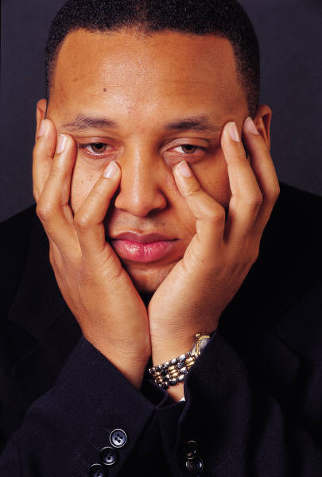
The Fantasy is not the Reality
Consider the bad advice of Jonadab (II Sam. 12:2-15)
Nobody is the same after a sexual sin.

Slide 55
New Testament
Lust: Matt. 5:27-30
Fornication: Matt. 5:32; 15:29; Rom. 1:29; I Cor. 6:9
Adultery: Rom. 13:9
Lasciviousness: I Pet. 4:3-4
Such like: Gal. 5:21
Concept of “bastard”: Heb. 12:8
Whoremonger: I Tim. 1:9-11; Heb. 13:4
Sodomy: Rom. 1:26-28; 31-32
Flee fornication: I Cor. 6:18-20
Possess your vessel in honor: I Thess. 4:3-8

Slide 56
WHY?

