Slide 1
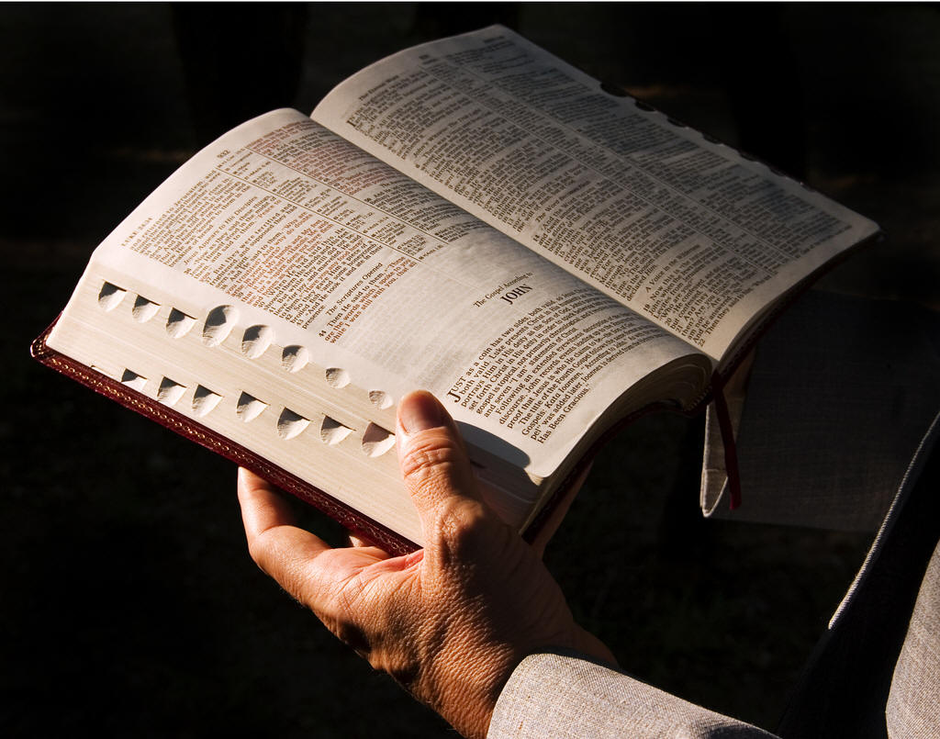
Acts 2 – Answering False Teaching
- part 2
2 Peter 1:19-21

Slide 2
INTRODUCTION
You may be wondering:
The church was just established!
There wasn’t enough time for error, yet!

Slide 3
INTRODUCTION
You may be wondering:
The church was just established!
There wasn’t enough time for error, yet!
Isn’t it amazing?
God answers religious error BEFORE it occurs
The word of God is the sword of the Spirit (Ephesians 6:17)
Again, we see the foreknowledge of God

Slide 4
INTRODUCTION
You may be wondering:
The church was just established!
There wasn’t enough time for error, yet!
Isn’t it amazing?
God answers religious error BEFORE it occurs
The word of God is the sword of the Spirit (Ephesians 6:17)
Again, we see the foreknowledge of God
Let’s look at some false doctrine answered in Acts 2

Slide 5
Baptism of the Holy Spirit
Acts 2:1-4

Slide 6
Baptism of the Holy Spirit
Acts 2:1-4
When the day of Pentecost had come, ____ were all together in one place. And suddenly there came from heaven a noise like a violent rushing wind, and it filled the whole house where ____ were sitting. And there appeared to ____ tongues as of fire distributing themselves, and they rested on each one of ____. And ____ were all filled with the Holy Spirit and began to speak with other tongues, as the Spirit was giving ____ utterance.

Slide 7
Baptism of the Holy Spirit
Acts 2:1-4
Who are “they”?
All the approximately 120 disciples from 1:15?
Only the Apostles?

Slide 8
Baptism of the Holy Spirit
Acts 2:1-4
Who are “they”?
All the approximately 120 disciples from 1:15?
Only the Apostles?
The nearest antecedent is in 1:26
Last verse of chapter 1 (remember, the Bible was not written in chapters and verses)
And they drew lots for them, and the lot fell to Matthias; and he was added to the eleven apostles.

Slide 9
Baptism of the Holy Spirit
Acts 2:1-4
When the day of Pentecost had come, they were all together in one place. And suddenly there came from heaven a noise like a violent rushing wind, and it filled the whole house where they were sitting. And there appeared to them tongues as of fire distributing themselves, and they rested on each one of them. And they were all filled with the Holy Spirit and began to speak with other tongues, as the Spirit was giving them utterance.

Slide 10
Baptism of the Holy Spirit
When the day of Pentecost had come, the Apostles were all together in one place.

Slide 11
Baptism of the Holy Spirit
When the day of Pentecost had come, the Apostles were all together in one place. And suddenly there came from heaven a noise like a violent rushing wind, and it filled the whole house where the Apostles were sitting. And there appeared to the Apostles tongues as of fire distributing themselves, and they rested on each one of the Apostles. And the Apostles were all filled with the Holy Spirit and began to speak with other tongues, as the Spirit was giving the Apostles utterance.

Slide 12
Baptism of the Holy Spirit
Acts 11:15
Peter had been given the keys to the Kingdom by Jesus (Matthew 16:19)

Slide 13
Baptism of the Holy Spirit
Acts 11:15
Peter had been given the keys to the Kingdom by Jesus (Matthew 16:19)
Later in Acts 2, he gave entrance to the first Jews
In Acts 10, we read about the first Gentiles baptized, Cornelius and his household

Slide 14
Baptism of the Holy Spirit
Acts 11:15
Peter had been given the keys to the Kingdom by Jesus (Matthew 16:19)
Later in Acts 2, he gave entrance to the first Jews
In Acts 10, we read about the first Gentiles baptized, Cornelius and his household
Peter is called to give an account of his actions
As part of his account he relates how “the Holy Spirit came upon us at the beginning”

Slide 15
Baptism of the Holy Spirit
Acts 11:15
Peter had been given the keys to the Kingdom by Jesus (Matthew 16:19)
Later in Acts 2, he gave entrance to the first Jews
In Acts 10, we read about the first Gentiles baptized, Cornelius and his household
Peter is called to give an account of his actions
As part of his account he relates how “the Holy Spirit came upon us at the beginning”
Verse 16 – references 1:5 (the Apostles)

Slide 16
The Kingdom
Did you know that many Jews are still waiting for the Messiah to come?
They rejected Jesus as the Messiah, so they still wait for Someone who has already come
They come up with all sorts of convoluted explanations and theories to explain away the simple truth

Slide 17
The Kingdom
Did you know that many Jews are still waiting for the Messiah to come?
They rejected Jesus as the Messiah, so they still wait for Someone who has already come
They come up with all sorts of convoluted explanations and theories to explain away the simple truth
The Jews don’t have a lock on this type of error
Many people commit the same error regarding the Kingdom

Slide 18
The Kingdom
Many people commit the same error regarding the Kingdom
They reject the fact that the church and the Kingdom on earth are one and the same
So they still wait for something that has already come

Slide 19
The Kingdom
Many people commit the same error regarding the Kingdom
They reject the fact that the church and the Kingdom on earth are one and the same
So they still wait for something that has already come
They come up with all sorts of convoluted explanations and theories to explain away the simple truth

Slide 20
The Kingdom
Did you know?
All passages before Pentecost refer to the Kingdom as being future
All passages after Pentecost refer to the Kingdom as already established
Colossians 1:13
Hebrews 12:28
Revelation 1:6, 9

Slide 21
The Kingdom
Mark 1:15
After John had been taken into custody
“The time is fulfilled…
The Kingdom of God is at hand (has come near)”

Slide 22
The Kingdom
Mark 1:15
After John had been taken into custody
“The time is fulfilled…
The Kingdom of God is at hand (has come near)”
Mark 9:1
“Some of those who are standing here…
…after it has come with power.”

Slide 23
The Kingdom
Acts 1:6 – the question is about the Kingdom
Verse 7 – Deuteronomy 29:29
Verse 8 - …but you will receive power when the Holy Spirit has come upon you…

Slide 24
To Come…
Praying for salvation – the Sinner’s Prayer
Acts 2:38 – FOR the forgiveness of sins…
One church is as good as another
Speaking in tongues

Slide 25
CONCLUSION
Acts 2 tells us of the establishment of the church
The promise fulfilled
The pattern starts to develop
By studying it, we learn many things
Including how to answer religious error
God gave us the sword, we have to use it

Slide 26
Are YOU a Christian?
Hear
Believe
Repent
Confess
Be Baptized
Continue Faithfully
Romans 10:17
Mark 16:16
Acts 2:38
Acts 22:16
Mark 16:16
Hebrews 10:38

