Slide 1
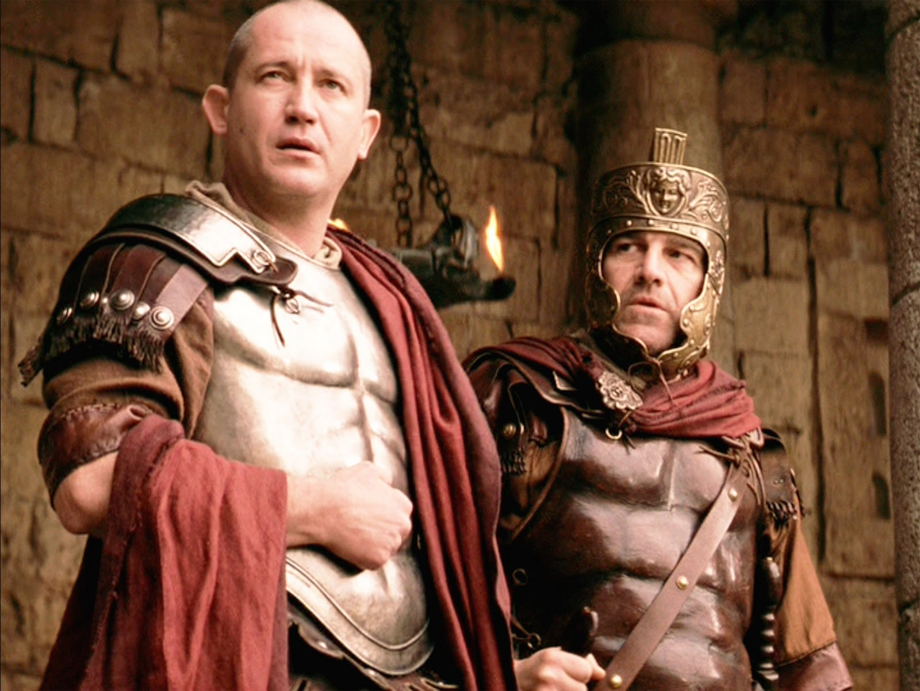
What Is Truth?
John 8:33-38

Slide 2
INTRODUCTION
Q? – How many legs does a dog have, if you count his tail as a leg?

Slide 3
INTRODUCTION
Q? – How many legs does a dog have, if you count his tail as a leg?
A: - He still only has 4 legs. Counting his tail as a leg doesn’t make it so.
– Abraham Lincoln

Slide 4
INTRODUCTION
Q? – How many legs does a dog have, if you count his tail as a leg?
A: - He still only has 4 legs. Counting his tail as a leg doesn’t make it so.
– Abraham Lincoln
People have struggled with the concept of truth since the Garden if Eden

Slide 5
A few more
The further a society drifts from truth, the more it will hate those that speak it.
– George Orwell

Slide 6
A few more
The further a society drifts from truth, the more it will hate those that speak it.
– George Orwell
The truth is like a lion – you don’t have to defend it. Let it loose – it will defend itself.
– Augustine

Slide 7
A few more
The further a society drifts from truth, the more it will hate those that speak it.
– George Orwell
The truth is like a lion – you don’t have to defend it. Let it loose – it will defend itself.
– Augustine
Even if you are a minority of one, truth is truth – Mahatma Gandhi

Slide 8
A few more
Truth is like the sun – you can shut it out for a time, but it ain’t goin’ away.
– Elvis Presley

Slide 9
A few more
Truth is like the sun – you can shut it out for a time, but it ain’t goin’ away.
– Elvis Presley
Truth is truth – even if no one believes it; a lie is a lie – even if everyone believes it.
– Anonymous

Slide 10
A few more
Truth is like the sun – you can shut it out for a time, but it ain’t goin’ away.
– Elvis Presley
Truth is truth – even if no one believes it; a lie is a lie – even if everyone believes it.
– Anonymous
Better to be slapped with the truth than kissed with a lie. – Russian Proverb

Slide 11
God’s Truth
Having noted all that…

Slide 12
God’s Truth
Having noted all that…
This will not be a philosophical lesson on truth
Subjective/objective
“My truth” versus “Your truth”
All truth is relative; there are no absolutes
All roads lead to Heaven

Slide 13
God’s Truth
Having noted all that…
This will not be a philosophical lesson on truth
Subjective/objective
“My truth” versus “Your truth”
All truth is relative; there are no absolutes
All roads lead to Heaven
This sermon is based on God’s truth as revealed in the Bible

Slide 14
The Gospel
The “message of truth” (Ephesians 1:13)
Truth is its primary characteristic

Slide 15
The Gospel
The “message of truth” (Ephesians 1:13)
Truth is its primary characteristic
Salvation was
Conceived by the “God of truth” (Psalm 31:5)
Purchased by the Son, Who is truth (John 14:6)
Guided by the Spirit of truth (John 16:13)
Sets us free (John 8:32)

Slide 16
The Gospel
The “message of truth” (Ephesians 1:13)
Truth is its primary characteristic
Salvation was
Conceived by the “God of truth” (Psalm 31:5)
Purchased by the Son, Who is truth (John 14:6)
Guided by the Spirit of truth (John 16:13)
Sets us free (John 8:32)
Believers are
People of the truth (John 18:37)
Who worship in spirit and in truth (John 4:24)
Obey the word of truth (John 17:17)

Slide 17
2 Truths Co-exist
1. God has a “perfect will” for us

Slide 18
2 Truths Co-exist
1. God has a “perfect will” for us
2 Peter 3:9; 1 Timothy 2:4; John 3:16
Revelation 2:21a – even for “Jezebel”
His “elective purpose”

Slide 19
2 Truths Co-exist
1. God has a “perfect will” for us
2 Peter 3:9; 1 Timothy 2:4; John 3:16
Revelation 2:21a – even for “Jezebel”
His “elective purpose”
As opposed to His “permissive will”
Revelation 2:21b; etc.

Slide 20
2 Truths Co-exist
1. God has a “perfect will” for us
2 Peter 3:9; 1 Timothy 2:4; John 3:16
Revelation 2:21a – even for “Jezebel”
His “elective purpose”
As opposed to His “permissive will”
Revelation 2:21b; etc.
He reveals that purpose to us throughout the Scriptures

Slide 21
2 Truths Co-exist
2. Mankind must respond to God’s truths
Freely and individually

Slide 22
2 Truths Co-exist
2. Mankind must respond to God’s truths
Freely and individually
“Not responding” is the wrong response (Matthew 12:30; John 3:17-18)
There is no fence to straddle; no neutral position

Slide 23
2 Truths Co-exist
2. Mankind must respond to God’s truths
Freely and individually
“Not responding” is the wrong response (Matthew 12:30; John 3:17-18)
There is no fence to straddle; no neutral position
Acts 4:12 – “…for there is no other name under Heaven that has been given among men by which we must be saved.”

Slide 24
2 Truths Co-exist
2. Mankind must respond to God’s truths
Freely and individually
“Not responding” is the wrong response (Matthew 12:30; John 3:17-18)
There is no fence to straddle; no neutral position
Acts 4:12 – “…for there is no other name under Heaven that has been given among men by which we must be saved.”
Living faith is our only acceptable response to God’s offer of salvation

Slide 25
CONCLUSION
False ideas (lies) about truth lead to false ideas about Heaven
Truth is absolute
God is the Creator and Holder of all truth
God’s word is truth
Jesus is the manifestation of truth
If we want to know the truth, God will give it to us

Slide 26
Are YOU a Christian?
Hear
Believe
Repent
Confess
Be Baptized
Continue Faithfully
Romans 10:17
Mark 16:16
Acts 2:38
Acts 22:16
Mark 16:16
Hebrews 10:38

