Slide 1
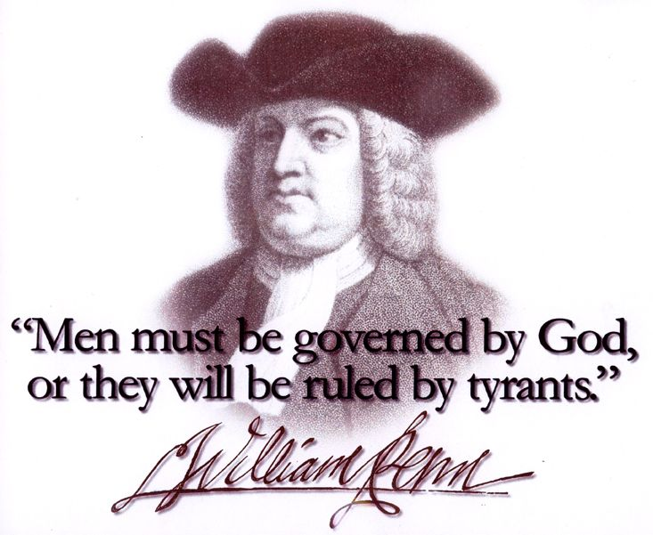
“We Must Obey God…”
Acts 5:25-29

Slide 2
INTRODUCTION
Jesus refused to follow spurious rules of the religious leaders of His day
Sabbath healing (Mark 3:1-6)
Ceremonial washings (Matthew 15:2)
Associating with Gentiles, sinners, etc.
Inner/outer applications of God’s laws (Matt 5)
Etc.

Slide 3
INTRODUCTION
Jesus refused to follow spurious rules of the religious leaders of His day
Paul wrote many of his epistles from a jail cell
Ephesians, Philippians, Colossians
Philemon
1st c. Christians were persecuted

Slide 4
INTRODUCTION
Jesus refused to follow spurious rules of the religious leaders of His day
Paul wrote many of his epistles from a jail cell
1st c. Christians were persecuted
What if Christians and all those who claim to follow God had stood up…
When prayer was taken out of public schools?
When the Bible was banned?
When abortion was legalized?

Slide 5
Friday, June 26, 2015
“Last Friday, five justices on the Supreme Court overturned the votes of 50 million Americans and demanded that the American people walk away from millennia of history and the reality of human nature. In reaching a decision so lacking in foundation in the text of the Constitution, in our history, and in our traditions, the Court has done serious damage to its own legitimacy. Just as with Roe v. Wade in 1973, the courts will not have the final say on this profound social matter. We cannot lapse into silence but must continue to speak uncompromisingly for the truth about what marriage is, always has been, and always will be: the union of one man and one woman.”

Slide 6
Friday, June 26, 2015
SCOTUS ruled that homosexuals have a constitutionally protected right to be joined in marriage.

Slide 7
Friday, June 26, 2015
SCOTUS ruled that homosexuals have a constitutionally protected right to be joined in marriage.
They found this right in the 14th Amendment
Causing much controversy/uproar

Slide 8
Friday, June 26, 2015
SCOTUS ruled that homosexuals have a constitutionally protected right to be joined in marriage.
They found this right in the 14th Amendment
Causing much controversy/uproar
While proponents claim that Christians still have the right to express their beliefs, Chief Justice Roberts himself, in a dissenting opinion, wrote, in essence, that this will soon NOT be the case.

Slide 9
Friday, June 26, 2015
SCOTUS ruled that homosexuals have a constitutionally protected right to be joined in marriage.
They found this right in the 14th Amendment
Causing much controversy/uproar
While proponents claim that Christians still have the right to express their beliefs, Chief Justice Roberts himself, in a dissenting opinion, wrote, in essence, that this will soon NOT be the case.
Look to Canada, Great Britain, the Netherlands, etc. to see where this is headed

Slide 10
Friday, June 26, 2015
TRADITIONAL MARRIAGE
HOMOSEXUAL MARRIAGE
Created by God
Created by man

Slide 11
Friday, June 26, 2015
TRADITIONAL MARRIAGE
HOMOSEXUAL MARRIAGE
Created by God
Unites both halves of humanity (“completes”, help-mate, both necessary)
Created by man
Only half (redundant) even if one identifies with a diff. sex; “open marriages”

Slide 12
Friday, June 26, 2015
TRADITIONAL MARRIAGE
HOMOSEXUAL MARRIAGE
Created by God
Unites both halves of humanity (“completes”, help-mate, both necessary)
Expression of love
Created by man
Only half (redundant) even if one identifies with a diff. sex; “open marriages”
Expression of lust

Slide 13
Friday, June 26, 2015
TRADITIONAL MARRIAGE
HOMOSEXUAL MARRIAGE
Created by God
Unites both halves of humanity (“completes”, help-mate, both necessary)
Expression of love
Creates life, produces children
Created by man
Only half (redundant) even if one identifies with a diff. sex; “open marriages”
Expression of lust
Cannot produce life, must pervert others to their ways

Slide 14
Friday, June 26, 2015
TRADITIONAL MARRIAGE
HOMOSEXUAL MARRIAGE
Created by God
Unites both halves of humanity (“completes”, help-mate, both necessary)
Expression of love
Creates life, produces children
Stable lifestyle
Created by man
Only half (redundant) even if one identifies with a diff. sex; “open marriages”
Expression of lust
Cannot produce life, must pervert others to their ways
Unstable lifestyle

Slide 15
Friday, June 26, 2015
TRADITIONAL MARRIAGE
HOMOSEXUAL MARRIAGE
Created by God
Unites both halves of humanity (“completes”, help-mate, both necessary)
Expression of love
Creates life, produces children
Stable lifestyle
Demonstrates a respect for God’s ways
Created by man
Only half (redundant) even if one identifies with a diff. sex; “open marriages”
Expression of lust
Cannot produce life, must pervert others to their ways
Unstable lifestyle
Leads to other deviations: NAMBLA, incest, bestiality

Slide 16
Friday, June 26, 2015
TRADITIONAL MARRIAGE
HOMOSEXUAL MARRIAGE
Created by God
Unites both halves of humanity (“completes”, help-mate, both necessary)
Expression of love
Creates life, produces children
Stable lifestyle
Demonstrates a respect for God’s ways
Blessed by God
Created by man
Only half (redundant) even if one identifies with a diff. sex; “open marriages”
Expression of lust
Cannot produce life, must pervert others to their ways
Unstable lifestyle
Leads to other deviations: NAMBLA, incest, bestiality
Condemned by God

Slide 17
Friday, June 26, 2015
Focus on the Family - 9 ways you’re affected
Harms children – study after study
Forced closures of faith-based adoption agencies
Legal/public harassment/fines – businesses

Slide 18
Friday, June 26, 2015
Focus on the Family - 9 ways you’re affected
Harms children – study after study
Forced closures of faith-based adoption agencies
Legal/public harassment/fines – businesses
Parental rights trumped at school, library, etc.
Loss of tax-exempt status–teaching/not marrying
Accrediting, licensing, employment req. affirm.

Slide 19
Friday, June 26, 2015
Focus on the Family - 9 ways you’re affected
Harms children – study after study
Forced closures of faith-based adoption agencies
Legal/public harassment/fines – businesses
Parental rights trumped at school, library, etc.
Loss of tax-exempt status–teaching/not marrying
Accrediting, licensing, employment req. affirm.
Counseling will be banned
Grant exclusions
Freedoms removed – speech, religion

Slide 20
Friday, June 26, 2015
Scriptures
Genesis 1:26-28 – Man is made in God’s image
Genesis 2:15, 21-25 – Marriage instituted

Slide 21
Friday, June 26, 2015
Scriptures
Genesis 1:26-28 – Man is made in God’s image
Genesis 2:15, 21-25 – Marriage instituted
Matthew 19:3-6 – Jesus refers back to Genesis to answer question about marriage
Components – One man, one woman
Permanence – Man cannot separate

Slide 22
Friday, June 26, 2015
Scriptures
Genesis 1:26-28 – Man is made in God’s image
Genesis 2:15, 21-25 – Marriage instituted
Matthew 19:3-6 – Jesus refers back to Genesis to answer question about marriage
Components – One man, one woman
Permanence – Man cannot separate
Eph 5:22-33 – Paul also refers back to Moses
Based on love, not lust
Represents an eternal reality – Christ & His church
Revelation 19-22

Slide 23
Friday, June 26, 2015
What ought we to do?
As a congregation:
Add specific language to our bylaws, as recommended
Continue to pray for this country and its leaders
Be aware of efforts to target/misrepresent us

Slide 24
Friday, June 26, 2015
What ought we to do?
As a congregation:
Add specific language to our bylaws, as recommended
Continue to pray for this country and its leaders
Be aware of efforts to target/misrepresent us
As individual Christians:
Be committed to biblical faith, ethics and definitions
Teach children NOW – many helpful resources available
Be ready for this topic in conversations-affirm the Bible
Be aware of “baiting”
It is an act of love to tell people the truth

Slide 25
CONCLUSION
Romans 13 does not place man’s government on God’s throne

Slide 26
CONCLUSION
Romans 13 does not place man’s government on God’s throne
“The Supreme Court has spoken with a very divided voice on something only the Supreme Being can do – redefin(e) marriage…”
– Mike Huckabee

Slide 27
CONCLUSION
Romans 13 does not place man’s government on God’s throne
“The Supreme Court has spoken with a very divided voice on something only the Supreme Being can do – redefining marriage…”
– Mike Huckabee
SCOTUS did not give us marriage equality, but marriage redefinition
Like redefining “human” to include dogs

Slide 28
CONCLUSION
God is Sovereign
His definition of marriage has not changed
No court can change that truth

Slide 29
CONCLUSION
God is Sovereign
His definition of marriage has not changed
No court can change that truth
However, the government can make our lives harder now
Pray for God’s guidance – personal, national

Slide 30
CONCLUSION
God is Sovereign
His definition of marriage has not changed
No court can change that truth
However, the government can make our lives harder now
Pray for God’s guidance – personal, national
Let your words be seasoned with salt (Col 4:6)

Slide 31
CONCLUSION
God is Sovereign
His definition of marriage has not changed
No court can change that truth
However, the government can make our lives harder now
Pray for God’s guidance – personal, national
Let your words be seasoned with salt (Col 4:6)
VOTE!

Slide 32
Are YOU a Christian?
Hear
Believe
Repent
Confess
Be Baptized
Continue Faithfully
Romans 10:17
Mark 16:16
Acts 2:38
Acts 22:16
Mark 16:16
Hebrews 10:38

