Slide 1
Teachers
John 13:12-13

Slide 2
INTRODUCTION
As we are nearing the end of this series on the organization of the church,
Jesus, the Head of the body
Elders, the leaders of the local congregation

Slide 3
INTRODUCTION
As we are nearing the end of this series on the organization of the church,
Jesus, the Head of the body
Elders, the leaders of the local congregation
Deacons, servants in the church
Preachers, evangelizing and edifying

Slide 4
INTRODUCTION
As we are nearing the end of this series on the organization of the church,
Jesus, the Head of the body
Elders, the leaders of the local congregation
Deacons, servants in the church
Preachers, evangelizing and edifying
…we come to the work of teachers
While this is a generic requirement of all the other positions

Slide 5
INTRODUCTION
As we are nearing the end of this series on the organization of the church,
Jesus, the Head of the body
Elders, the leaders of the local congregation
Deacons, servants in the church
Preachers, evangelizing and edifying
…we come to the work of teachers
While this is a generic requirement of all the other positions
…it is a position in, and of, itself (James 3:1)

Slide 6
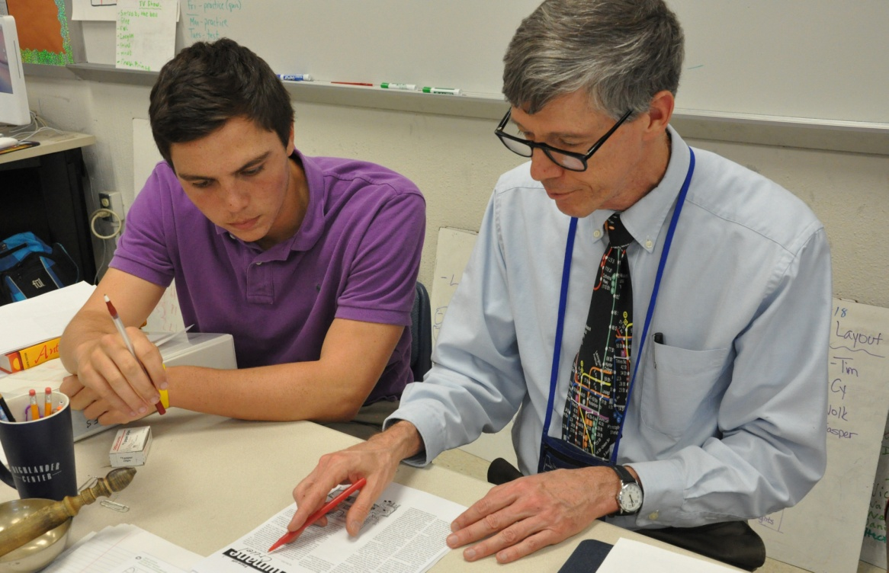
Teachers
“Teachers affect eternity, they can never know the full range of their influence.”
– Henry Brooks Adams

Slide 7
Teachers
“Teachers affect eternity, they can never know the full range of their influence.”
– Henry Brooks Adams
Proverbs 22:6 – Train up (instruct) a child…

Slide 8
Teachers
“Teachers affect eternity, they can never know the full range of their influence.”
– Henry Brooks Adams
Proverbs 22:6 – Train up (instruct) a child…
Teacher: One who:
Instructs
Imparts knowledge
Trains

Slide 9
Teachers
“Teachers affect eternity, they can never know the full range of their influence.”
– Henry Brooks Adams
Proverbs 22:6 – Train up (instruct) a child…
Teacher: One who:
Instructs
Imparts knowledge
Trains
Presupposes ability & knowledge

Slide 10
A Good Quality to Have
Said of God
Isaiah 48:17 – God instructs
John 13:13 – Jesus
John 14:26 – HS would teach the Apostles

Slide 11
A Good Quality to Have
Said of God
Isaiah 48:17 – God instructs
John 13:13 – Jesus
John 14:26 – HS would teach the Apostles
…and His servants
Deuteronomy 32:2; 6:1 – Moses (OT)
2 Timothy 2:2 – faithful Christians (NT)

Slide 12
A Good Quality to Have
Said of God
Isaiah 48:17 – God instructs
John 13:13 – Jesus
John 14:26 – HS would teach the Apostles
…and His servants
Deuteronomy 32:2; 6:1 – Moses (OT)
2 Timothy 2:2 – faithful Christians (NT)
Do you remember your favorite teacher?
Elementary – Spiritual

Slide 13
In the church
Jesus, the Head

Slide 14
In the church
Jesus, the Head
Prophets – Daniel 9:10
Apostles – Matthew 28:20

Slide 15
In the church
Jesus, the Head
Prophets – Daniel 9:10
Apostles – Matthew 28:20
Elders – 1 Timothy 3:2
Deacons -

Slide 16
In the church
Jesus, the Head
Prophets – Daniel 9:10
Apostles – Matthew 28:20
Elders – 1 Timothy 3:2
Deacons -
Preachers – Acts 28:31
Teachers – James 3:1

Slide 17
In the church
Jesus, the Head
Prophets – Daniel 9:10
Apostles – Matthew 28:20
Elders – 1 Timothy 3:2
Deacons -
Preachers – Acts 28:31
Teachers – James 3:1
All – 2 Timothy 2:2; Hebrews 5:12
Parents (Eph. 6:4), older ladies (Titus 2:3-5) , etc.

Slide 18
Because of the great responsibility
James 3:1
Rabbi (Teacher) was a title of honor (John 3:2)

Slide 19
Because of the great responsibility
James 3:1
Rabbi (Teacher) was a title of honor (John 3:2)
Many wanted it (1 Timothy 1:6-8)

Slide 20
Because of the great responsibility
James 3:1
Rabbi (Teacher) was a title of honor (John 3:2)
Many wanted it (1 Timothy 1:6-8)
Hebrews 5:12 - God expects us to be proficient enough with the Scriptures to be able to
Move beyond the basics (milk) of the word

Slide 21
Because of the great responsibility
James 3:1
Rabbi (Teacher) was a title of honor (John 3:2)
Many wanted it (1 Timothy 1:6-8)
Hebrews 5:12 - God expects us to be proficient enough with the Scriptures to be able to
Move beyond the basics (milk) of the word
Give an account of our hope – 1 Peter 3:15
Teach others – 2 Timothy 2:2
Defend ourselves from Satan – Ephesians 6:17

Slide 22
Because of the great responsibility
James 3:1
Rabbi (Teacher) was a title of honor (John 3:2)
Many wanted it (1 Timothy 1:6-8)
Hebrews 5:12 - God expects us to be proficient enough with the Scriptures to be able to
Move beyond the basics (milk) of the word
Give an account of our hope – 1 Peter 3:15
Teach others – 2 Timothy 2:2
Defend ourselves from Satan – Ephesians 6:17
We should all be teachers, but not all Teachers

Slide 23
How?
While we should all strive to be able to teach others about God, some have a greater ability to teach (1 Cor. 12:27-29; Rom. 12:6-7)

Slide 24
How?
While we should all strive to be able to teach others about God, some have a greater ability to teach (1 Cor. 12:27-29; Rom. 12:6-7)
But, there is some common ground
We seek God’s approval – 2 Timothy 2:15
We use God’s word (textbook) – 2 Tim 3:14-17
We must not be hypocritical – Romans 2:21
1st – student; 2nd – doer, 3rd – teacher

Slide 25
Additional Benefits
Beside pleasing God, we grow more. We learn:
10% of what we read
20% of what we hear
30% of what we see

Slide 26
Additional Benefits
Beside pleasing God, we grow more. We learn:
10% of what we read
20% of what we hear
30% of what we see
50% of what we see and hear
70% of what we discuss with others
80% of what we experience personally

Slide 27
Additional Benefits
Beside pleasing God, we grow more. We learn:
10% of what we read
20% of what we hear
30% of what we see
50% of what we see and hear
70% of what we discuss with others
80% of what we experience personally
95% of what we teach others

Slide 28
Additional Benefits
Beside pleasing God, we grow more. We learn:
10% of what we read
20% of what we hear
30% of what we see
50% of what we see and hear
70% of what we discuss with others
80% of what we experience personally
95% of what we teach others
God has designed teaching to “bless both ways”

Slide 29
CONCLUSION
Teaching is a critical part of being a Christian
It takes the gospel to the lost
It edifies those who are in the body
The ability to teach is necessary for every role in the church
God gives His approval to those who teach
And, there are other benefits
Not all can be Teachers, but all should teach

Slide 30
Are YOU a Christian?
Hear
Believe
Repent
Confess
Be Baptized
Continue Faithfully
Romans 10:17
Mark 16:16
Acts 2:38
Acts 22:16
Mark 16:16
Hebrews 10:38

