Slide 1
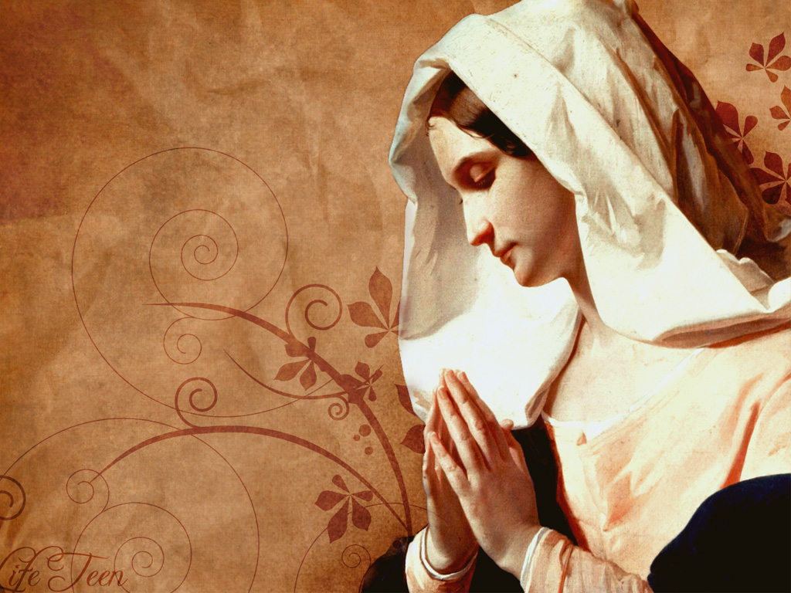
Mary, Mother of Jesus
Luke 1:39-45

Slide 2
INTRODUCTION
I was asked to prepare a study on Mary, the mother of Jesus

Slide 3
INTRODUCTION
I was asked to prepare a study on Mary, the mother of Jesus
As a former Catholic, I know how venerated she is to Catholics
Most family members
A member of the “Holy Name Society”
Prayers to “her” (“she’ll convince Jesus/God”)

Slide 4
INTRODUCTION
I was asked to prepare a study on Mary, the mother of Jesus
As a former Catholic, I know how venerated she is to Catholics
Most family members
A member of the “Holy Name Society”
Prayers to “her” (“she’ll convince Jesus/God”)
They frown upon people “bad mouthing” her

Slide 5
INTRODUCTION
I was asked to prepare a study on Mary, the mother of Jesus
As a former Catholic, I know how venerated she is to Catholics
Most family members
A member of the “Holy Name Society”
Prayers to “her” (“she’ll convince Jesus/God”)
They frown upon people “bad mouthing” her
“Fourth member of the Trinity”; “Queen Mother”

Slide 6
INTRODUCTION
I was asked to prepare a study on Mary, the mother of Jesus
As a former Catholic, I know how venerated she is to Catholics
Most family members
A member of the “Holy Name Society”
Prayers to “her” (“she’ll convince Jesus/God”)
They frown upon people “bad mouthing” her
“Fourth member of the Trinity”; “Queen Mother”
This sermon is the result of that study

Slide 7
INTRODUCTION
A risk that we often run when studying about subjects such as these is that we often don’t sufficiently consider the person being taught
Flippant answers
Jokes
Meat of the word

Slide 8
INTRODUCTION
A risk that we often run when studying about subjects such as these is that we often don’t sufficiently consider the person being taught
Flippant answers
Jokes
Meat of the word
1 Corinthians 9:19-23
Under Law/not under the Law
To save some

Slide 9
Luke 1:26-38
A virgin
Isaiah 7:14 – a prophecy/Matt 1:23 (2 Peter 1:20)

Slide 10
Luke 1:26-38
A virgin
Isaiah 7:14 – a prophecy/Matt 1:23 (2 Peter 1:20)
Virgin – a “young lady” being pregnant is not a sign
…with child…bear a son…Immanuel

Slide 11
Luke 1:26-38
A virgin
Isaiah 7:14 – a prophecy/Matt 1:23 (2 Peter 1:20)
Virgin – a “young lady” being pregnant is not a sign
…with child…bear a son…Immanuel
Luke 1:34 – “How can this be…?”

Slide 12
Luke 1:26-38
A virgin
Isaiah 7:14 – a prophecy/Matt 1:23 (2 Peter 1:20)
Virgin – a “young lady” being pregnant is not a sign
…with child…bear a son…Immanuel
Luke 1:34 – “How can this be…?”
Luke 1:28 – “The Lord is with you.”
Luke 1:30 – “…found favor with God.”

Slide 13
Luke 1:26-38
A virgin
Isaiah 7:14 – a prophecy/Matt 1:23 (2 Peter 1:20)
Virgin – a “young lady” being pregnant is not a sign
…with child…bear a son…Immanuel
Luke 1:34 – “How can this be…?”
Luke 1:28 – “The Lord is with you.”
Luke 1:30 – “…found favor with God.”
Luke 1:38 – Her humility

Slide 14
Mary
Luke 1:47 – “…God my Savior.”

Slide 15
Mary
Luke 1:47 – “…God my Savior.”
There is no evidence to say that this means anything other than the obvious
(Remember 2 Peter 1:20?)
Not flippant/poetic
Not “saving my reputation”

Slide 16
Mary
Luke 1:47 – “…God my Savior.”
There is no evidence to say that this means anything other than the obvious
(Remember 2 Peter 1:20?)
Not flippant/poetic
Not “saving my reputation”
1 Timothy 1:1; 2:3; Titus 2:10; 3:4; etc.

Slide 17
Mary
Luke 1:47 – “…God my Savior.”
There is no evidence to say that this means anything other than the obvious
(Remember 2 Peter 1:20?)
Not flippant/poetic
Not “saving my reputation”
1 Timothy 1:1; 2:3; Titus 2:10; 3:4; etc.
Conclusion: Mary had need of a Savior, like all the rest of us do.

Slide 18
Mary
Luke 1:47 – “…God my Savior.”
There is no evidence to say that this means anything other than the obvious
(Remember 2 Peter 1:20?)
Not flippant/poetic
Not “saving my reputation”
1 Timothy 1:1; 2:3; Titus 2:10; 3:4; etc.
Conclusion: Mary had need of a Savior, like all the rest of us do.
This contradicts doctrines we’ll look at

Slide 19
Matthew 1:18-25
Verse 18
Betrothed/put her away – In 1st c. Jewish culture, a betrothal was almost as binding as a marriage (however, not consummated)

Slide 20
Matthew 1:18-25
Verse 18
Betrothed/put her away – In 1st c. Jewish culture, a betrothal was almost as binding as a marriage (however, not consummated)
Someone “unfaithful” could be “divorced”
If betrothed died, you would be a widow(er)

Slide 21
Matthew 1:18-25
Verse 18
Betrothed/put her away – In 1st c. Jewish culture, a betrothal was almost as binding as a marriage (however, not consummated)
Someone “unfaithful” could be “divorced”
If betrothed died, you would be a widow(er)
…by the Holy Spirit
The same God who miraculously gave life to the 1st Adam
Now, miraculously conceived the second Adam

Slide 22
Matthew 1:18-25
v 25 - …kept her a virgin until she gave birth…

Slide 23
Matthew 1:18-25
v 25 - …kept her a virgin until she gave birth…
Luke 2:7 – “firstborn”, not “only”
John 3:16 – …His only-begotten Son…

Slide 24
Matthew 1:18-25
v 25 - …kept her a virgin until she gave birth…
Luke 2:7 – “firstborn”, not “only”
John 3:16 – …His only-begotten Son…
Hence, God’s only-begotten was Mary’s firstborn

Slide 25
Matthew 1:18-25
v 25 - …kept her a virgin until she gave birth…
Luke 2:7 – “firstborn”, not “only”
John 3:16 – …His only-begotten Son…
Hence, God’s only-begotten was Mary’s firstborn
Mathew 13:54-56
…the carpenter’s son – referring to earthly family
…mother Mary

Slide 26
Matthew 1:18-25
v 25 - …kept her a virgin until she gave birth…
Luke 2:7 – “firstborn”, not “only”
John 3:16 – …His only-begotten Son…
Hence, God’s only-begotten was Mary’s firstborn
Mathew 13:54-56
…the carpenter’s son – referring to earthly family
…mother Mary
Brothers: James, Joseph, Simon, Judas
Sisters (plural), “all” – 2, possibly 3 or more

Slide 27
Her Changing Relationship
Mary was, and always will be, the mother of Jesus

Slide 28
Her Changing Relationship
Mary was, and always will be, the mother of Jesus
But, notice how her relationship to her Son changes over the years (like many mothers)

Slide 29
Her Changing Relationship
Mary was, and always will be, the mother of Jesus
But, notice how her relationship to her Son changes over the years (like many mothers)
1. Mother
Birth
Luke 2:22-33 - …present Him to the Lord (1st born) at the temple, sacrifice (turtle dove = poverty)
Matthew 2:13-23 – danger to Child, escape to Egypt, return to Nazareth

Slide 30
Her Changing Relationship
Mary was, and always will be, the mother of Jesus
But, notice how her relationship to her Son changes over the years (like many mothers)
2. “Whatever He says to you, do it.”
Cana – 1st miracle
After Jesus’ baptism
Apparently has some authority with the servants?

Slide 31
Her Changing Relationship
Mary was, and always will be, the mother of Jesus
But, notice how her relationship to her Son changes over the years (like many mothers)
2. “Whatever He says to you, do it.”
Cana – 1st miracle
After Jesus’ baptism
Apparently has some authority with the servants?
3. Matthew 12:46-50
Jesus is now emphasizing His spiritual family

Slide 32
Her Changing Relationship
Mary was, and always will be, the mother of Jesus
But, notice how her relationship to her Son changes over the years (like many mothers)
4. John 19:25-27 – Jesus on the cross
Jesus is now responsible for His mother
He passes that responsibility on to His disciple, John

Slide 33
Her Changing Relationship
Mary was, and always will be, the mother of Jesus
But, notice how her relationship to her Son changes over the years (like many mothers)
4. John 19:25-27 – Jesus on the cross
Jesus is now responsible for His mother
He passes that responsibility on to His disciple, John
5. Acts 1:12-14
Mary and Jesus’ (half)brothers wait w/ the disciples
She is now a follower of His

Slide 34
Her Changing Relationship
Mary was, and always will be, the mother of Jesus
But, notice how her relationship to her Son changes over the years (like many mothers)
She went from
Giving birth to Him and caring for Him
To being with His disciples on the day of Pentecost

Slide 35
Her Changing Relationship
Mary was, and always will be, the mother of Jesus
But, notice how her relationship to her Son changes over the years (like many mothers)
She went from
Giving birth to Him and caring for Him
To being with His disciples on the day of Pentecost
This is the last we read about her in the Bible

Slide 36
Many Doctrines Have Arisen
Perpetual Virgin
Starting around 2nd century
Scriptures referring to brothers, sisters are symbolic, or referring to cousins or half-brothers by Joseph’s previous marriage
We see how one false doctrine begets more
Many who take this view do so because sexual relations are considered sinful, even in marriage (cf Hebrews 13:4)
Rej. pl. truth & twisting Scriptures (2 P 3:16-18)

Slide 37
Many Doctrines Have Arisen
Mother of God
Reasoning:
Mother of Jesus; Jesus is God
Hence, mother of God

Slide 38
Many Doctrines Have Arisen
Mother of God
Reasoning:
Mother of Jesus; Jesus is God
Hence, mother of God
Error:
Jesus is the incarnation of the Word (of the Trinity)
John 1:1-3; 14

Slide 39
Many Doctrines Have Arisen
Mother of God
Reasoning:
Mother of Jesus; Jesus is God
Hence, mother of God
Error:
Jesus is the incarnation of the Word (of the Trinity)
John 1:1-3; 14
God is eternal (Psalm 90:2) having no beginning or end

Slide 40
Many Doctrines Have Arisen
Mother of God
Reasoning:
Mother of Jesus; Jesus is God
Hence, mother of God
Error:
Jesus is the incarnation of the Word (of the Trinity)
John 1:1-3; 14
God is eternal (Psalm 90:2) having no beginning or end
The Word emptied Himself and became man (Philippians 2:5-8; Hebrews 2:9-15. etc.)
His divine nature (God) needed no mother

Slide 41
Many Doctrines Have Arisen
Intervention of Mary
She has been elevated to a “Queen Mother of Heaven”
Jesus and the HS intercede for us

Slide 42
Many Doctrines Have Arisen
Intervention of Mary
She has been elevated to a “Queen Mother of Heaven”
Jesus and the HS intercede for us
Worship of Mary
Related to error listed above
We shouldn’t worship mankind/angel; only God

Slide 43
Many Doctrines Have Arisen
Intervention of Mary
She has been elevated to a “Queen Mother of Heaven”
Jesus and the HS intercede for us
Worship of Mary
Related to error listed above
We shouldn’t worship mankind/angel; only God
Assumption
Compared to Enoch, Elijah
No Scripture to support this

Slide 44
CONCLUSION
Mary was a special woman chosen by God to give birth to His only-begotten Son
She was a humble, faithful person
We should recognize her for her special place in God’s plan – as any hero of the Bible
However, she should not be venerated, worshipped, or made like God

Slide 45
CONCLUSION
Mary was a special woman chosen by God to give birth to His only-begotten Son
She was a humble, faithful person
We should recognize her for her special place in God’s plan – as any hero of the Bible
However, she should not be venerated, worshipped, or made like God
I wonder what she’s thinking when this happens?

Slide 46
Are YOU a Christian?
Hear
Believe
Repent
Confess
Be Baptized
Continue Faithfully
Romans 10:17
Mark 16:16
Acts 2:38
Acts 22:16
Mark 16:16
Hebrews 10:38

