Slide 1
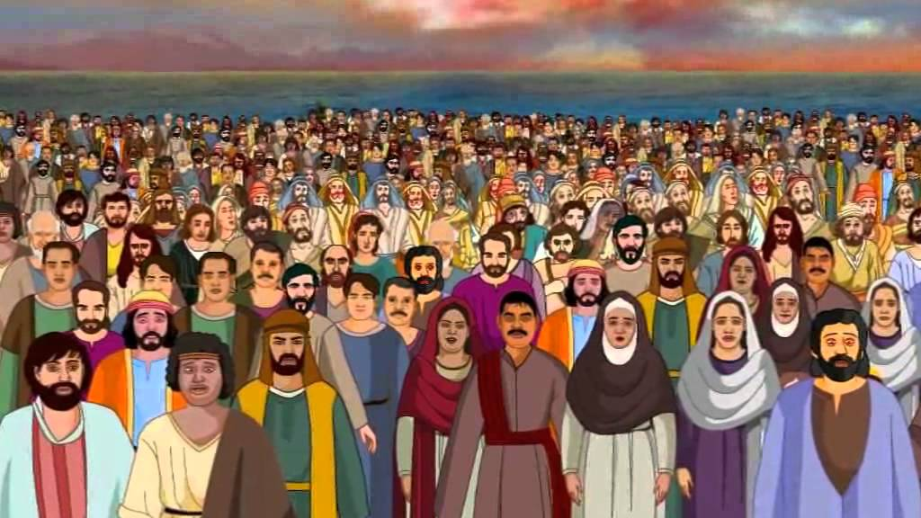
Lessons From the 5000
John 6:1-13

Slide 2
INTRODUCTION
The Bible reveals not only the basics of God’s will for us, but also “the deep things”
1 Peter 2:2 – the pure milk of the word
Hebrews 5:12-14 – meat (solid food) of the word
1 Corinthians 2:10-13 – both revealed to us

Slide 3
INTRODUCTION
The Bible reveals not only the basics of God’s will for us, but also “the deep things”
1 Peter 2:2 – the pure milk of the word
Hebrews 5:12-14 – meat (solid food) of the word
1 Corinthians 2:10-13 – both revealed to us
I have often seen that many times BOTH are in the same passage
Many levels of understanding
Many levels of application

Slide 4
INTRODUCTION
An example
Mark 1:1-3 – The gospel (good news) of Jesus Christ, the Son of God…send My messenger…

Slide 5
INTRODUCTION
An example
Mark 1:1-3 – The gospel (good news) of Jesus Christ, the Son of God…send My messenger…
Mark 1:1-3 – Nobility would send out a gospel (good news) of the birth of ______, son of _____ by way of a messenger who would prepare (make straight) the way for the visitation of the royalty

Slide 6
INTRODUCTION
An example
Mark 1:1-3 – The gospel (good news) of Jesus Christ, the Son of God…send My messenger…
Mark 1:1-3 – Nobility would send out a gospel (good news) of the birth of ______, son of _____ by way of a messenger who would prepare (make straight) the way for the visitation of the royalty
We read it at one level and it makes sense
Read at a deeper level, it makes more sense

Slide 7
INTRODUCTION
Another example
John 21:15-17 – “Simon, son of John, do you love Me more than these?” “Yes, Lord, you know that I love you.” – Jesus reaffirms Peter’s love
For Peter’s benefit
Because of the three denials?
John 21:15-17 (deeper)
First time – agapao v phileo
Second time – agapao v phileo
Third time – phileo v phileo
Also: tend lambs, shepherd sheep, tend sheep

Slide 8
Parables
This principle is the basis for parables
“Why do You speak to them in parables?”
For whoever has, to him more shall be given…

Slide 9
Parables
This principle is the basis for parables
“Why do You speak to them in parables?”
For whoever has, to him more shall be given…
Whoever does not have, even what he has shall be taken away…
Become dull
Scarcely hear
Closed their eyes

Slide 10
Parables
This principle is the basis for parables
“Why do You speak to them in parables?”
For whoever has, to him more shall be given…
Whoever does not have, even what he has shall be taken away…
Become dull
Scarcely hear
Closed their eyes
Many would hear a story about soils, others would ask and hear about men’s hearts

Slide 11
God’s people have to do their part
It probably would have taken less time to distribute the food miraculously, than by hand

Slide 12
God’s people have to do their part
It probably would have taken less time to distribute the food miraculously, than by hand
“God does the impossible, we do the rest”

Slide 13
God’s people have to do their part
It probably would have taken less time to distribute the food miraculously, than by hand
“God does the impossible, we do the rest”
John 2 – wedding at Cana
Jesus: water to wine
Servants: fill the waterpots, take to headwaiter

Slide 14
God’s people have to do their part
It probably would have taken less time to distribute the food miraculously, than by hand
“God does the impossible, we do the rest”
John 2 – wedding at Cana
Jesus: water to wine
Servants: fill the waterpots, take to headwaiter
Salvation:
God: live a perfect life, die for our sins
Us: accept the free gift, remain faithful

Slide 15
God’s people have to do their part
This also provided them an opportunity to serve
Jesus, their Leader
The crowd, their fellow men

Slide 16
God’s people have to do their part
This also provided them an opportunity to serve
Jesus, their Leader
The crowd, their fellow men
The opposite of what would be expected (Matthew 20:25-28)
God’s people must be humble servants

Slide 17
God’s people have to do their part
This also provided them an opportunity to serve
Jesus, their Leader
The crowd, their fellow men
The opposite of what would be expected (Matthew 20:25-28)
God’s people must be humble servants
It is a privilege to be a part of God’s work
Many of God’s blessings are “wrapped in service to others”

Slide 18
“Pay it Forward”
The disciples had to give what they had received
Material food/spiritual food
Matthew 10:8; 1 Corinthians 11:23; 15:3

Slide 19
“Pay it Forward”
The disciples had to give what they had received
Material food/spiritual food
Matthew 10:8; 1 Corinthians 11:23; 15:3
Matthew 25:31-46 – a visit, a cup of water…
Luke 16:10 – “…faithful in a little…”

Slide 20
“Pay it Forward”
The disciples had to give what they had received
Material food/spiritual food
Matthew 10:8; 1 Corinthians 11:23; 15:3
Matthew 25:31-46 – a visit, a cup of water…
Luke 16:10 – “…faithful in a little…”
We are entrusted with God’s blessings
Acts 20:26-27 – spiritually
2 Corinthians 9:6-8 – materially

Slide 21
CONCLUSION
Besides the obvious lessons
We can often learn hidden/deeper lessons
Further studying can bring gems for our heavenly treasure

Slide 22
CONCLUSION
Besides the obvious lessons
We can often learn hidden/deeper lessons
Further studying can bring gems for our heavenly treasure
WARNING:
Don’t forget the basics as you discover weightier matters
Don’t neglect the weightier matters (Matt 23:23)
Never think that your opinion is equal to God’s revealed word (Matt 15:3-9)

Slide 23
CONCLUSION
Besides the obvious lessons
We can often learn hidden/deeper lessons
Further studying can bring gems for our heavenly treasure
WARNING:
Don’t forget the basics as you discover weightier matters
Don’t neglect the weightier matters (Matt 23:23)
Never think that your opinion is equal to God’s revealed word (Matt 15:3-9)
2 Timothy 3:16-17

Slide 24
Are YOU a Christian?
Hear
Believe
Repent
Confess
Be Baptized
Continue Faithfully
Romans 10:17
Mark 16:16
Acts 2:38
Acts 22:16
Mark 16:16
Hebrews 10:38

