Slide 1
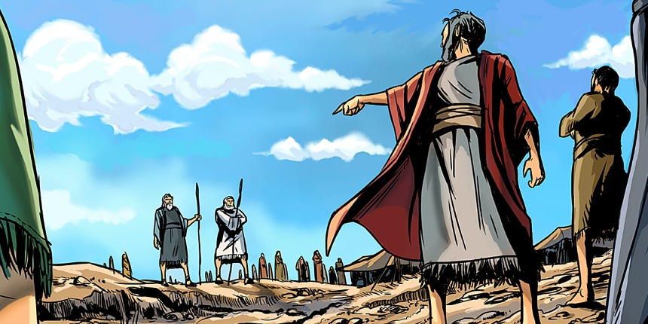
Korah’s Rebellion
Numbers 16:3, 8-11

Slide 2
INTRODUCTION
Jude uses Korah’s rebellion as a warning
Verses 3-7
Contend earnestly for the faith
Ungodly men have crept in…
God’s punishment of the wicked

Slide 3
INTRODUCTION
Jude uses Korah’s rebellion as a warning
Verses 3-7
Contend earnestly for the faith
Ungodly men have crept in…
God’s punishment of the wicked
Verses 8-16
“Dreamers” – Imaginings, desires, sins (Rom. 13:11)
Condemned, as prophesied

Slide 4
INTRODUCTION
Jude uses Korah’s rebellion as a warning
Verses 3-7
Contend earnestly for the faith
Ungodly men have crept in…
God’s punishment of the wicked
Verses 8-16
“Dreamers” – Imaginings, desires, sins (Rom. 13:11)
Condemned, as prophesied
What can we learn from them (1 Cor. 10)

Slide 5
Context
Numbers 13 & 14
On the verge of entering the Promised Land

Slide 6
Context
Numbers 13 & 14
On the verge of entering the Promised Land
12 spies sent in
2 spies – Yea; 10 spies – Nay (“…because of our kids…”)

Slide 7
Context
Numbers 13 & 14
On the verge of entering the Promised Land
12 spies sent in
2 spies – Yea; 10 spies – Nay (“…because of our kids…”)
God: “Okay, wilderness 40 years, I’ll train your kids.”
Hearing this, the people decided to go in – but, God didn’t go in w/them. – They failed

Slide 8
Context
Numbers 13 & 14
On the verge of entering the Promised Land
12 spies sent in
2 spies – Yea; 10 spies – Nay (“…because of our kids…”)
God: “Okay, wilderness 40 years, I’ll train your kids.”
Hearing this, the people decided to go in – but, God didn’t go in w/them. – They failed
That was all a few weeks ago to them

Slide 9
Context
Numbers 16 (cf chap. 12-Miriam & Aaron)
They are still bugged about it (verses 13-14)

Slide 10
Context
Numbers 16 (cf chap. 12-Miriam & Aaron)
They are still bugged about it (verses 13-14)
They “gather their forces” (verses 1-2)
The initial three
More

Slide 11
Context
Numbers 16 (cf chap. 12-Miriam & Aaron)
They are still bugged about it (verses 13-14)
They “gather their forces” (verses 1-2)
The initial three
More
Then, they confront Moses (verse 3)
You have gone far enough
Everyone (all are included is holy, the Lord…midst
Why do YOU exalt YOURSELVES above the…Lord?

Slide 12
Context
Numbers 16 (cf chap. 12-Miriam & Aaron)
They are still bugged about it (verses 13-14)
They “gather their forces” (verses 1-2)
The initial three
More
Then, they confront Moses (verse 3)
You have gone far enough
Everyone (all are included is holy, the Lord…midst
Why do YOU exalt YOURSELVES above the…Lord?
Notice 1 Samuel 15:23; Psalm 78:8 - Rebellion

Slide 13
The instigators
Korah – a Kohathite ( great privileges)
Num. 3:29 – camped on the S side of tabernacle
Num. 4:15 – carried the holy things

Slide 14
The instigators
Korah – a Kohathite ( great privileges)
Num. 3:29 – camped on the S side of tabernacle
Num. 4:15 – carried the holy things
Dathan & Abiram – Reubenites
Brothers

Slide 15
The instigators
Korah – a Kohathite ( great privileges)
Num. 3:29 – camped on the S side of tabernacle
Num. 4:15 – carried the holy things
Dathan & Abiram – Reubenites
Brothers
On – a Reubenite
Not mentioned later

Slide 16
The instigators
Korah – a Kohathite ( great privileges)
Num. 3:29 – camped on the S side of tabernacle
Num. 4:15 – carried the holy things
Dathan & Abiram – Reubenites
Brothers
On – a Reubenite
Not mentioned later
Others – leaders of the congregation

Slide 17
Moses answers
First, goes to God in prayer
Numbers 16:4 – Not prostrating to the men

Slide 18
Moses answers
First, goes to God in prayer
Numbers 16:4 – Not prostrating to the men
Answers the group
Numbers 6-7a – “Let’s see what God says.”
Numbers 7b – Returns the accusation

Slide 19
Moses answers
First, goes to God in prayer
Numbers 16:4 – Not prostrating to the men
Answers the group
Numbers 6-7a – “Let’s see what God says.”
Numbers 7b – Returns the accusation
Answers Korah
You were close to God
Why do you seek more (the unauthorized)?
Pride

Slide 20
The rest of the story
Moses calls Dathan & Abiram
They refuse
They blame him for the problems

Slide 21
The rest of the story
Moses calls Dathan & Abiram
They refuse
They blame him for the problems
The people involved will let God decide
Sooner rather than later
A very specific test

Slide 22
The rest of the story
Moses calls Dathan & Abiram
They refuse
They blame him for the problems
The people involved will let God decide
Sooner rather than later
A very specific test
God decides decisively
Punishes the wicked
Sets up a warning for future insurgents

Slide 23
Lessons to be learned
Authority

Slide 24
Lessons to be learned
Authority
God has established authority in our world
Government, Parents, Employers, Elders, Men
Higher authority does not automatically mean better people

Slide 25
Lessons to be learned
Authority
God has established authority in our world
Government, Parents, Employers, Elders, Men
Higher authority does not automatically mean better people
Rebellion against authority is rebellion against God
1 Samuel 8:7, etc.

Slide 26
Lessons to be learned
Authority
God has established authority in our world
Government, Parents, Employers, Elders, Men
Higher authority does not automatically mean better people
Rebellion against authority is rebellion against God
1 Samuel 8:7, etc.
Disobeying evil orders is not a sin
Exercising your rights (voting, going to court) isn’t

Slide 27
Lessons to be learned
Pride

Slide 28
Lessons to be learned
Pride
You are never less like Christ than when you let pride rule in your heart
Philippians 2:4-9

Slide 29
Lessons to be learned
Pride
You are never less like Christ than when you let pride rule in your heart
Philippians 2:4-9
God is opposed to those who “exalt themselves”
We must be satisfied with our condition in life (Philippians 4:12)

Slide 30
Lessons to be learned
Pride
You are never less like Christ than when you let pride rule in your heart
Philippians 2:4-9
God is opposed to those who “exalt themselves”
We must be satisfied with our condition in life (Philippians 4:12)
If we focus on serving God, He will bless us
As with all sins, this one is contagious

Slide 31
Lessons to be learned
Ingratitude

Slide 32
Lessons to be learned
Ingratitude
Closely related to the other sins
Ingratitude is dissatisfaction with what we have already been given

Slide 33
Lessons to be learned
Ingratitude
Closely related to the other sins
Ingratitude is dissatisfaction with what we have already been given
We ignore what we SHOULD be doing for what WE want to do
“It’s not fair; I can do a better job.”

Slide 34
Lessons to be learned
Ingratitude
Closely related to the other sins
Ingratitude is dissatisfaction with what we have already been given
We ignore what we SHOULD be doing for what WE want to do
“It’s not fair; I can do a better job.”
Ingratitude is usually a manifestation of a more basic sin in our hearts

Slide 35
Lessons to be learned
Strife

Slide 36
Lessons to be learned
Strife
We are to be people at peace
There are occasions where we must defend ourselves (verbally, physically – ex. Moses)
Matthew 18:15-18 gives us the method

Slide 37
Lessons to be learned
Strife
We are to be people at peace
There are occasions where we must defend ourselves (verbally, physically – ex. Moses)
Matthew 18:15-18 gives us the method
However, we must SEEK peace (Romans 12:18)
“…blessed are the peacekeepers” (Matthew 5:9)

Slide 38
Lessons to be learned
Strife
We are to be people at peace
There are occasions where we must defend ourselves (verbally, physically – ex. Moses)
Matthew 18:15-18 gives us the method
However, we must SEEK peace (Romans 12:18)
“…blessed are the peacekeepers” (Matthew 5:9)
Especially within the body of Christ
Even if you are in the right

Slide 39
Lessons to be learned
Causing others to sin

Slide 40
Lessons to be learned
Causing others to sin
Sin will keep people from Heaven
When we sin, we are jeopardizing our own eternal lives

Slide 41
Lessons to be learned
Causing others to sin
Sin will keep people from Heaven
When we sin, we are jeopardizing our own eternal lives
However, when we cause others to sin, God takes special note of that
Mark 9:42
Romans 14:20-21
Matthew 13:41

Slide 42
Lessons to be learned
Causing others to sin
Sin will keep people from Heaven
When we sin, we are jeopardizing our own eternal lives
However, when we cause others to sin, God takes special note of that
Mark 9:42
Romans 14:20-21
Matthew 13:41
Tearing down is the opposite of edifying

Slide 43
CONCLUSION
Korah and the others were not happy, so they sinned
They could have repented, but didn’t
They were punished and the events recorded for our learning
Sadly, most people who are in a similar situation don’t see themselves in it
In all things, seek God’s approval

Slide 44
Are YOU a Christian?
Hear
Believe
Repent
Confess
Be Baptized
Continue Faithfully
Romans 10:17
Mark 16:16
Acts 2:38
Acts 22:16
Mark 16:16
Hebrews 10:38

