Slide 1
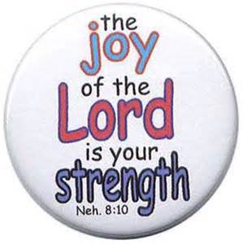
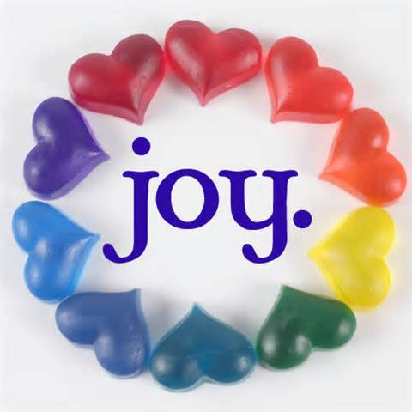
Joy

Slide 2
INTRODUCTION
Nehemiah 8:10b: “…for the joy of the Lord is your strength.”

Slide 3
INTRODUCTION
Nehemiah 8:10b: “…for the joy of the Lord is your strength.”
Jesus spoke of sharing His joy
John 15:11 – “My joy may be in you, and your joy may be complete”
John 17:13 – “…so that they may have My joy made full…”

Slide 4
INTRODUCTION
Nehemiah 8:10b: “…for the joy of the Lord is your strength.”
Jesus spoke of sharing His joy
John 15:11 – “My joy may be in you, and your joy may be complete”
John 17:13 – “…so that they may have My joy made full…”
Joy is a fruit of the Spirit – Galatians 5:22
Second, only behind love

Slide 5
INTRODUCTION
Nehemiah 8:10b: “…for the joy of the Lord is your strength.”
Jesus spoke of sharing His joy
John 15:11 – “My joy may be in you, and your joy may be complete”
John 17:13 – “…so that they may have My joy made full…”
Joy is a fruit of the Spirit – Galatians 5:22
Second, only behind love
NOTE: “…against such things there is no law.”

Slide 6
INTRODUCTION
However, many Christians seem to fall short of experiencing, or reflecting, this joy that the Bible speaks about

Slide 7
INTRODUCTION
However, many Christians seem to fall short of experiencing, or reflecting, this joy that the Bible speaks about
Seen in their eyes/lifestyle-sad, unenthusiastic
Heard in their speech-”Oh, holding on.” “Just getting by.”
In their worship – bored, mumble songs/prayers

Slide 8
INTRODUCTION
However, many Christians seem to fall short of experiencing, or reflecting, this joy that the Bible speaks about
Seen in their eyes/lifestyle-sad, unenthusiastic
Heard in their speech-”Oh, holding on.” “Just getting by.”
In their worship – bored, mumble songs/prayers
Note: “Joy inexpressible” doesn’t mean giddiness

Slide 9
INTRODUCTION
However, many Christians seem to fall short of experiencing, or reflecting, this joy that the Bible speaks about
Seen in their eyes/lifestyle-sad, unenthusiastic
Heard in their speech-”Oh, holding on.” “Just getting by.”
In their worship – bored, mumble songs/prayers
Note: “Joy inexpressible” doesn’t mean giddiness
How can we be “filled with joy”?

Slide 10
What Makes Christianity a Joy?
In Jesus, we have victory over sin/Satan
We are battling for our souls – 2 Cor 10:3-5
We are on the winning side – 2 Cor 2:14

Slide 11
What Makes Christianity a Joy?
In Jesus, we have victory over sin/Satan
We are battling for our souls – 2 Cor 10:3-5
We are on the winning side – 2 Cor 2:14
In Jesus, we have a second chance
2 Corinthians 5:14-17; Romans 6:3-6
1 Cor. 6:19-20; 10:31 – …do all to the glory of God
Matt 6:33; Gal. 2:20a – prioritize God in your life

Slide 12
What Makes Christianity a Joy?
In Jesus, we have every spiritual blessing
Ephesians 1:3 – none omitted
Redemption, God’s family, prayer, inheritance

Slide 13
What Makes Christianity a Joy?
In Jesus, we have every spiritual blessing
Ephesians 1:3 – none omitted
Redemption, God’s family, prayer, inheritance
In Jesus, even death is a blessing
Revelation 14:13 – “Blessed are the dead…”
Psalm 116:15 – “Precious…”
2 Corinthians 5:6-8 ; 1 Thessalonians 4:13

Slide 14
What Makes Christianity a Joy?
In Jesus, we have every spiritual blessing
Ephesians 1:3 – none omitted
Redemption, God’s family, prayer, inheritance
In Jesus, even death is a blessing
Revelation 14:13 – “Blessed are the dead…”
Psalm 116:15 – “Precious…”
2 Corinthians 5:6-8 ; 1 Thessalonians 4:13
1 Thessalonians 4:16b – rise first
1 Cor. 15:55 – “…where is your victory? …sting?

Slide 15
Joy Should Affect Our Attitude
When one receives the gospel
Matthew 13:20, 44
Acts 8:39 (Eth. eunuch); 16:34 (Philippian jailer)

Slide 16
Joy Should Affect Our Attitude
When one receives the gospel
Matthew 13:20, 44
Acts 8:39 (Eth. eunuch); 16:34 (Philippian jailer)
In our daily life
Phil 2:12-18
Regardless of the circumstances-Acts 5:41; 16:25

Slide 17
Joy Should Affect Our Attitude
When one receives the gospel
Matthew 13:20, 44
Acts 8:39 (Eth. eunuch); 16:34 (Philippian jailer)
In our daily life
Phil 2:12-18
Regardless of the circumstances-Acts 5:41; 16:25
Even in death
Hebrews 12:2 – Jesus is our example
For reasons already studied

Slide 18
Joy Should Affect Our Actions
Spiritually
Assembly – Hebrews 10:25; Psalm 122:1
Prayer – Philippians 1:2-4

Slide 19
Joy Should Affect Our Actions
Spiritually
Assembly – Hebrews 10:25; Psalm 122:1
Prayer – Philippians 1:2-4
Teaching lost souls – Phil. 4:1; Proverbs 11:30
Returning to the Lord (you/others)-Lk 15:7, 10, 32

Slide 20
Joy Should Affect Our Actions
Spiritually
Assembly – Hebrews 10:25; Psalm 122:1
Prayer – Philippians 1:2-4
Teaching lost souls – Phil. 4:1; Proverbs 11:30
Returning to the Lord (you/others)-Lk 15:7, 10, 32
Here on earth
Acts 20:35; 2 Cor. 9:7 – Benevolence
Philippians 2:1-5 - service

Slide 21
Joy Should Affect Our Attention
Romans 12:12 – “Rejoice in hope…”
Galatians 5:22 – fruit of the Spirit
Philippians 4:4-9
Rejoice!
Think on these things…
NOTE: being joyful doesn’t mean that we always have a smile on our face, it means we have the inner peace and assurance that “every thing works for good…” (Rom 8:24-31)

Slide 22
CONCLUSION
There are so many reasons for us to be full of joy
…and none for us to be sour
Young man: “Were you baptized into pickle juice?”
Our lives –
Coming to Christ
Living in Christ
Forever in Christ

Slide 23
Are YOU a Christian?
Hear
Believe
Repent
Confess
Be Baptized
Continue Faithfully
Romans 10:17
Mark 16:16
Acts 2:38
Acts 22:16
Mark 16:16
Hebrews 10:38

