Slide 1
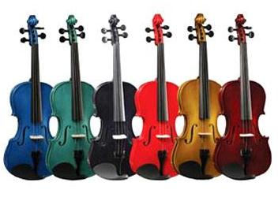
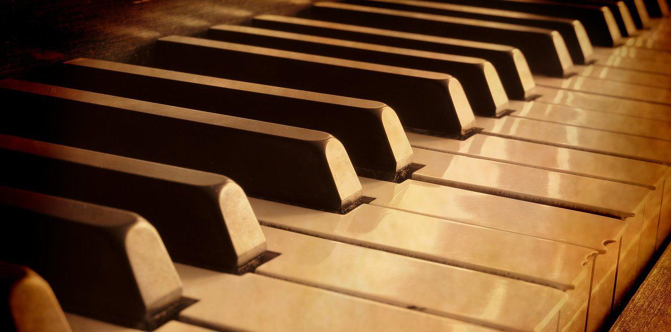
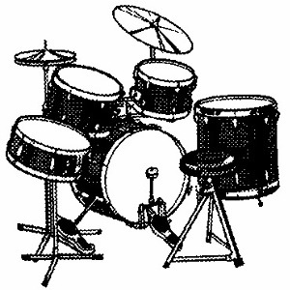
Instrumental Music
Ephesians 5:18-19

Slide 2
INTRODUCTION
An important part of the worship of God is our singing
Music has always played an important part of the worship service
In the NT, we are authorized (C, Ex, & NI) to sing

Slide 3
INTRODUCTION
An important part of the worship of God is our singing
Music has always played an important part of the worship service
In the NT, we are authorized (C, Ex, & NI) to sing
Yet, one of the first things that visitors notice is the lack of an instrumental accompaniment (piano, organ, guitar, drums, etc.) during our assembly

Slide 4
INTRODUCTION
Some think:
The congregation is too small/poor
Building acoustics
Personal preference
Oddity (“Oh, well…”)

Slide 5
INTRODUCTION
Some think:
The congregation is too small/poor
Building acoustics
Personal preference
Oddity (“Oh, well…”)
What IS the reason?
It has to do with authority (Remember all those lessons/sermons on authority?)

Slide 6
INTRODUCTION
Some think:
The congregation is too small/poor
Building acoustics
Personal preference
Oddity (“Oh, well…”)
What IS the reason?
It has to do with authority (Remember all those lessons/sermons on authority?)
It has to do with attitude (worshipping God “in spirit and in truth”; not pleasing self)

Slide 7
ATTITUDE
First, we have to ask ourselves:
Why do we do the things we do (religiously)?

Slide 8
ATTITUDE
First, we have to ask ourselves:
Why do we do the things we do (religiously)?
Tradition/Custom – the way “it’s always been done” = VAIN Worship (Matthew 15:9)

Slide 9
ATTITUDE
First, we have to ask ourselves:
Why do we do the things we do (religiously)?
Tradition/Custom – the way “it’s always been done” = VAIN Worship (Matthew 15:9)
Self - “I think…” = WILL worship (Colossians 2:20-23)

Slide 10
ATTITUDE
First, we have to ask ourselves:
Why do we do the things we do (religiously)?
Tradition/Custom – the way “it’s always been done” = VAIN Worship (Matthew 15:9)
Self - “I think…” = WILL worship (Colossians 2:20-23)
Ummm… - “Not sure…” – IGNORANT worship (Acts 17:22-23)

Slide 11
ATTITUDE
First, we have to ask ourselves:
Why do we do the things we do (religiously)?
Tradition/Custom – the way “it’s always been done” = VAIN Worship (Matthew 15:9)
Self - “I think…” = WILL worship (Colossians 2:20-23)
Ummm… - “Not sure…” – IGNORANT worship (Acts 17:22-23)
God authorized it – “Book, Chapter, Verse” = TRUE worship (John 4:23-24)

Slide 12
ATTITUDE
First, we have to ask ourselves:
Why do we do the things we do (religiously)?
Tradition/Custom – the way “it’s always been done” = VAIN Worship (Matthew 15:9)
Self - “I think…” = WILL worship (Colossians 2:20-23)
Ummm… - “Not sure…” – IGNORANT worship (Acts 17:22-23)
God authorized it – “Book, Chapter, Verse” = TRUE worship (John 4:23-24)
Matthew 21:25 – Jesus only gave 2 choices:
Heaven or man

Slide 13
ATTITUDE
First, we have to ask ourselves:
Can anyone find Christians in the New Testament playing mechanical instruments in their worship of God?

Slide 14
ATTITUDE
First, we have to ask ourselves:
Can anyone find Christians in the New Testament playing mechanical instruments in their worship of God?
As we look around the religious community, we must ask “Why not?”

Slide 15
ATTITUDE
First, we have to ask ourselves:
Can anyone find Christians in the New Testament playing mechanical instruments in their worship of God?
As we look around the religious community, we must ask “Why not?”
REMEMBER: Noah was told to build an ark
Hammer, saw, nails, etc. = OK (expedients)

Slide 16
ATTITUDE
First, we have to ask ourselves:
Can anyone find Christians in the New Testament playing mechanical instruments in their worship of God?
As we look around the religious community, we must ask “Why not?”
REMEMBER: Noah was told to build an ark
Hammer, saw, nails, etc. = OK (expedients)
Other wood (pine, oak, etc.) = NOT OK (addition)
Regardless of reasons/excuses, violates command

Slide 17
Consider This
Ephesians 5:18-20
“speaking to one another…”
“making melody with your heart…”

Slide 18
Consider This
Ephesians 5:18-20
“speaking to one another…”
“making melody with your heart…”
Colossians 3:16-17
Let the word of Christ richly dwell within you…
w/all wisdom teaching & admonishing…
w/psalms, hymns, spiritual songs, singing w/…
V 17 – “Whatever you do…”

Slide 19
Consider This
Ephesians 5:18-20
“speaking to one another…”
“making melody with your heart…”
Colossians 3:16-17
Let the word of Christ richly dwell within you…
w/all wisdom teaching & admonishing…
w/psalms, hymns, spiritual songs, singing w/…
V 17 – “Whatever you do…”
Hebrews 13:15 – “…the fruit of lips…”

Slide 20
Consider This
What “organ” is to accompany our singing?

Slide 21
Consider This
What “organ” is to accompany our singing?
The heart! (zeal, enthusiasm, spirit) – The only “accompaniment” authorized by God
To add/replace it w/inanimate (“heart-less”, “soul-less”) instruments is no different

Slide 22
Consider This
What “organ” is to accompany our singing?
The heart! (zeal, enthusiasm, spirit) – The only “accompaniment” authorized by God
To add/replace it w/inanimate (“heart-less”, “soul-less”) instruments is no different
How about coffee & doughnuts for the Lord’s Supper?
We’re never told NOT to!
It may be more modern and socially preferred
Ridiculous? It’s already being done

Slide 23
4 Arguments put forth in favor
1. They had them in the OT (2 Chr. 29:25; etc.)

Slide 24
4 Arguments put forth in favor
1. They had them in the OT (2 Chr. 29:25; etc.)
Understanding the different dispensations helps
Patriarchal
Mosaic
Christian

Slide 25
4 Arguments put forth in favor
1. They had them in the OT (2 Chr. 29:25; etc.)
Understanding the different dispensations helps
Patriarchal
Mosaic
Christian
Galatians 5:3 (circumcision) – bringing a part of the OT into the NT makes you a debtor to the Law (animal sacrifices, stoning, etc.)

Slide 26
4 Arguments put forth in favor
1. They had them in the OT (2 Chr. 29:25; etc.)
Understanding the different dispensations helps
Patriarchal
Mosaic
Christian
Galatians 5:3 (circumcision) – bringing a part of the OT into the NT makes you a debtor to the Law (animal sacrifices, stoning, etc.)
Verse 4 – This will cause you to fall from grace

Slide 27
4 Arguments put forth in favor
2. Greek word “Psallo” includes instruments

Slide 28
4 Arguments put forth in favor
2. Greek word “Psallo” includes instruments
Orig. meaning: strum (cf “baptism”= “immerse”)

Slide 29
4 Arguments put forth in favor
2. Greek word “Psallo” includes instruments
Orig. meaning: strum (cf “baptism”= “immerse”)
Eph 5:19 – 2 words:
ADO (singing)
PSALLO (making melody or strumming)…(w/what?)
WITH YOUR HEART! – No musical instr. In the context

Slide 30
4 Arguments put forth in favor
2. Greek word “Psallo” includes instruments
Orig. meaning: strum (cf “baptism”= “immerse”)
Eph 5:19 – 2 words:
ADO (singing)
PSALLO (making melody or strumming)…(w/what?)
WITH YOUR HEART! – No musical instr. In the context
James 5:13, 1 Corinthians 14:15, etc.
What “proves too much, proves nothing”

Slide 31
4 Arguments put forth in favor
3. God didn’t prohibit it

Slide 32
4 Arguments put forth in favor
3. God didn’t prohibit it
Nadab & Abihu (Leviticus 10:1-3)-”strange fire”…

Slide 33
4 Arguments put forth in favor
3. God didn’t prohibit it
Nadab & Abihu (Leviticus 10:1-3)-”strange fire”…
John 4:24 (spirit/truth), 17:17 (Thy word is truth)

Slide 34
4 Arguments put forth in favor
3. God didn’t prohibit it
Nadab & Abihu (Leviticus 10:1-3)-”strange fire”…
John 4:24 (spirit/truth), 17:17 (Thy word is truth)
Hebrews 7:12-14
Change in priesthood = change in Law
Our Lord from another tribe
Judah, …which Moses spoke nothing concern. priests

Slide 35
4 Arguments put forth in favor
3. God didn’t prohibit it
Nadab & Abihu (Leviticus 10:1-3)-”strange fire”…
John 4:24 (spirit/truth), 17:17 (Thy word is truth)
Hebrews 7:12-14
Change in priesthood = change in Law
Our Lord from another tribe
Judah, …which Moses spoke nothing concern. priests
We must have a proper respect for what God has spoken, not build upon the silence of the Scriptures!

Slide 36
4 Arguments put forth in favor
4. “My church says it’s ok”, (You guys are weird) – “Sticks and stones…”

Slide 37
4 Arguments put forth in favor
4. “My church says it’s ok”, (You guys are weird) – “Sticks and stones…”
Historically, the first organs were added by the Roman Catholic church around 600-700 AD (the Greek Orthodox still doesn’t accept them)

Slide 38
4 Arguments put forth in favor
4. “My church says it’s ok”, (You guys are weird) – “Sticks and stones…”
Historically, the first organs were added by the Roman Catholic church around 600-700 AD (the Greek Orthodox still doesn’t accept them)
John Calvin – Musical instruments, in celebrating praises to God, would be no more suitable than the burning of incense, the lighting of lamps,… The Papists, therefore have foolishly borrowed this, as well as many other things from the Jews.” (Calvin’s Comments on Psalm 33)

Slide 39
4 Arguments put forth in favor
4. “My church says it’s ok”, (You guys are weird) – “Sticks and stones…”
John Wesley – “I have no objection to instruments of music in our chapels, provided they are neither seen nor heard.” (Clark’s Comm. Vol 14, page 686)

Slide 40
4 Arguments put forth in favor
4. “My church says it’s ok”, (You guys are weird) – “Sticks and stones…”
John Wesley – “I have no objection to instruments of music in our chapels, provided they are neither seen nor heard.” (Clark’s Comm. Vol 14, page 686)
Martin Luther – “…an ensign of Baal…” (McClintocks Strong’s Encyclopedia, Music, vol 6, page 762)

Slide 41
4 Arguments put forth in favor
4. “My church says it’s ok”, (You guys are weird) – “Sticks and stones…”
John Wesley – “I have no objection to instruments of music in our chapels, provided they are neither seen nor heard.” (Clark’s Comm. Vol 14, page 686)
Martin Luther – “…an ensign of Baal…” (McClintocks Strong’s Encyclopedia, Music, vol 6, page 762)
Erasmus, Justin Martyr, Charles Spurgeon, Clement of Alexandria, etc.

Slide 42
CONCLUSION
God has authorized singing (“fruit of the lips”) as acceptable worship
Generics - Expedients
We can find no authority for instruments (different type-added) to accompany our singing
Many have recognized this throughout history
1 Peter 3:15 – “Always being ready…”

Slide 43
Are YOU a Christian?
Hear
Believe
Repent
Confess
Be Baptized
Continue Faithfully
Romans 10:17
Mark 16:16
Acts 2:38
Acts 22:16
Mark 16:16
Hebrews 10:38

