Slide 1
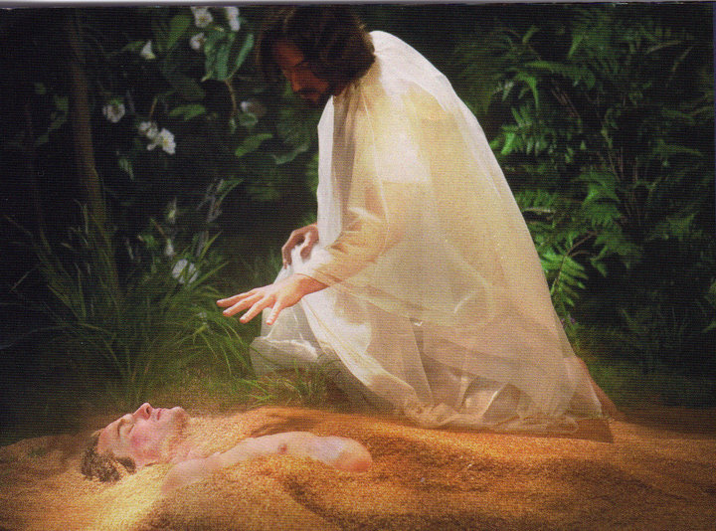
In His Likeness
2 Corinthians 4:16-18

Slide 2
INTRODUCTION
We read in Genesis 1 about man’s creation
Last day of creation-everything else created

Slide 3
INTRODUCTION
We read in Genesis 1 about man’s creation
Last day of creation-everything else created
Verse 26 – Something not said about anything else in the Genesis account of creation

Slide 4
INTRODUCTION
We read in Genesis 1 about man’s creation
Last day of creation-everything else created
Verse 26 – Something not said about anything else in the Genesis account of creation
Verse 27 – “Male and female” (female not an afterthought – God had already created females in many species)

Slide 5
What is “in God’s image”?
Physical? – All creatures had physical bodies

Slide 6
What is “in God’s image”?
Physical? – All creatures had physical bodies
Spiritual – John 4:24 – God is Spirit
Elevates man above the animals
Allows man to grasp intangible/spiritual concepts like music, justice, time/eternity, humor, God, etc
Permits man to communicate with God

Slide 7
What is “in God’s image”?
Physical? – All creatures had physical bodies
Spiritual – John 4:24 – God is Spirit
Elevates man above the animals
Allows man to grasp intangible/spiritual concepts like music, justice, time/eternity, humor, God, etc
Permits man to communicate with God
For dominion (v 26b, 28) – God is over all
To subdue it (Genesis 1:28)
To tend (cultivate/keep) it (Genesis 2:15)

Slide 8
Not just a brain…
…but a mind (in the image of God’s intellect)

Slide 9
Not just a brain…
…but a mind (in the image of God’s intellect)
Capable of rational thought
Isaiah 1:18 – “Come, let us reason together…
Ephesians 3:4 – “When you read this…”

Slide 10
Not just a brain…
…but a mind (in the image of God’s intellect)
Capable of rational thought
Isaiah 1:18 – “Come, let us reason together…
Ephesians 3:4 – “When you read this…”
Capable of choosing right/wrong
Animals are given instincts which man is not
Genesis 2, 3, 6, etc.
Deuteronomy 30:15-20; Joshua 24:14-24; etc.

Slide 11
Not just a brain…
…but a mind (in the image of God’s intellect)
Capable of rational thought
Isaiah 1:18 – “Come, let us reason together…
Ephesians 3:4 – “When you read this…”
Capable of choosing right/wrong
Animals are given instincts which man is not
Genesis 2, 3, 6, etc.
Deuteronomy 30:15-20; Joshua 24:14-24; etc.
Every time someone does math, paints a picture, invents something, writes a new song, etc., they proclaim God’s image in mankind

Slide 12
Not just spirit…
…but morality (in the image of God’s holiness)

Slide 13
Not just spirit…
…but morality (in the image of God’s holiness)
Not everything spiritual is morally good

Slide 14
Not just spirit…
…but morality (in the image of God’s holiness)
Not everything spiritual is morally good
Mankind was created innocent and righteous
Genesis 1:31; 2:25, etc.
He lost both when he sinned

Slide 15
Not just spirit…
…but morality (in the image of God’s holiness)
Not everything spiritual is morally good
Mankind was created innocent and righteous
Genesis 1:31; 2:25, etc.
He lost both when he sinned
Our conscience (moral compass) is all we have left
It must be attuned to God’s will
Otherwise, it isn’t reliable (Rom. 10:1-3; Acts 23:1)

Slide 16
Not just spirit…
…but morality (in the image of God’s holiness)
Not everything spiritual is morally good
Mankind was created innocent and righteous
Genesis 1:31; 2:25, etc.
He lost both when he sinned
Our conscience (moral compass) is all we have left
It must be attuned to God’s will
Otherwise, it isn’t reliable (Rom. 10:1-3; Acts 23:1)
Every time we draw near to God, recoil from evil, encourage good, feel guilty, etc. we declare that God’s image is in us.

Slide 17
Not just individually…
…but socially (this reflects the trinity/love)

Slide 18
Not just individually…
…but socially (this reflects the trinity/love)
We can see in nature the power of social behavior
Whether insects (ants, bees) with no one over them
Or, dolphins – highly structured

Slide 19
Not just individually…
…but socially (this reflects the trinity/love)
We can see in nature the power of social behavior
Whether insects (ants, bees) with no one over them
Or, dolphins – highly structured
Mankind goes a step further: fellowship
Genesis 2:18; 3:8; 4:12-13; etc.
Hist., one of man’s greatest punishments: Disfellowship

Slide 20
Not just individually…
…but socially (this reflects the trinity/love)
We can see in nature the power of social behavior
Whether insects (ants, bees) with no one over them
Or, dolphins – highly structured
Mankind goes a step further: fellowship
Genesis 2:18; 3:8; 4:12-13; etc.
Hist., one of man’s greatest punishments: Disfellowship
Whenever we make a new friend, congregate to celebrate or grieve, choose a spouse, assemble to worship God, etc., we demonstrate that we have God’s image imprinted in us.

Slide 21
Then, it all fell apart (Sin)
God cannot look with approval upon sin
Even when it’s His own Son who is carrying it
His righteous anger is brought out
His justice demands punishment
His holiness/purity demands separation

Slide 22
Then, it all fell apart (Sin)
God cannot look with approval upon sin
Even when it’s His own Son who is carrying it
His righteous anger is brought out
His justice demands punishment
His holiness/purity demands separation
We were left with a marred image
Instead of fellowship – a “God-shaped void”
Instead of innocence – a conscience
We still have His image (Mk 12:13-17; James 3:9), just marred

Slide 23
So…
2 Corinthians 4:16; 5:17
Ephesians 1:13 – sealed with the Holy Spirit
Ephesians 2:10 – created in Christ Jesus
Ephesians 4:24 – in the image (likeness) of God

Slide 24
So…
2 Corinthians 4:16; 5:17
Ephesians 1:13 – sealed with the Holy Spirit
Ephesians 2:10 – created in Christ Jesus
Ephesians 4:24 – in the image (likeness) of God
We must walk with Him (1 John 1:5-6; Eph 5:8)
For God to “stamp Thine own image deep in my heart”, we must walk (maintain contact) w/Him
We must crucify the old man and be reborn to walk with Him (Romans 6, etc.)

Slide 25
Some things to do
Prayer –
Prayer requires faith, trust, humility…
Matthew 6:6-13; Ephesians 6:18; James 1:6
Hence, 1 Thessalonians 5:17
Prayer brings you into contact with God, therefore, continual prayer equals continuous contact

Slide 26
Some things to do
Overcoming trials (negatives)
Romans 5:3-4; James 1:3-4
Each one gives you the opportunity to draw closer to God
Each one gives you the opportunity to purge something bad from your life

Slide 27
Some things to do
Overcoming trials (negatives)
Romans 5:3-4; James 1:3-4
Each one gives you the opportunity to draw closer to God
Each one gives you the opportunity to purge something bad from your life
Exercise and practice (positive)
Hebrews 5:14
1 Corinthians 9:24-27
Choosing right today makes future choices easier

Slide 28
CONCLUSION
Man was created in God’s image
Then, man sinned
The image became marred
God restores that image in us through Jesus with the Holy Spirit being the seal
In order for that to happen, we must be baptized into Christ and walk in the light

Slide 29
Are YOU a Christian?
Hear
Believe
Repent
Confess
Be Baptized
Continue Faithfully
Romans 10:17
Mark 16:16
Acts 2:38
Acts 22:16
Mark 16:16
Hebrews 10:38

