Slide 1
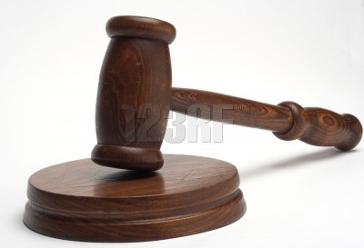
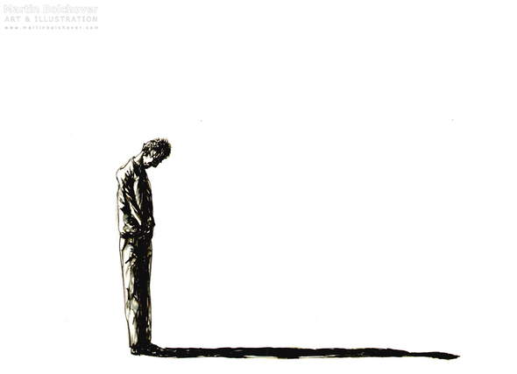
Conviction or Guilt?
John 16:7-14

Slide 2
INTRODUCTION
Man is guilty of sin (Romans 3:9, 23)

Slide 3
INTRODUCTION
Man is guilty of sin (Romans 3:9, 23)
Of willful…

Slide 4
INTRODUCTION
Man is guilty of sin (Romans 3:9, 23)
Of willful…
Commission (1 John 3:4; 2 John 9-10)

Slide 5
INTRODUCTION
Man is guilty of sin (Romans 3:9, 23)
Of willful…
Commission (1 John 3:4; 2 John 9-10)
Participation (2 John 11; Ephesians 5:11)

Slide 6
INTRODUCTION
Man is guilty of sin (Romans 3:9, 23)
Of willful…
Commission (1 John 3:4; 2 John 9-10)
Participation (2 John 11; Ephesians 5:11)
Omission (James 4:17)

Slide 7
INTRODUCTION
Man is guilty of sin (Romans 3:9, 23)
Of willful…
Commission (1 John 3:4; 2 John 9-10)
Participation (2 John 11; Ephesians 5:11)
Omission (James 4:17)
Of ignorance

Slide 8
INTRODUCTION
Man is guilty of sin (Romans 3:9, 23)
Of willful…
Commission (1 John 3:4; 2 John 9-10)
Participation (2 John 11; Ephesians 5:11)
Omission (James 4:17)
Of ignorance
Willful (2 Thessalonians 1:8-9; 2:10)

Slide 9
INTRODUCTION
Man is guilty of sin (Romans 3:9, 23)
Of willful…
Commission (1 John 3:4; 2 John 9-10)
Participation (2 John 11; Ephesians 5:11)
Omission (James 4:17)
Of ignorance
Willful (2 Thessalonians 1:8-9; 2:10)
Unknowing (Acts 17:30)

Slide 10
INTRODUCTION
Man must recognize this (1 John 1:8-10)

Slide 11
INTRODUCTION
Man must recognize this (1 John 1:8-10)
The Holy Spirit convicts the world of sin

Slide 12
INTRODUCTION
Man must recognize this (1 John 1:8-10)
The Holy Spirit convicts the world of sin
John 16:7-11

Slide 13
INTRODUCTION
Man must recognize this (1 John 1:8-10)
The Holy Spirit convicts the world of sin
John 16:7-11
Prove, show to be so, convince

Slide 14
INTRODUCTION
Man must recognize this (1 John 1:8-10)
The Holy Spirit convicts the world of sin
John 16:7-11
Prove, show to be so, convince
1st step toward repentance

Slide 15
INTRODUCTION
Man must recognize this (1 John 1:8-10)
The Holy Spirit convicts the world of sin
John 16:7-11
Prove, show to be so, convince
1st step toward repentance
Satan accuses us of sin

Slide 16
INTRODUCTION
Man must recognize this (1 John 1:8-10)
The Holy Spirit convicts the world of sin
John 16:7-11
Prove, show to be so, convince
1st step toward repentance
Satan accuses us of sin
Revelation 12:9-10

Slide 17
INTRODUCTION
Man must recognize this (1 John 1:8-10)
The Holy Spirit convicts the world of sin
John 16:7-11
Prove, show to be so, convince
1st step toward repentance
Satan accuses us of sin
Revelation 12:9-10
Accusations may be true, false, frivolous, etc.

Slide 18
SORROW
2 Corinthians 7:10
For the sorrow that is according to the will of God produces a repentance without regret, leading to salvation,

Slide 19
SORROW
2 Corinthians 7:10
For the sorrow that is according to the will of God produces a repentance without regret, leading to salvation,
but the sorrow of the world produces death.

Slide 20
2 EXAMPLES
Peter (Matthew 26-28)
Ran away, denied Jesus 3 times, cursed
Wept bitterly
Repented, returned

Slide 21
2 EXAMPLES
Peter (Matthew 26-28)
Ran away, denied Jesus 3 times, cursed
Wept bitterly
Repented, returned
Judas
Betrayed Him (Matthew 26)
Felt remorse (Matthew 27:3)
Hanged himself (verse 5)

Slide 22
Psalm 32:1-6
1) How blessed is he whose transgression is forgiven, Whose sin is covered! 2) How blessed is the man to whom the LORD does not impute iniquity, And in whose spirit there is no deceit!
3) When I kept silent about my sin, my body wasted away Through my groaning all day long.

Slide 23
Psalm 32:1-6
4) For day and night Your hand was heavy upon me; My vitality was drained away as with the fever heat of summer. Selah.
5) I acknowledged my sin to You, And my iniquity I did not hide; I said, "I will confess my transgressions to the LORD"; And You forgave the guilt of my sin. Selah.

Slide 24
Psalm 32:1-6
6) Therefore, let everyone who is godly pray to You in a time when You may be found; Surely in a flood of great waters they will not reach him.

Slide 25
God, The Holy Spirit…
He convicts us of our sins, with an eye toward the solution – Christ

Slide 26
God, The Holy Spirit…
He convicts us of our sins, with an eye toward the solution – Christ
Conviction

Slide 27
God, The Holy Spirit…
He convicts us of our sins, with an eye toward the solution – Christ
Conviction
Repentance

Slide 28
God, The Holy Spirit…
He convicts us of our sins, with an eye toward the solution – Christ
Conviction
Repentance
Confession

Slide 29
God, The Holy Spirit…
He convicts us of our sins, with an eye toward the solution – Christ
Conviction
Repentance
Confession
Baptism

Slide 30
God, The Holy Spirit…
He convicts us of our sins, with an eye toward the solution – Christ
Conviction
Repentance
Confession
Baptism
Life in Christ

Slide 31
God, The Holy Spirit…
He convicts us of our sins, with an eye toward the solution – Christ
Conviction
Repentance
Confession
Baptism
Life in Christ
Acts 10:43; Colossians 2:13

Slide 32
The devil…
Accuses…
Brethren, even God

Slide 33
The devil…
Accuses…
Brethren, even God
Actions, inactions, motives

Slide 34
The devil…
Accuses…
Brethren, even God
Actions, inactions, motives
Real, false, half-truths

Slide 35
The devil…
Accuses…
Brethren, even God
Actions, inactions, motives
Real, false, half-truths
Twisted , frivolous

Slide 36
The devil…
Accuses…
Brethren, even God
Actions, inactions, motives
Real, false, half-truths
Twisted , frivolous
Counterfeits God’s name on his accusations

Slide 37
The devil…
Accuses…
Brethren, even God
Actions, inactions, motives
Real, false, half-truths
Twisted , frivolous
Counterfeits God’s name on his accusations
With an eye toward your destruction

Slide 38
CONCLUSION
2 Main types of wounds to your spirit
Sorrow (godly)
Godly sorrow leads to repentance
Ultimately, salvation
A “clean” wound that leads to healing

Slide 39
CONCLUSION
2 Main types of wounds to your spirit
Sorrow (godly)
Godly sorrow leads to repentance
Ultimately, salvation
A “clean” wound that leads to healing
Guilt w/o godly sorrow
Leads to death
Doesn’t point you anywhere
An “unclean” wound that just festers

Slide 40
CONCLUSION
What to do?
Take your guilt to God
Lay it at the cross, where the debt has been paid

Slide 41
CONCLUSION
What to do?
Take your guilt to God
Lay it at the cross, where the debt has been paid
Take your godly sorrow and follow it to repentance, then, ultimately to salvation in Christ
Zechariah 3:1-7; John 8:1-11

Slide 42
Are YOU a Christian?
Hear
Believe
Repent
Confess
Be Baptized
Continue Faithfully
Romans 10:17
Mark 16:16
Acts 2:38
Acts 22:16
Mark 16:16
Hebrews 10:38

