Slide 1
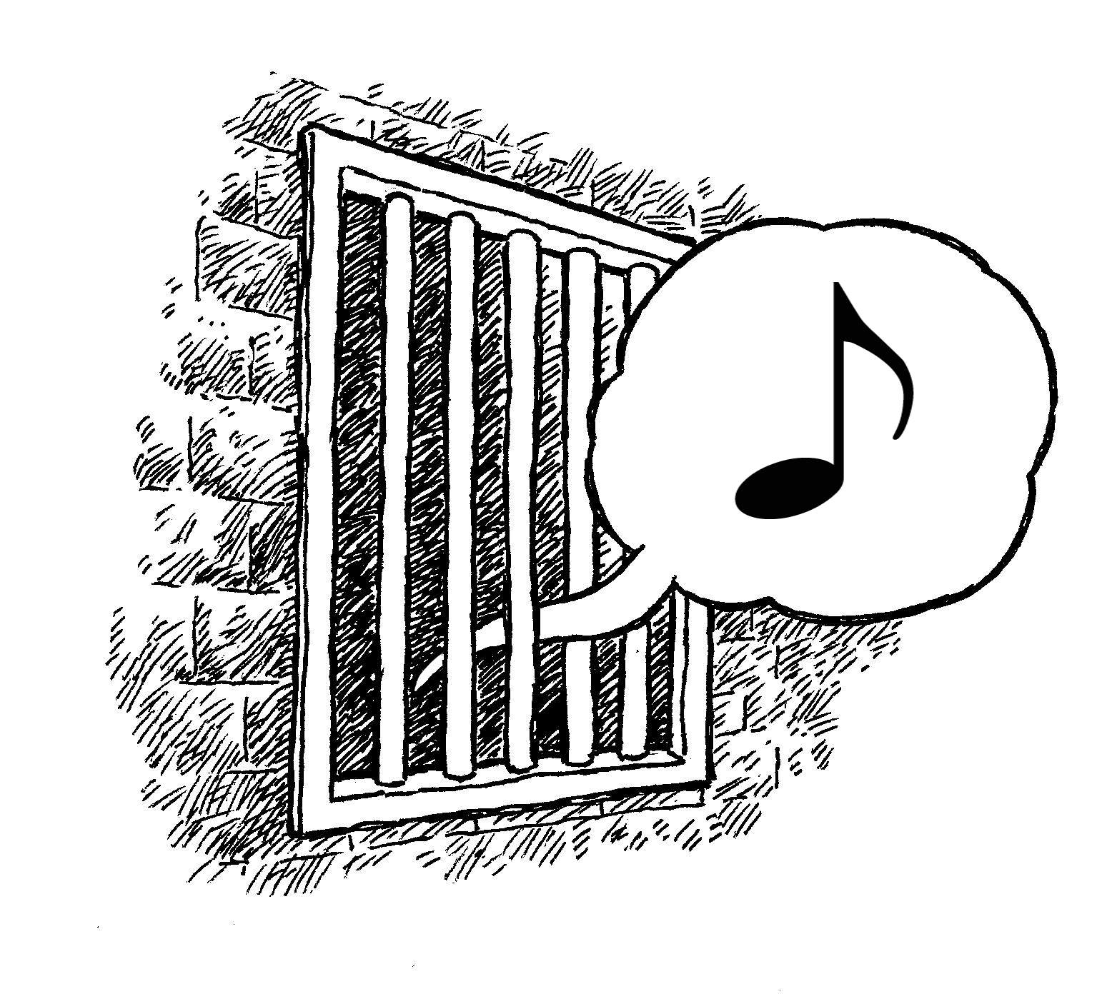
CONTENTMENT
Philippians 4:4-14

Slide 2
INTRODUCTION
Today, I want us to consider contentment
Usually, we consider how God tells us that our focus must be on spiritual things

Slide 3
INTRODUCTION
Today, I want us to consider contentment
Usually, we consider how God tells us that our focus must be on spiritual things
And that where our hearts are, there our treasures are, also (and vice versa)
And, that one way to combat covetousness, or anxiety or lack of faith is to learn to be content with our “station in life”

Slide 4
INTRODUCTION
Today, I want us to consider contentment
Usually, we consider how God tells us that our focus must be on spiritual things
And that where our hearts are, there our treasures are, also (and vice versa)
And, that one way to combat covetousness, or anxiety or lack of faith is to learn to be content with our “station in life”
Did you ever see a hearse pulling a U-Haul?

Slide 5
INTRODUCTION
Today, I want us to consider contentment
Usually, we consider how God tells us that our focus must be on spiritual things
And that where our hearts are, there our treasures are, also (and vice versa)
And, that one way to combat covetousness, or anxiety or lack of faith is to learn to be content with our “station in life”
Did you ever see a hearse pulling a U-Haul?
Let’s learn some principles, then make appl.

Slide 6
Philippians 4:11-12
Context 4:4-14
Not that I speak from want…
It does not mean that he didn’t HAVE any needs, just that he was not guided, directed by them
His joy at receiving their fellowship was genuine because of the blessings they would receive

Slide 7
Philippians 4:11-12
Context 4:4-14
Not that I speak from want…
It does not mean that he didn’t HAVE any needs, just that he was not guided, directed by them
His joy at receiving their fellowship was genuine because of the blessings they would receive
…for I…
As with much of Christianity, it must be personal
Our contentment is as personal as our faith, our hope and our peace with God

Slide 8
Philippians 4:11-12
…have learned…
This is not the natural state of mankind
As we mature, we learn many things
At one time Paul had not yet learned this lesson
2 Corinthians 3:4-5; 12:9

Slide 9
Philippians 4:11-12
…have learned…
This is not the natural state of mankind
As we mature, we learn many things
At one time Paul had not yet learned this lesson
2 Corinthians 3:4-5; 12:9
…whatever state I am in…
As the external conditions change, the inner state doesn’t have to follow
Happiness/joy; dying/growing; poor/rich; -v 12

Slide 10
Philippians 4:11-12
…to be…
Ongoing, not a one-time (passing) attitude
This gives us stability in all things
As finances, friendships, etc. come and go, we continue our marathon, as Paul did

Slide 11
Philippians 4:11-12
…to be…
Ongoing, not a one-time (passing) attitude
This gives us stability in all things
As finances, friendships, etc. come and go, we continue our marathon, as Paul did
…content
Satisfaction, sufficiency, at peace, fulfillment
Psalm 37:16 – better is the little…
You have a trust in God to work out the details (Romans 8:28, 31)

Slide 12
Contentment is the answer
…to anxiety
Matthew 6:25-33 – “…do not worry…”
v 32 …the pagans (Gentiles)…

Slide 13
Contentment is the answer
…to anxiety
Matthew 6:25-33 – “…do not worry…”
v 32 …the pagans (Gentiles)…
…to covetousness (Hebrews 13:5)
Romans 7:7-8
2 Corinthians 12:10

Slide 14
Contentment is the answer
…to anxiety
Matthew 6:25-33 – “…do not worry…”
v 32 …the pagans (Gentiles)…
…to covetousness (Hebrews 13:5)
Romans 7:7-8
2 Corinthians 12:10
…to lack of security, obedience (1 Peter 5:6-7)
Humble yourselves…that He may exalt you…
Casting all your anxiety on Him…He cares for you

Slide 15
However
Satan may use discontentment on us in spiritual matters
We may successfully resist his temptations in material things (jewelry, “toys” gadgets)
And, material attitudes (fame, misjudging others, pride, etc.)

Slide 16
However
Satan may use discontentment on us in spiritual matters
We may successfully resist his temptations in material things (jewelry, “toys” gadgets)
And, material attitudes (fame, misjudging others, pride, etc.)
He may change his focus to our desires to grow spiritually
How come no one trusts me to do that?
How come the few are “running the show”?

Slide 17
Godliness
Godliness – 1 Tim 6:6; 4:7-8
“God-like”-ness, holiness; opposite of worldliness

Slide 18
Godliness
Godliness – 1 Tim 6:6; 4:7-8
“God-like”-ness, holiness; opposite of worldliness
Eph 4:24 “…put on the new self…”

Slide 19
Godliness
Godliness – 1 Tim 6:6; 4:7-8
“God-like”-ness, holiness; opposite of worldliness
Eph 4:24 “…put on the new self…”
God is a giving God
I’m not God, what can I give?
Forgiveness
Life
Prayers

Slide 20
Godliness
Godliness – 1 Tim 6:6; 4:7-8
“God-like”-ness, holiness; opposite of worldliness
Eph 4:24 “…put on the new self…”
God is a giving God
I’m not God, what can I give?
Forgiveness
Life
Prayers
But, Satan is smart and we are weak

Slide 21
A different twist
Satan may use our desire to be servants of God, and to grow spiritually, against us
How come the brethren don’t ask me?
How come “they” do it (hog it) all?
I’m willing, if someone would just ask

Slide 22
A different twist
Satan may use our desire to be servants of God, and to grow spiritually, against us
How come the brethren don’t ask me?
How come “they” do it (hog it) all?
I’m willing, if someone would just ask
He tempts us with spiritual DISCONTENTMENT!
Again, anxiety!
Again, covetousness!
Again, pride!

Slide 23
The Answer?
Focus on serving God
1 Cor. 10:31 – It’s all about God, not us

Slide 24
The Answer?
Focus on serving God
1 Cor. 10:31 – It’s all about God, not us
Hebrews 4:13 – God knows what you are doing even if others don’t

Slide 25
The Answer?
Focus on serving God
1 Cor. 10:31 – It’s all about God, not us
Hebrews 4:13 – God knows what you are doing even if others don’t
Matthew 25:23 – Be faithful servants
Notice, the 2 talent man didn’t covet the 5 talent man’s greater opportunities/abilities

Slide 26
The Answer?
Focus on serving God
1 Cor. 10:31 – It’s all about God, not us
Hebrews 4:13 – God knows what you are doing even if others don’t
Matthew 25:23 – Be faithful servants
Notice, the 2 talent man didn’t covet the 5 talent man’s greater opportunities/abilities
Many who are “hogging it all” are doing it by default and really, REALLY, would like a helping hand

Slide 27
The Answer?
“Let your light shine”!
Let your desire to “work in the vineyard” be known by the brethren

Slide 28
The Answer?
“Let your light shine”!
Let your desire to “work in the vineyard” be known by the brethren
Volunteer. Raise your hand. Be vocal.
The more you do, the more you get to do

Slide 29
The Answer?
“Let your light shine”!
Let your desire to “work in the vineyard” be known by the brethren
Volunteer. Raise your hand. Be vocal.
The more you do, the more you get to do
The opposite is also true: the less you do…

Slide 30
The Answer?
“Let your light shine”!
Let your desire to “work in the vineyard” be known by the brethren
Volunteer. Raise your hand. Be vocal.
The more you do, the more you get to do
The opposite is also true: the less you do…
Do it for the right reason – GOD
Hebrews 13:5

Slide 31
CONCLUSION
We are commanded to be content with our situation/station in life
Even when it changes (good/bad; more/less)
We also have examples of those who were

Slide 32
CONCLUSION
We are commanded to be content with our situation/station in life
Even when it changes (good/bad; more/less)
We also have examples of those who were
Contentment does not mean complacency
We must trust God and look to Him for our security (1 Peter 5:6-7)

Slide 33
CONCLUSION
We are commanded to be content with our situation/station in life
Even when it changes (good/bad; more/less)
We also have examples of those who were
Contentment does not mean complacency
We must trust God and look to Him for our security (1 Peter 5:6-7)
We must focus on the spiritual
Tonight: God can use you

Slide 34
Are YOU a Christian?
Hear
Believe
Repent
Confess
Be Baptized
Continue Faithfully
Romans 10:17
Mark 16:16
Acts 2:38
Acts 22:16
Mark 16:16
Hebrews 10:38

