Slide 1
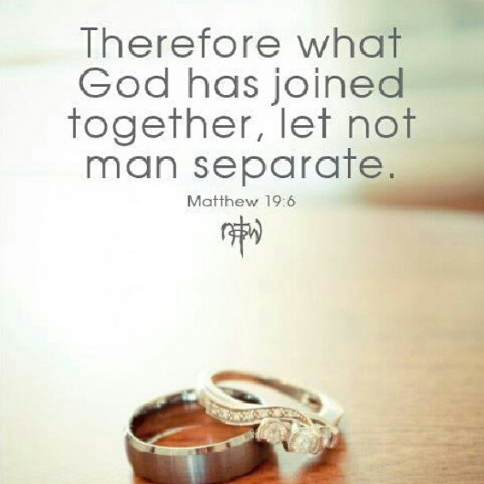
Back to Basics – Marriage
Genesis
2:18-24

Slide 2
INTRODUCTION
There is lots of opposition to marriage
American courts/other countries

Slide 3
INTRODUCTION
There is lots of opposition to marriage
American courts/other countries
Special int. groups: gay rights groups (LGBT, etc.), Mormons, Muslims, NAMBLA, bestiality orgs, etc.

Slide 4
INTRODUCTION
There is lots of opposition to marriage
American courts/other countries
Special int. groups: gay rights groups (LGBT, etc.), Mormons, Muslims, NAMBLA, bestiality orgs, etc.
Why?
THEY SAY: To make marriage more inclusive and legal for more people; for legal reasons

Slide 5
INTRODUCTION
There is lots of opposition to marriage
American courts/other countries
Special int. groups: gay rights groups (LGBT, etc.), Mormons, Muslims, NAMBLA, bestiality orgs, etc.
Why?
THEY SAY: To make marriage more inclusive and legal for more people; for legal reasons
HOWEVER: God instituted marriage – He defines it, not man

Slide 6
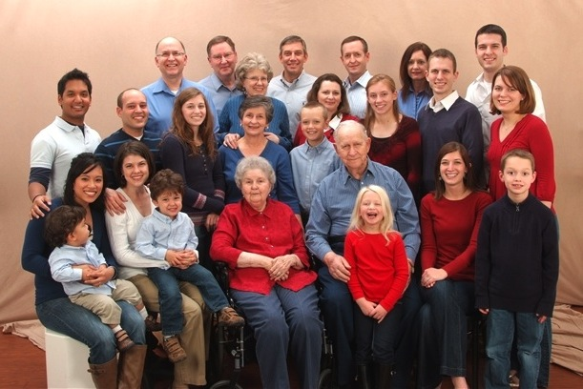
God’s Institutions
The Family

Slide 7
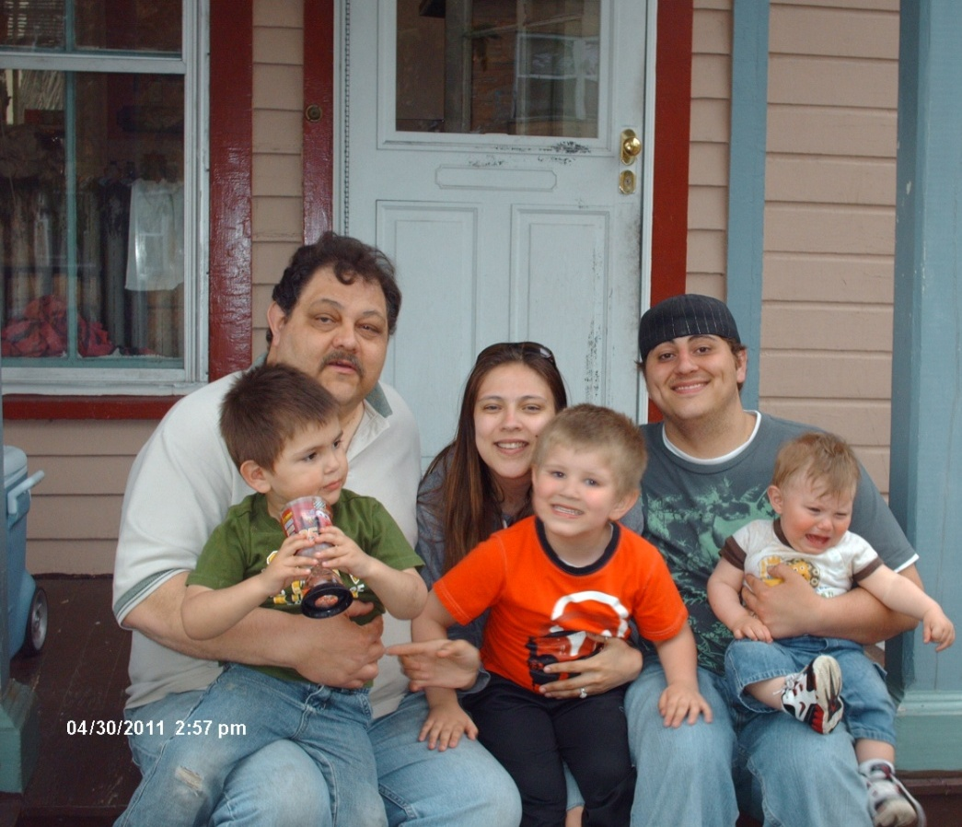
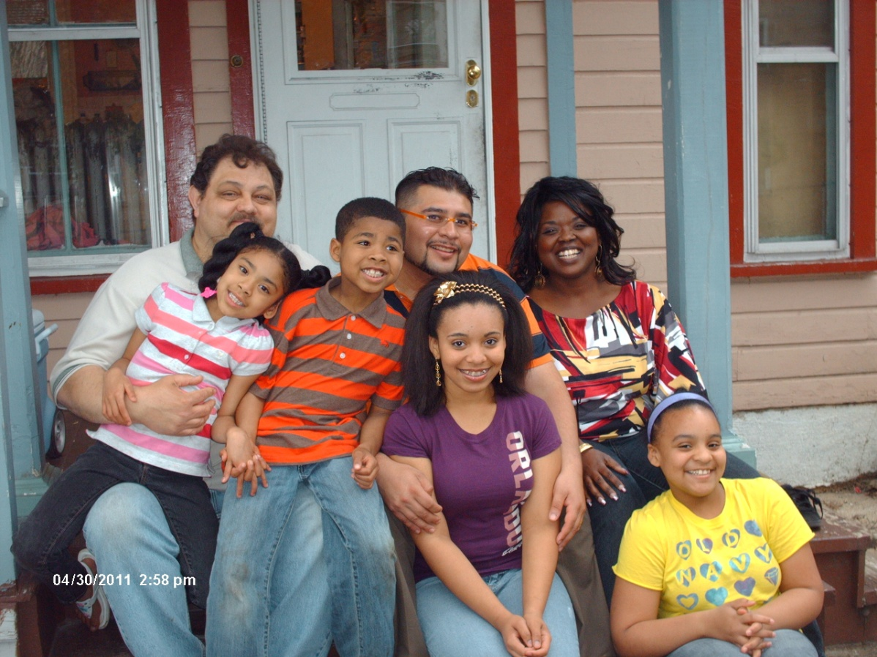
God’s Institutions
The Family

Slide 8
God’s Institutions
The Family
The first institution God created for man
The building block of society

Slide 9
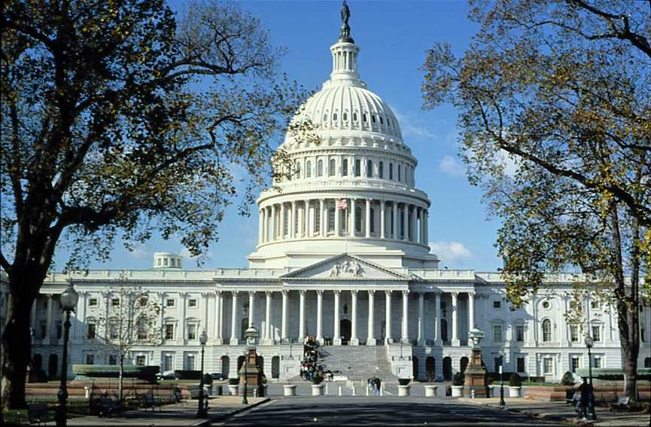
God’s Institutions
The Family
The Government

Slide 10
God’s Institutions
The Family
The first institution God created for man
The building block of society
The Government
A restraining institution (laws, punishment, etc.)
Established ON the institution of the family
Not authorized to change other institutions

Slide 11
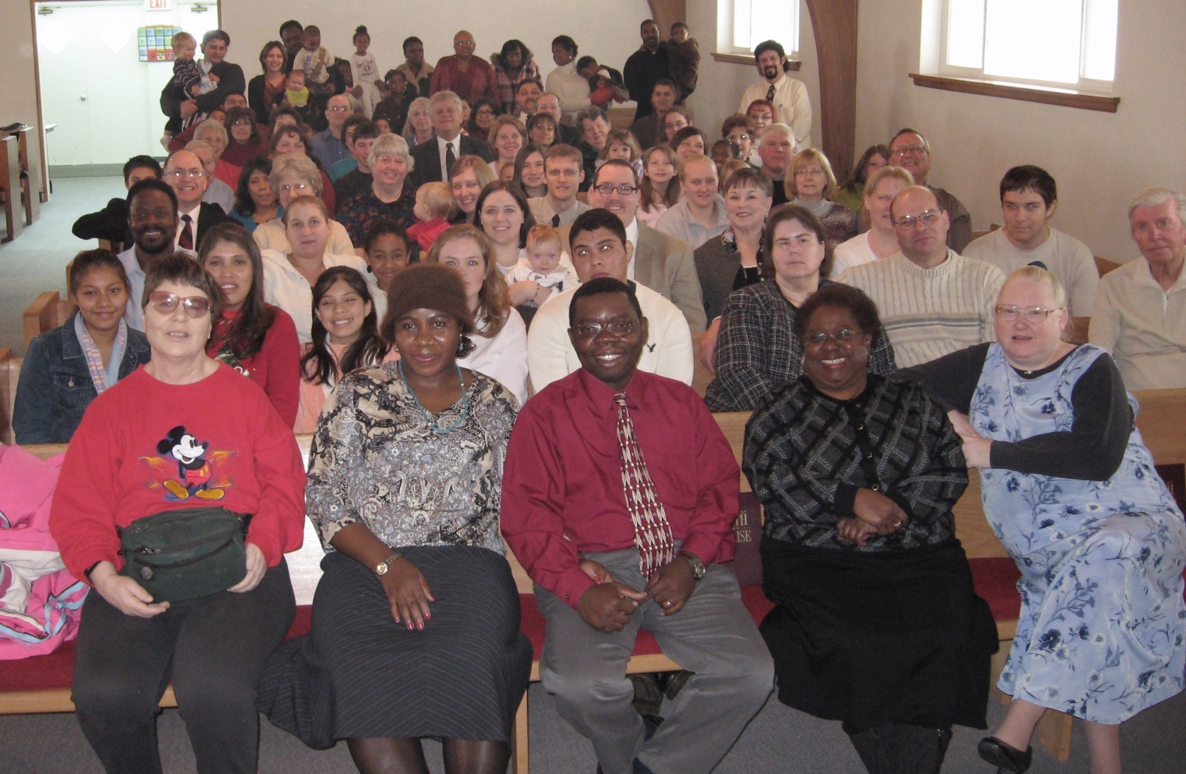
God’s Institutions
The Family
The Government
The Church

Slide 12
God’s Institutions
The Family
The first institution God created for man
The building block of society
The Government
A restraining institution (laws, punishment, etc.)
Established ON the institution of the family
Not authorized to change other institutions
The Church
The family/community of the saved
Ultimately, spiritual in nature

Slide 13
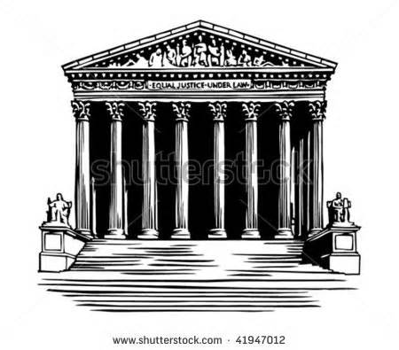
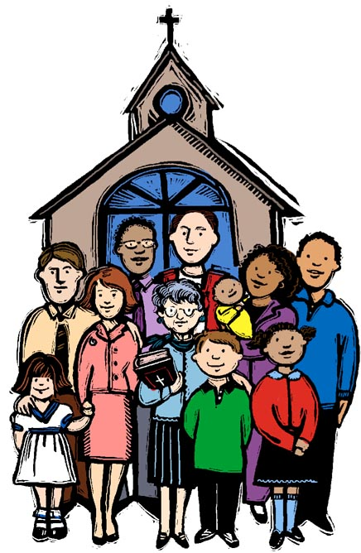
God’s Institutions

Slide 14
Genesis 2:24
“Therefore” – a conclusion, result

Slide 15
Genesis 2:24
Therefore – a conclusion, result
Shall – a statement of fact, an obligation

Slide 16
Genesis 2:24
Therefore – a conclusion, result
Shall – a statement of fact, an obligation
A man – maturity, not a child

Slide 17
Genesis 2:24
Therefore – a conclusion, result
Shall – a statement of fact, an obligation
A man – maturity, not a child
Leave his father and his mother – family unit

Slide 18
Genesis 2:24
Therefore – a conclusion, result
Shall – a statement of fact, an obligation
A man – maturity, not a child
Leave his father and his mother – family unit
And be joined - commitment, new family unit

Slide 19
Genesis 2:24
Therefore – a conclusion, result
Shall – a statement of fact, an obligation
A man – maturity, not a child
Leave his father and his mother – family unit
And be joined - commitment, new family unit
To his wife - complementary, suitable, helpmate

Slide 20
Genesis 2:24
Therefore – a conclusion, result
Shall – a statement of fact, an obligation
A man – maturity, not a child
Leave his father and his mother – family unit
And be joined - commitment, new family unit
To his wife - complementary, suitable, helpmate
And they – the new male/female family

Slide 21
Genesis 2:24
Therefore – a conclusion, result
Shall – a statement of fact, an obligation
A man – maturity, not a child
Leave his father and his mother – family unit
And be joined - commitment, new family unit
To his wife - complementary, suitable, helpmate
And they – the new male/female family
Shall become – process, result, future event

Slide 22
Genesis 2:24
Therefore – a conclusion, result
Shall – a statement of fact, an obligation
A man – maturity, not a child
Leave his father and his mother – family unit
And be joined - commitment, new family unit
To his wife - complementary, suitable, helpmate
And they – the new male/female family
Shall become – process, result, future event
One flesh – intimacy, exclusiveness, unity

Slide 23
God Binds Together
There is a third party at all marriages: God
He hears our vows
He does the marriage bonding
The actual ceremony will vary (laws, customs)

Slide 24
God Binds Together
There is a third party at all marriages: God
He hears our vows
He does the marriage bonding
The actual ceremony will vary (laws, customs)
This is true whether or not you are one of God’s people
God’s institution is universal–“…in the beginning…” (Mark 10:6-8)
Herod/Herodias (Mark 6:18)
Samaritan woman (John 4:18)

Slide 25
Only God Can Loose
When man tries to change this, he complicates matters
Individually – multiple marriages

Slide 26
Only God Can Loose
When man tries to change this, he complicates matters
Individually – multiple marriages
Gov’t – no-fault div., common-law marriage

Slide 27
Only God Can Loose
When man tries to change this, he complicates matters
Individually – multiple marriages
Gov’t – no-fault div., common-law marriage
Churches – “What you did before…”

Slide 28
Only God Can Loose
When man tries to change this, he complicates matters
Individually – multiple marriages
Gov’t – no-fault div., common-law marriage
Churches – “What you did before…”
There are only two ways to end a marriage
Death – Romans 7:1-3; 1 Corinthians 7:39

Slide 29
Only God Can Loose
When man tries to change this, he complicates matters
Individually – multiple marriages
Gov’t – no-fault div., common-law marriage
Churches – “What you did before…”
There are only two ways to end a marriage
Death – Romans 7:1-3; 1 Corinthians 7:39
Divorce due to adultery – Matthew 19:1-9
God hates divorce – Malachi 2:16
Only the innocent party is loosed

Slide 30
Some reject God’s authority
They may have a piece of paper stating something that a Higher Authority rejects

Slide 31
Some reject God’s authority
They may have a piece of paper stating something that a Higher Authority rejects
They have no basis for accepting/rejecting any innovation in marriage

Slide 32
Some reject God’s authority
They may have a piece of paper stating something that a Higher Authority rejects
They have no basis for accepting/rejecting any innovation in marriage
They must recognize that they are rejecting God’s authority in place of another authority

Slide 33
Some reject God’s authority
They may have a piece of paper stating something that a Higher Authority rejects
They have no basis for accepting/rejecting any innovation in marriage
They must recognize that they are rejecting God’s authority in place of another authority
They will stand before God on Judgment Day
Matthew 28:18; John 8:31
John 6:66-68

Slide 34
CONCLUSION
Male and female
Opposite, not same, sex
Singular
Not good that man should be alone (Gen. 2:18)
Woman was not an afterthought
God had already created male/female (as well as other variations of reproduction)
Man needed to understand his need

Slide 35
CONCLUSION
God created the institution of marriage
In the beginning (Gen. 2:24 is prophetic – no father or mother yet)
He decided what is acceptable in His sight
He binds
He looses
He blesses the marriage
Our choice is whether we obey or not

Slide 36
Are YOU a Christian?
Hear
Believe
Repent
Confess
Be Baptized
Continue Faithfully
Romans 10:17
Mark 16:16
Acts 2:38
Acts 22:16
Mark 16:16
Hebrews 10:38

