Slide 1
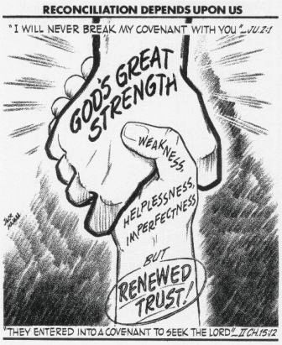
Are You Using ALL Your Strength?
2 Corinthians 1:8-9

Slide 2
INTRODUCTION
A little boy was trying to roll a rock as his father watched from a distance. The boy was heaving and sighing, but he couldn’t turn the stone over. His dad said to him, “Son, are you using all of your strength?” The boy said, “Yes, Daddy, I’m using it all.” And the father said, “No, you’re not. You haven’t asked me to help you.”

Slide 3
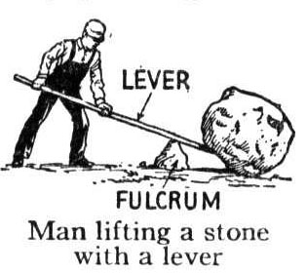
We use aids all the time
Lever/Fulcrum

Slide 4
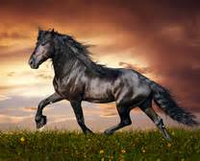
We use aids all the time
Lever/Fulcrum
Horse

Slide 5
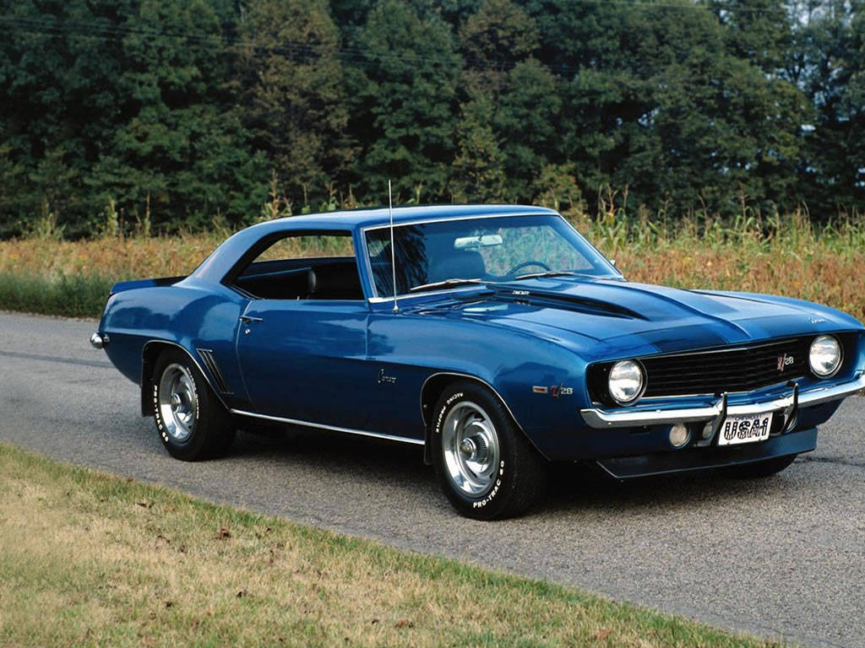
We use aids all the time
Lever/Fulcrum
Horse
Auto

Slide 6
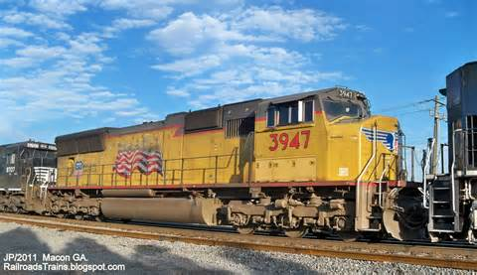
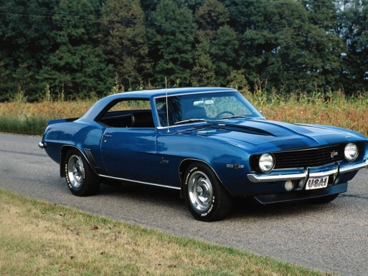
We use aids all the time
Lever/Fulcrum
Horse
Auto
Train

Slide 7
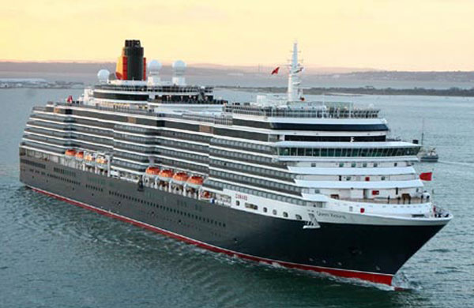
We use aids all the time
Lever/Fulcrum
Horse
Auto
Train
Boats

Slide 8
We use aids all the time
Lever/Fulcrum
Horse
Auto
Train
Boats
So, too, in the spiritual realm

Slide 9
“I can do it myself.”
One can walk from Elgin to Chicago and back. That doesn’t mean that it would be wise to forego all aids and do it, just because it CAN be done.

Slide 10
“I can do it myself.”
One can walk from Elgin to Chicago and back. That doesn’t mean that it would be wise to forego all aids and do it, just because it CAN be done.
This is a form of pride. We trust in our own strength.

Slide 11
“I can do it myself.”
One can walk from Elgin to Chicago and back. That doesn’t mean that it would be wise to forego all aids and do it, just because it CAN be done.
This is a form of pride. We trust in our own strength.
1 Corinthians 10:12 – “Let him who thinks…”

Slide 12
“I can do it myself.”
One can walk from Elgin to Chicago and back. That doesn’t mean that it would be wise to forego all aids and do it, just because it CAN be done.
This is a form of pride. We trust in our own strength.
1 Corinthians 10:12 – “Let him who thinks…”
Notice Judges 7:1-7 – Gideon and the 300 men

Slide 13
Nothing is impossible for God
Genesis 18:14 – Isaac’s birth promised

Slide 14
Nothing is impossible for God
Genesis 18:14 – Isaac’s birth promised
Jeremiah 32:17-27 – Jeremiah asks, God answers

Slide 15
Nothing is impossible for God
Genesis 18:14 – Isaac’s birth promised
Jeremiah 32:17-27 – Jeremiah asks, God answers
Luke 1:37 – virgin birth of Jesus

Slide 16
Nothing is impossible for God
Genesis 18:14 – Isaac’s birth promised
Jeremiah 32:17-27 – Jeremiah asks, God answers
Luke 1:37 – virgin birth of Jesus
Matthew 19:26 – Entering the kingdom

Slide 17
Nothing is impossible for God
Genesis 18:14 – Isaac’s birth promised
Jeremiah 32:17-27 – Jeremiah asks, God answers
Luke 1:37 – virgin birth of Jesus
Matthew 19:26 – Entering the kingdom
Romans 4:21 – God’s promises

Slide 18
Nothing is impossible for God
Genesis 18:14 – Isaac’s birth promised
Jeremiah 32:17-27 – Jeremiah asks, God answers
Luke 1:37 – virgin birth of Jesus
Matthew 19:26 – Entering the kingdom
Romans 4:21 – God’s promises
Isaiah 40:31 – Spiritual strength

Slide 19
Nothing is impossible for God
Genesis 18:14 – Isaac’s birth promised
Jeremiah 32:17-27 – Jeremiah asks, God answers
Luke 1:37 – virgin birth of Jesus
Matthew 19:26 – Entering the kingdom
Romans 4:21 – God’s promises
Isaiah 40:31 – Spiritual strength
Philippians 4:13 – I can do all things…

Slide 20
Paul’s thorn in the flesh
2 Corinthians 12:7-10

Slide 21
Paul’s thorn in the flesh
2 Corinthians 12:7-10
“…to keep me from exalting myself…”

Slide 22
Paul’s thorn in the flesh
2 Corinthians 12:7-10
“…to keep me from exalting myself…”
“…implored the Lord three times…”

Slide 23
Paul’s thorn in the flesh
2 Corinthians 12:7-10
“…to keep me from exalting myself…”
“…implored the Lord three times…”
“…power is perfected in weakness.”

Slide 24
Paul’s thorn in the flesh
2 Corinthians 12:7-10
“…to keep me from exalting myself…”
“…implored the Lord three times…”
“…power is perfected in weakness.”
“…I am well content with weaknesses …for Christ’s sake…”

Slide 25
Paul’s thorn in the flesh
2 Corinthians 12:7-10
“…to keep me from exalting myself…”
“…implored the Lord three times…”
“…power is perfected in weakness.”
“…I am well content with weaknesses …for Christ’s sake…”
“…when I am weak, then I am strong.”

Slide 26
Paul’s thorn in the flesh
2 Corinthians 12:7-10
“…to keep me from exalting myself…”
“…implored the Lord three times…”
“…power is perfected in weakness.”
“…I am well content with weaknesses …for Christ’s sake…”
“…when I am weak, then I am strong.”
Luke 18:9-14 – Too many of us still have not learned what the Pharisee’s error was

Slide 27
God overcomes the world
John 16:33
“In the world you have tribulation, but take courage; I have overcome the world.“

Slide 28
God overcomes the world
John 16:33
“In the world you have tribulation, but take courage; I have overcome the world.“
Psalm 23:4
“Even though I walk through the valley of the shadow of death, I fear no evil, for you are with me…”

Slide 29
CONCLUSION
The Armor of God
Be strong in the Lord
In the strength of His might
Full armor of God
Stand firm
Resist in the evil day
Romans 8:37 – …we are more than conquerors through Him…

Slide 30
Are YOU a Christian?
Hear
Believe
Repent
Confess
Be Baptized
Continue Faithfully
Romans 10:17
Mark 16:16
Acts 2:38
Acts 22:16
Mark 16:16
Hebrews 10:38

