Slide 1
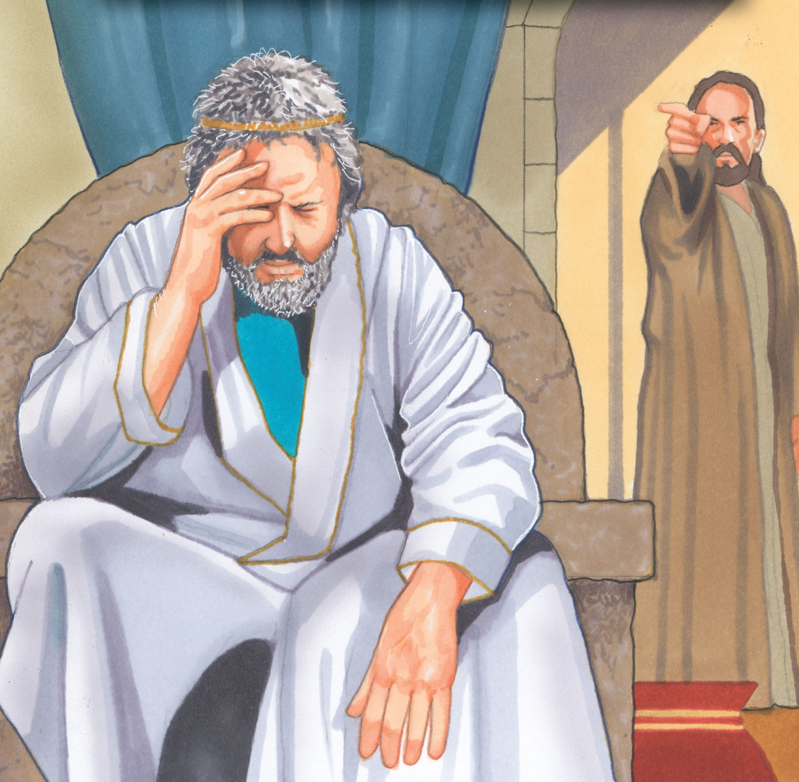
An “A-HA” Moment
2 Samuel 12:1-13

Slide 2
INTRODUCTION
Have you ever had an “A-Ha Moment”?
Sometimes, it’s because of something someone says

Slide 3
INTRODUCTION
Have you ever had an “A-Ha Moment”?
Sometimes, it’s because of something someone says
Sometimes, it’s because you’ve done some serious thinking

Slide 4
INTRODUCTION
Have you ever had an “A-Ha Moment”?
Sometimes, it’s because of something someone says
Sometimes, it’s because you’ve done some serious thinking
Sometimes, you have no idea why it came to you

Slide 5
INTRODUCTION
Have you ever had an “A-Ha Moment”?
Sometimes, it’s because of something someone says
Sometimes, it’s because you’ve done some serious thinking
Sometimes, you have no idea why it came to you
Merriam-Webster definition:
A moment of sudden realization, inspiration, insight, recognition, or comprehension (1939)

Slide 6
INTRODUCTION
Have you ever had an “A-Ha Moment”?
Sometimes, it’s because of something someone says
Sometimes, it’s because you’ve done some serious thinking
Sometimes, you have no idea why it came to you
Merriam-Webster definition:
A moment of sudden realization, inspiration, insight, recognition, or comprehension (1939)
Rey definition: A light-bulb moment

Slide 7
INTRODUCTION
I’ve been thinking about this lesson for a while now
Collecting scriptures
Thinking about how to present it

Slide 8
INTRODUCTION
I’ve been thinking about this lesson for a while now
Collecting scriptures
Thinking about how to present it
Then, along comes an article by Nathan Morrison (sent out by Ron Halbrook)
He did most of my work for me
So, I tweaked it and here it is

Slide 9
David
2 Samuel 11-12
David sins with Bathsheba
He tries to cover it up; it goes from bad to worse
God sends Nathan to confront David

Slide 10
David
2 Samuel 11-12
David sins with Bathsheba
He tries to cover it up; it goes from bad to worse
God sends Nathan to confront David
A-HA
Verse 7 – “You are the man!”
Verse 13 – “I have sinned.”

Slide 11
Naaman
2 Kings 5
Naaman, an important man, had leprosy
He came to Elisha to be cured, expecting a miracle
When told to dip seven times in the Jordan, he went away angry (verses 10-11)

Slide 12
Naaman
2 Kings 5
Naaman, an important man, had leprosy
He came to Elisha to be cured, expecting a miracle
When told to dip seven times in the Jordan, he went away angry (verses 10-11)
A-HA
Verse 13 – His servants pointed out the truth of the matter
Verse 14 – He does as he was told and is healed

Slide 13
The Prodigal Son
Luke 15:11-24
Wasted his inheritance w/loose living (verse 13)
Living among pigs (unclean animal)
Desiring their food (slop)

Slide 14
The Prodigal Son
Luke 15:11-24
Wasted his inheritance w/loose living (verse 13)
Living among pigs (unclean animal)
Desiring their food (slop)
A-HA
Verse 17 – Came to his senses
Verse 18-19 – Humbly plans to return home and accept the consequences
Verses 20-24 – He is accepted back

Slide 15
Jews on Pentecost
Acts 2:14-47
The same Jews who had been part of the crowd that shouted “Crucify Him!” and “His blood shall be on us and on our children!” (Matt 27:22-25)
The had been manipulated by the rulers
Jesus had prayed for their forgiveness

Slide 16
Jews on Pentecost
Acts 2:14-47
The same Jews who had been part of the crowd that shouted “Crucify Him!” and “His blood shall be on us and on our children!” (Matt 27:22-25)
The had been manipulated by the rulers
Jesus had prayed for their forgiveness
A-HA
Verse 36 – “…whom you crucified.”
Verse 37 – Pierced to their hearts…”What shall we do?” Answer: verse 38

Slide 17
Peter
Confessed Jesus’ deity 3x
Luke 5:8 – As a new apostle
Matthew 16:16 – Well known confession
John 6:69 – “To whom shall we go?”

Slide 18
Peter
Confessed Jesus’ deity 3x
Luke 5:8 – As a new apostle
Matthew 16:16 – Well known confession
John 6:69 – “To whom shall we go?”
Denies Jesus 3x – Luke 22:54-60

Slide 19
Peter
Confessed Jesus’ deity 3x
Luke 5:8 – As a new apostle
Matthew 16:16 – Well known confession
John 6:69 – “To whom shall we go?”
Denies Jesus 3x – Luke 22:54-60
Is asked about his love 3x (John 21)

Slide 20
Peter
Confessed Jesus’ deity 3x
Luke 5:8 – As a new apostle
Matthew 16:16 – Well known confession
John 6:69 – “To whom shall we go?”
Denies Jesus 3x – Luke 22:54-60
Is asked about his love 3x (John 21)
A-HA
Luke 22:61 – A look from Jesus
Verse 62 - …went out and wept bitterly

Slide 21
Bad examples
Judas
(In)famously betrayed Jesus with a kiss for 30 pieces of silver (Matthew 26)
Matthew 27:3 – Realized what he had done
Matthew 27:5 – didn’t repent-killed himself

Slide 22
Bad examples
Judas
(In)famously betrayed Jesus with a kiss for 30 pieces of silver (Matthew 26)
Matthew 27:3 – Realized what he had done
Matthew 27:5 – didn’t repent-killed himself
King Agrippa
Acts 26 – He was familiar with Jews/Scriptures
Verse 27 – “Do you believe…?” “I know…you do.”
Verse 28 – “In a short time…”

Slide 23
CONCLUSION
There are many ways to get to an “A-HA” moment
By someone accusing you (Nathan)
By someone reminding you (Naaman)
By looking around at your circumstances (son)
By hearing what you’ve done (Jews)
Simply, by a look
Hopefully, you’ll have a correct response

Slide 24
Are YOU a Christian?
Hear
Believe
Repent
Confess
Be Baptized
Continue Faithfully
Romans 10:17
Mark 16:16
Acts 2:38
Acts 22:16
Mark 16:16
Hebrews 10:38

