Slide 1
WHY?
Why…
Do we meet at 9:45 AM, 10:45 AM & 5 PM on Sunday?
Do we meet on Wednesdays? At 7 PM?
Have Gospel Meetings twice a year?
Change our meeting times to 7:30 PM for G.M.s?
Have the collection after the Lord’s Supper?
Close with a closing prayer?
Have an invitation song?

Slide 2
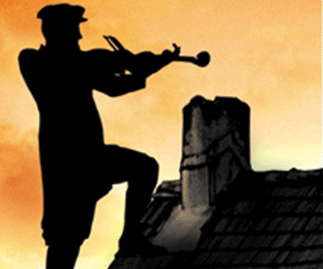
TRADITION!
2 Thessalonians
2:15

Slide 3
INTRODUCTION
Jewish identity and culture
Tanakh (Hebrew Bible) and rabbinic writings
Traditions
Catholics base their authority on the concept of Living Magisterium
Bible (and “ex cathedra”)
Their own traditions
Many Protestant denominations also base their authority for doing things on…
“We’ve always done them that way.” (Tradition)

Slide 4
The Lord’s church
“Speak where the Bible speaks and be silent where the Bible is silent.” (1 Corinthians 4:6)
The silence of the Scriptures prohibits, never authorizes. (Hebrews 7:14)
“1st century Christians” (Acts 11:26)
church of Christ (Romans 16:16)
Ready to give a defense (1 Peter 3:15)
Not add to, take from, change in any way, etc.

Slide 5
WHAT DOES “TRADITION” MEAN?
Etymology - “trans” (over) + “dare” (give)
To deliver, hand over, hand down
A doublet of “treason”
Tradition (good sense), treason (bad sense)
Example: zealous/jealous
By word of mouth (story, song) or writing

Slide 6
THE WORD “TRADITION” IN THE N.T.
1) Handed down by Jewish fathers/elders
Constituted the “oral law”
Mitzvah
Most common use in the New Testament
Originally, wrongly considered equal to OT
Pharisees gave even greater authority to it
Mark 7:1-13; Galatians 1:14; Colossians 2:8

Slide 7
THE WORD “TRADITION” IN THE N.T.
2) Gospel truths taught during NT times
3 references – all by Paul
1 Corinthians 11:2
2 Thessalonians 2:15; and 3:6
Apostles verbally taught the Gospel as well as writing it down in what we refer to as the New Testament gospels, epistles, etc.

Slide 8
THE WORD “TRADITION” IN THE N.T.
2) Gospel truths taught during NT times
Some are recorded by the Holy Spirit as NT sermons and/or conversations
These did not contradict written passages
Not adding to Scriptures
Don’t authorize us to bind our traditions
Expedients may change our traditions

Slide 9
CONCLUSION
Traditions can be oral or written
They’re helpful in many ways, within limits
They can be divine in origin or of human origin
Traditions may be tied to expedients
We must still abide by the revealed word of God

Slide 10
Are YOU a Christian?
Hear
Believe
Repent
Confess
Be Baptized
Continue Faithfully
Romans 10:17
Mark 16:16
Acts 2:38
Acts 22:16
Mark 16:16
Hebrews 10:38

