Slide 1
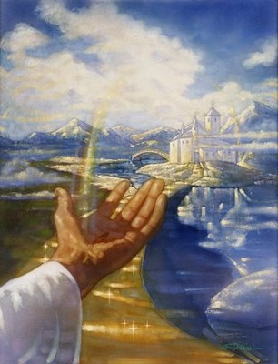
If You Don’t Make It To Heaven
John 3:16

Slide 2
INTRODUCTION
Back to basics
This is a basic, fundamental lesson
For those who are new to the Gospel
For those who have yet to accept Christ, Christianity
Even for those who have been Christians for years
The visitor will hear needed information
The spiritual warrior will be reminded (2 Peter 1:12-13; 3:1)
“Drooping leaves may indicate root problems”

Slide 3
On Our Minds/Hearts
A basic desire in all mankind
Non-Christian (Religious, atheist, agnostic, etc)
Central to Christianity (2 Peter 1:9)
Songs we sing:
When the Roll is Called Up Yonder
When We All Get to Heaven
When All of God’s Singers Get Home
God also wants us to make it
John 3:16
2 Peter 3:9b

Slide 4
What has God done to help?
Shined the light on the correct path
This eliminates the questions:
Which? Where? & What way?
Apart from God, we are all in darkness
If we are led by anyone other than God, we are like “the blind leading the blind”
Matthew 15:14

Slide 5
What has God done to help?
…and on the dangers/tricks of the false ones
Based on our own reasoning
Proverbs 14:12
Jeremiah 10:23
Based on others
Rom 1:22; Matt 15:14
Based on Satan
1 Tim 4:1-3
2 Thess 2:9

Slide 6
What has God done to help?
Given us the standard
God’s revealed will
John 5:39-40; 8:37; 12:48
Compared to our actions – 2 Corinthians 5:10
Some (many) will fail
Daniel 4 (Belshazzar & the handwriting on the wall)
Matthew 7:21

Slide 7
What has God done to help?
He has given us the rule book/instructions
1 Corinthians 2:10-13, 16
Contrary to what the world may think, we DO come with an owner’s manual!
Luke 16:28-31 – Rich man/Lazarus
Jude 3b – “…once for all given…”

Slide 8
What has God done to help?
Sent His Son to do what we couldn’t
Not just to die (we can all do that)
To live a perfect life
To die without sin (Hebrews 4:15)
Then, to offer that payment of sin to us for free
John 3:17-18
1 John 4:10
Romans 6:23

Slide 9
What has God done to help?
Keeps the adversary in check (limits him)
Job 1 – Actually, there has never been a time when Satan could do whatever he felt like doing
1 John 4:4
James 4:7
Jude 6

Slide 10
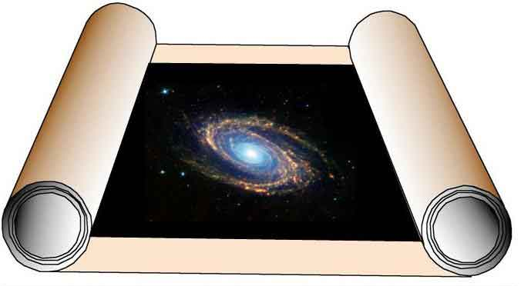
What has God done to help?
Let’s us read how the story ends
Revelation 1-22
I like “Spoilers” (movie, book, etc.)
We read about the dark hours coming (no surprises)
And of our need to endure
And of our victory
And of our reward
These isn’t just wishful
thinking-it’s prophecy

Slide 11
What has God done to help?
Warns us of what hell will be like
Matthew 25:41 – originally for the devil/demons
Matthew 25:30 – outer darkness
Rev. 20:10-15 – lake of fire
Matt 13:50 – weeping/gnashing of teeth
Mark 9:48 – worm never dies…
Rev 14:10 – fire/brimstone
Rev 14:11 – eternal
2 Th 1:9 - away from
God’s presence

Slide 12
CONCLUSION
We all want (or, should want) to get to Heaven
God also wants us to get to Heaven
He’s done everything we can’t do ourselves
And given us everything we need to make it to Heaven
If we don’t make it to Heaven, the eternal wailing may just be from the memory
Of the things we put before God
Of the opportunities we passed up

Slide 13
Are YOU a Christian?
Hear
Believe
Repent
Confess
Be Baptized
Continue Faithfully
Romans 10:17
Mark 16:16
Acts 2:38
Acts 22:16
Mark 16:16
Hebrews 10:38

