Slide 1
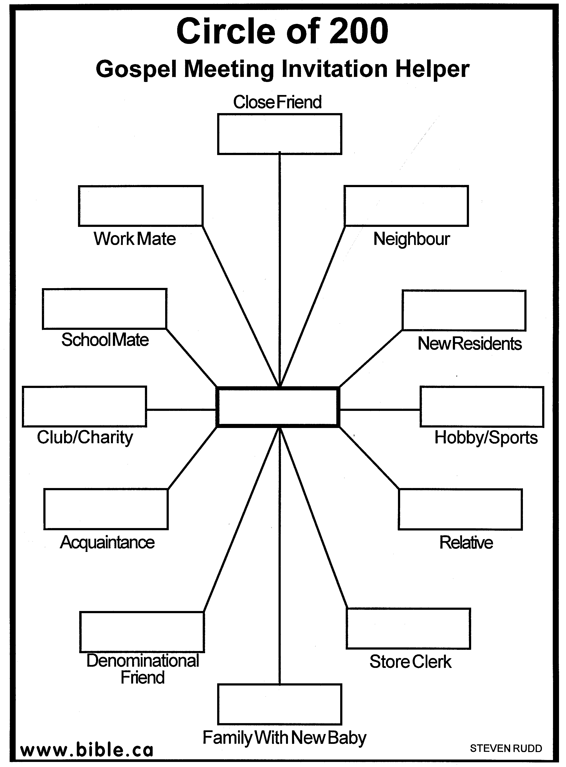
Gospel Meeting – Why?
Acts 13:42-44

Slide 2
INTRODUCTION
Acts 13:44 – Q?: Wouldn’t it be great if the whole city turned out next week?
…or, at least enough to fill our building to overflowing?
Let’s look at a few things regarding the upcoming meeting
What it isn’t
What it should be
What each of us can do to help

Slide 3
What Its Purpose Is NOT
To raise funds/Promote human institutions
Rough economy/less members-money needed
God has authorized – 1 Corinthians 16:1-2
Cheerful, free-will offering by brethren on 1st day
No collections from visitors or on weekdays
To arouse emotions/ excitement/ gimmicks
No speaking in tongues/ no famous people
No “Karate for Christ” or “Weightlifters for God”
We teach God’s way – John 6:45; Romans 1:16

Slide 4
What Its Purpose Is NOT
To amuse/ amaze/ entertain
No professional singers/magicians/clowns
No buffet afterwards, no hidden prizes
Romans 14:17; 1 Corinthians 11:34,22
To embarrass/ brow beat/ scare
We will preach on hellfire/judgment where needed
However, 1 Corinthians 4:6
Acts 20:20, 27

Slide 5
The Purpose of a Gospel Meeting IS
To teach God’s word
1 Timothy 3:15 – the church is the pillar/support of truth
Matthew 13:18, 23 – the word of the Kingdom is the spiritual seed that we must sow-1 Peter 1:23
To worship and exalt God
Matthew 28:18-20 – Great Commission – Go
1 Corinthians 15:1-4 – message preached

Slide 6
The Purpose of a Gospel Meeting IS
To call the lost
Romans 1:16 – The power of God
1 Corinthians 1:18, 24 – The word of the cross
2 Timothy 3:15 – lead to salvation…
2 Thess. 2:13-14 – called through the gospel
To edify/encourage the Christians
Acts 20:32 – the word of His grace
Ephesians 4:11-12 – ...edification…
2 Timothy 4:2 – preach the word…exhort…

Slide 7
What Can I Do?
Pray
Ephesians 6:18-20 – Paul’s request
2 Thessalonians 3:1 – spread rapidly
Assemble – Hebrews 10:25
What if someone I invite comes and I’m not there?
Set the example for others
Be edified

Slide 8
What Can I Do?
Arrive early
Think “7 PM” (hopefully, you’ve prepared ahead)
Zeal, enthusiasm; not hurriedness
Welcome visitors – Christians or not
Philippians 2:4 – show interest for others
Participate
Ephesians 5:19; Colossians 3:16 - sing
“He who has an ear to hear…” – pay attention

Slide 9
What Can I Do?
Invite people – Acts 10:24 (Cornelius)
If you can’t be a “Peter”, be an “Andrew”
Proverbs 11:30 – He who is wise wins souls
Offer to give a ride, if possible
Invite people you’ve previously invited
Invite total strangers
See “invitation wheel” (from Bible.ca)

Slide 10
“INVITATION WHEEL”

Slide 11
CONCLUSION
Gospel Meetings ARE a “thing of the past”
…and a thing of the future, and of the present
They serve the same purpose they always have – God’s purpose
Spread the truth
Edify Christians
Call the lost
We need to be busy doing God’s work

Slide 12
Are YOU a Christian?
Hear
Believe
Repent
Confess
Be Baptized
Continue Faithfully
Romans 10:17
Mark 16:16
Acts 2:38
Acts 22:16
Mark 16:16
Hebrews 10:38

