Slide 1
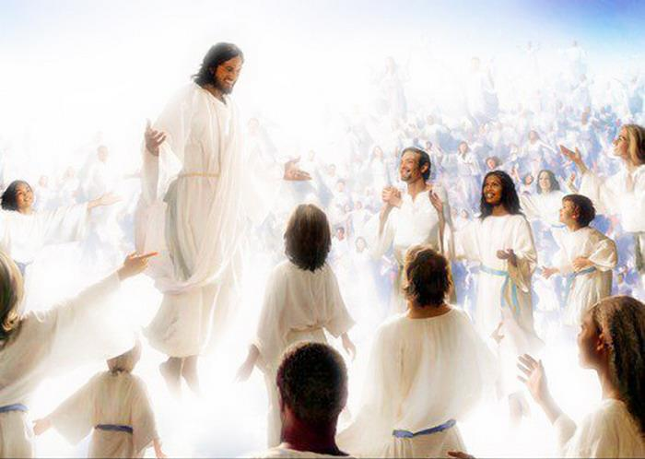
Conformed to His Image
Romans 8:28-31

Slide 2
INTRODUCTION
Genesis 1:26-27 says:
Then God said, “Let Us make man in Our image, according to Our likeness…(and) God created man in His own image, in the image of God He created him; male and female He created them.

Slide 3
INTRODUCTION
Genesis 1:26-27 says:
Then God said, “Let Us make man in Our image, according to Our likeness…(and) God created man in His own image, in the image of God He created him; male and female He created them.
Verse 31: “…it was very good.”
Genesis 5:1; 9:6; etc.

Slide 4
INTRODUCTION
Genesis 1:26-27 says:
Then God said, “Let Us make man in Our image, according to Our likeness…(and) God created man in His own image, in the image of God He created him; male and female He created them.
Verse 31: “…it was very good.”
Genesis 5:1; 9:6; etc.
Then, man sinned (Genesis 3), and the image was marred

Slide 5
INTRODUCTION
1 Corinthians 15:42-50
Dead/resurrected
Perishable/imperishable

Slide 6
INTRODUCTION
1 Corinthians 15:42-50
Dead/resurrected
Perishable/imperishable
Dishonor/glory
Weakness/power

Slide 7
INTRODUCTION
1 Corinthians 15:42-50
Dead/resurrected
Perishable/imperishable
Dishonor/glory
Weakness/power
Natural/spiritual
Adam/Christ
Earthy/heavenly

Slide 8
INTRODUCTION
1 Corinthians 15:42-50
Dead/resurrected
Perishable/imperishable
Dishonor/glory
Weakness/power
Natural/spiritual
Adam/Christ
Earthy/heavenly
God repairs the image through Christianity

Slide 9
Romans 8:29-30
Paul refers to a process that we are a part of that prepares us for being with God
2 Peter 1:2-11 – Peter also describes our growth
Paul’s reference to this process is not all-inclusive
Notice: no holiness, sanctification, etc.
1 Peter 1:14-16; 1 John 3:7, etc.
He calls this “…to become conformed to the image of His Son.”
Without this preparation, we will not enter Heaven

Slide 10
The Process
Since we are unique in our…
Strengths/weaknesses
Abilities
History
Etc.

Slide 11
The Process
Since we are unique in our…
Strengths/weaknesses
Abilities
History
Etc.
The process is unique to each of us
Many similarities
Same goal

Slide 12
The Process
The image is not repaired instantly
It is described as “a walk” (Romans 6:4; 8:4)
It is a life-long “marathon” (Hebrews 12:1-2)
A “maturing” (Hebrews 5:12-14; Eph 2)

Slide 13
The Process
The image is not repaired instantly
It is described as “a walk” (Romans 6:4; 8:4)
It is a life-long “marathon” (Hebrews 12:1-2)
A “maturing” (Hebrews 5:12-14; Eph 2)
Some things are easier; some harder
Sometimes it is painful (Jas 1:2-4; 1 Peter 1:7)

Slide 14
The Process
The image is not repaired instantly
It is described as “a walk” (Romans 6:4; 8:4)
It is a life-long “marathon” (Hebrews 12:1-2)
A “maturing” (Hebrews 5:12-14; Eph 2)
Some things are easier; some harder
Sometimes it is painful (Jas 1:2-4; 1 Peter 1:7)
We make choices/reactions daily
Remember: we are in His capable hands (Philippians 3:21)
1 John 3:2 – The process does have an end

Slide 15
The Process
The image is that of Jesus
We are not called to be like other Christians, we are called to be like Christ.
Ephesians 5:1-3; 1 Corinthians 11:1
1 Peter 2:21

Slide 16
The Process
The image is that of Jesus
We are not called to be like other Christians, we are called to be like Christ.
Ephesians 5:1-3; 1 Corinthians 11:1
1 Peter 2:21
From easier to harder
Pre-school. grade school, college, specialty
Matthew 13:12

Slide 17
2 Corinthians 3:18
Unveiled face
By turning to the Lord – v 16
1 Corinthians 4:3-5 – the alternative

Slide 18
2 Corinthians 3:18
Unveiled face
By turning to the Lord – v 16
1 Corinthians 4:3-5 – the alternative
In a mirror…glory
1 Corinthians 13:12 – now…then
Not the substance, but enough

Slide 19
2 Corinthians 3:18
Unveiled face
By turning to the Lord – v 16
1 Corinthians 4:3-5 – the alternative
In a mirror…glory
1 Corinthians 13:12 – now…then
Not the substance, but enough
Transformed…same image
From one to another
Growth

Slide 20
CONCLUSION
We have a “blessed assurance”
The One who began the process (work) will finish it (Philippians 1:6)
God works through His word
The milk/meat
The word of God is not only given to inform us, but to transform us.
Have you allowed God to start the process?

Slide 21
Are YOU a Christian?
Hear
Believe
Repent
Confess
Be Baptized
Continue Faithfully
Romans 10:17
Mark 16:16
Acts 2:38
Acts 22:16
Mark 16:16
Hebrews 10:38

