Slide 1
INTRODUCTION
Q?: What do these have in common?
Song of Deborah
Lord’s Supper

Slide 2
INTRODUCTION
Q?: What do these have in common?
Song of Deborah
Lord’s Supper
Hymn: “When I Survey the Wondrous Cross”
Daily Bible readings

Slide 3
INTRODUCTION
Q?: What do these have in common?
Song of Deborah
Lord’s Supper
Hymn: “When I Survey the Wondrous Cross”
Daily Bible readings
Children’s song: “Jesus Chose Them One By One”
Genealogies of Matthew 1 & Luke 3

Slide 4
INTRODUCTION
Q?: What do these have in common?
Song of Deborah
Lord’s Supper
Hymn: “When I Survey the Wondrous Cross”
Daily Bible readings
Children’s song: “Jesus Chose Them One By One”
Genealogies of Matthew 1 & Luke 3
A: They all help us remember something

Slide 5
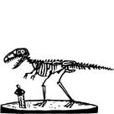
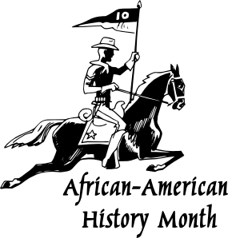
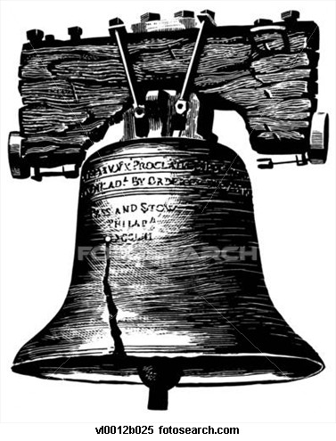
WHY HISTORY?
Joshua
4:1-9

Slide 6
INTRODUCTION
History, to many, is B-O-R-I-N-G!
I hated history class in school (I wasn’t alone)
Studying “a bunch of dead people”, etc

Slide 7
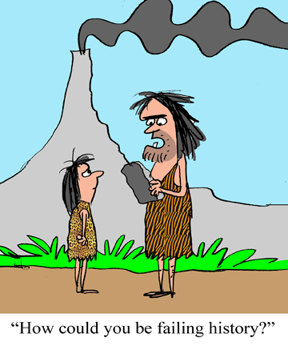

Slide 8
INTRODUCTION
History, to many, is B-O-R-I-N-G!
I hated history class in school (I wasn’t alone)
Studying “a bunch of dead people”, etc
However, it is extremely important to mankind
“Those who don’t learn from the past are doomed to repeat it”

Slide 9
INTRODUCTION
History, to many, is B-O-R-I-N-G!
I hated history class in school (I wasn’t alone)
Studying “a bunch of dead people”, etc
However, it is extremely important to mankind
“Those who don’t learn from the past are doomed to repeat it”
…and especially to God’s people
Who are we?
Why are we here?

Slide 10
INTRODUCTION
History, to many, is B-O-R-I-N-G!
I hated history class in school (I wasn’t alone)
Studying “a bunch of dead people”, etc
However, it is extremely important to mankind
“Those who don’t learn from the past are doomed to repeat it”
…and especially to God’s people
Who are we? Identity
Why are we here? Purpose

Slide 11
Aids
Many aids to remembering
Songs/poetry
Books

Slide 12
Aids
Many aids to remembering
Songs/poetry
Books
Holidays
Memorials

Slide 13
Aids
Many aids to remembering
Songs/poetry
Books
Holidays
Memorials
Games
Pictures
Other mnemonic devices – acrostics, etc.

Slide 14
God uses these
Songs/poetry
Songs of Deborah/Moses
Psalms

Slide 15
God uses these
Songs/poetry
Songs of Deborah/Moses
Psalms
Books
Kings/Chronicles
Acts

Slide 16
God uses these
Songs/poetry
Songs of Deborah/Moses
Psalms
Books
Kings/Chronicles
Acts
Holidays
Passover/Yom Kippur

Slide 17
God uses these
Songs/poetry
Songs of Deborah/Moses
Psalms
Books
Kings/Chronicles
Acts
Holidays
Passover/Yom Kippur
Memorials
Joshua 4 (stones)/Lord’s Supper (bread/wine)

Slide 18
Why History?
More than just remembering bare facts
Facts without context/purpose are not very useful
Trivia(l)

Slide 19
Why History?
More than just remembering bare facts
Facts without context/purpose are not very useful
Trivia(l)
Genealogies
Identity – Luke 3:8; John 8:33
Qualifications – Nehemiah 7:64 (Aaron/Levi)
Fulfilled prophecy – Matthew 1 & Luke 3

Slide 20
Why History?
Concern for “the big picture”
Cause/effect
(Warning: blurry/incomplete “big picture”)
Macro evolution/age of the universe, etc.
Gen 5 – death due to sin/life for walking w/God

Slide 21
Why History?
Concern for “the big picture”
Cause/effect
(Warning: blurry/incomplete “big picture”)
Macro evolution/age of the universe, etc.
Gen 5 – death due to sin/life for walking w/God
In the Bible
One event, several appl: Exodus – wrath, mercy, redemption
Several accts, one event: Christ – 4 gospels, plus
Misuse: premillenialism; 70 AD theory

Slide 22
Why History?
Identity
To relate past events to current events
How has God dealt with His people in the past
Romans 15:4; 1 Corinthians 10:6, 11
The need for God’s guidance

Slide 23
Why History?
Identity
To relate past events to current events
How has God dealt with His people in the past
Romans 15:4; 1 Corinthians 10:6, 11
The need for God’s guidance
Avoid mistakes
God’s attitude toward sin/Jesus/man/Satan/jdgmt
“Those who cannot remember the past…
“No one will live long enough to make all mistakes”

Slide 24
Why History?
Gives us hope for the future
1 Corinthians 13:13; Romans 8:24-25
2 Peter 2:4-9 – “…if…then”
2 Timothy 4:7-8 – Paul’s assurance
Acts 17:30-31 – …because God furnished proof

Slide 25
CONCLUSION
History, is all around us
Written
Oral
Memorials
Holidays

Slide 26
CONCLUSION
History, is all around us
Written
Oral
Memorials
Holidays
Knowing history is important
Identity/purpose/origin
Learning from past mistakes
Looking to the future

Slide 27
CONCLUSION
One day, history will be gone – only eternity will surround us
Until then, let’s study God’s history book

Slide 28
CONCLUSION
One day, history will be gone – only eternity will surround us
Until then, let’s study God’s history book
The Bible
Is written by God, therefore is accurate
Reveals His will
Is according to His purpose
Supplies faith, but not blind faith
Through it, we too can have a “Blessed Assurance”

Slide 29
Are YOU a Christian?
Hear
Believe
Repent
Confess
Be Baptized
Continue Faithfully
Romans 10:17
Mark 16:16
Acts 2:38
Acts 22:16
Mark 16:16
Hebrews 10:38

