Slide 1
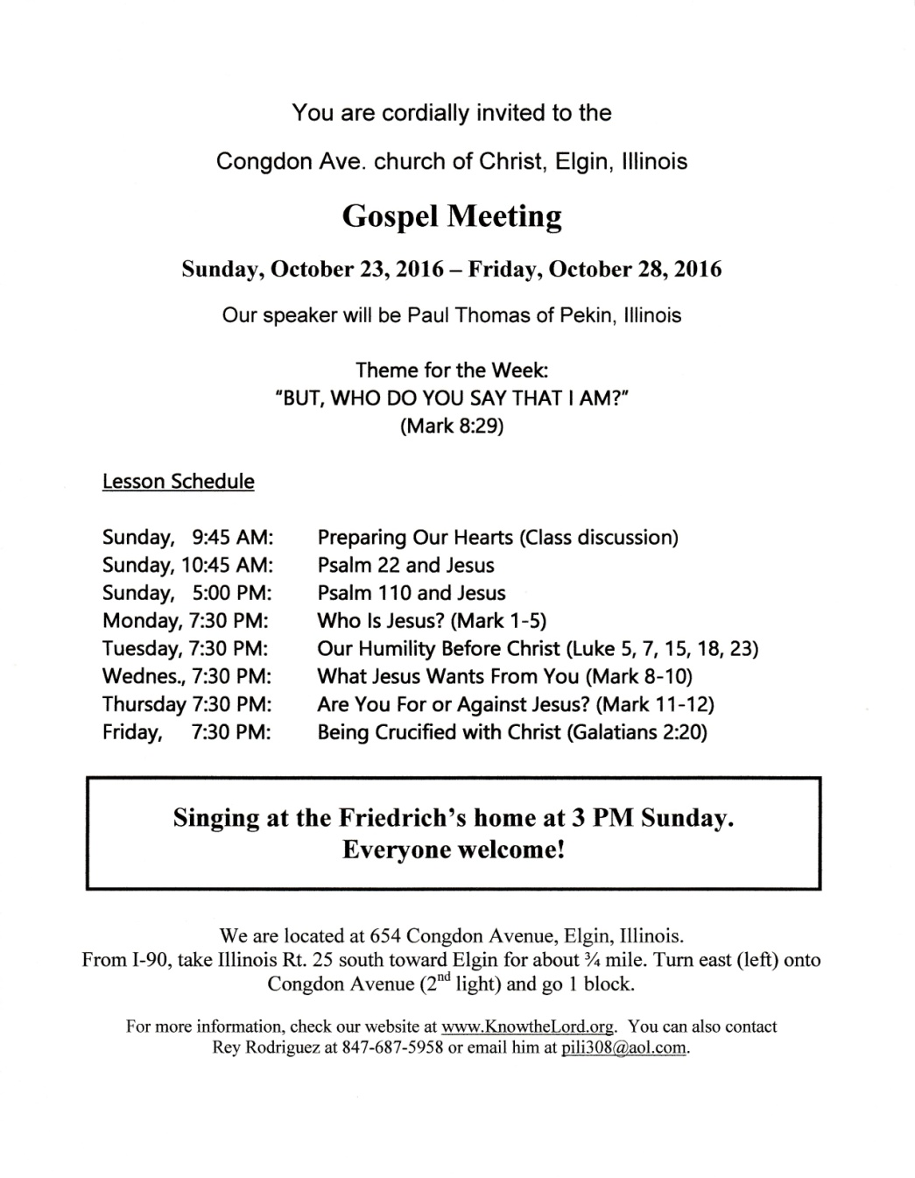
THE GOSPEL MEETING
1 Timothy 3:14-15

Slide 2
We’ve had a few glitches
We had agreed with a preacher to hold our Gospel Meeting this Fall
Due to scheduling problems, he had to pull out
This was an inconvenience, but we had plenty of time, and we understand that “things happen”

Slide 3
We’ve had a few glitches
We had agreed with a preacher to hold our Gospel Meeting this Fall
Due to scheduling problems, he had to pull out
This was an inconvenience, but we had plenty of time, and we understand that “things happen”
We agreed with another preacher to come
For personal reasons, he also had to cancel
Weird (two in a row) – never happened before
Time is getting tighter, but – no panic

Slide 4
We’ve had a few glitches
We looked at our options
Try to get a third preacher?
Hold the meeting myself?
Have various preachers come for 1-2 days each?
Not have a meeting?

Slide 5
We’ve had a few glitches
We looked at our options
Try to get a third preacher?
Hold the meeting myself?
Have various preachers come for 1-2 days each?
Not have a meeting?
We tried one more time
We found someone willing to come on short notice
We set the date and agreed on a theme
We printed up flyers, sent out announcements…

Slide 6
We’ve had a few glitches
We looked at our options
Try to get a third preacher?
Hold the meeting myself?
Have various preachers come for 1-2 days each?
Not have a meeting?
We tried one more time
We found someone willing to come on short notice
We set the date and agreed on a theme
We printed up flyers, sent out announcements…
What if I had to tell you now that…

Slide 7
THE GOSPEL MEETING

Slide 8
The Gospel Meeting
IS NOT
Cancelled!

Slide 9
INTRODUCTION
But, what if it were?
What would that mean to you?
Just another glitch, an inconvenience?
A stress (this is bad-we must get this right next time)
Maybe nothing at all?

Slide 10
INTRODUCTION
But, what if it were?
What would that mean to you?
Just another glitch, an inconvenience?
A stress (this is bad-we must get this right next time)
Maybe nothing at all?
Everyone is different, so we must examine ourselves (2 Corinthians 13:5)

Slide 11
INTRODUCTION
But, what if it were?
What would that mean to you?
Just another glitch, an inconvenience?
A stress (this is bad-we must get this right next time)
Maybe nothing at all?
Everyone is different, so we must examine ourselves (2 Corinthians 13:5)
Again, Paul Thomas will be here on the 23rd, Lord willing

Slide 12
If the meeting were cancelled…
Would you have to start again to fill in your calendar for that week?
Appointments, schedules, “to-do”s
Spend extra time in prayer, Bible study

Slide 13
If the meeting were cancelled…
Would you have to start again to fill in your calendar for that week?
Appointments, schedules, “to-do”s
Spend extra time in prayer, Bible study
Or, would it not really matter, because those things were never removed?
They were too important (“God understands”)
You had planned on missing on those days

Slide 14
If the meeting were cancelled…
Would you have to start again to fill in your calendar for that week?
Appointments, schedules, “to-do”s
Spend extra time in prayer, Bible study
Or, would it not really matter, because those things were never removed?
They were too important (“God understands”)
You had planned on missing on those days
Hebrews 10:24-25; Matthew 6:33, etc.

Slide 15
If the meeting were cancelled…
Would you have to get on the phone and inform all the people you invited?
Relatives, friends, co-workers, neighbors…
Let them know and make alternate plans

Slide 16
If the meeting were cancelled…
Would you have to get on the phone and inform all the people you invited?
Relatives, friends, co-workers, neighbors…
Let them know and make alternate plans
Or, would it not really matter, because you hadn’t invited anyone?
Few people know you well enough to be invited
You really haven’t had the time

Slide 17
If the meeting were cancelled…
Would you have to get on the phone and inform all the people you invited?
Relatives, friends, co-workers, neighbors…
Let them know and make alternate plans
Or, would it not really matter, because you hadn’t invited anyone?
Few people know you well enough to be invited
You really haven’t had the time
John 1:44-46; 4:29; Luke 10:2; Mark 12:30-31

Slide 18
If the meeting were cancelled…
Would you wonder about all your prayers?
Preacher, other visitors traveling
Good weather, no more glitches
Productive attitudes, edifying worship

Slide 19
If the meeting were cancelled…
Would you wonder about all your prayers?
Preacher, other visitors traveling
Good weather, no more glitches
Productive attitudes, edifying worship
Or, would it not really matter, because you haven’t been praying for the meeting?
God’s in charge; the brethren are handling things
I haven’t really thought about that

Slide 20
If the meeting were cancelled…
Would you wonder about all your prayers?
Preacher, other visitors traveling
Good weather, no more glitches
Productive attitudes, edifying worship
Or, would it not really matter, because you haven’t been praying for the meeting?
God’s in charge; the brethren are handling things
I haven’t really thought about that
Ephesians 6:18-19; Philippians 4:6; James 5:16

Slide 21
If the meeting were cancelled…
Would you wonder about all the plans you made for hospitality with the brethren?
Will you still get together since there’s no meeting?
Will you have a few over anyway?

Slide 22
If the meeting were cancelled…
Would you wonder about all the plans you made for hospitality with the brethren?
Will you still get together since there’s no meeting?
Will you have a few over anyway?
Or, would it not really matter, because you didn’t have any plans to begin with?
It’s a struggle just to commit to assemble
That hadn’t really come to mind

Slide 23
If the meeting were cancelled…
Would you wonder about all the plans you made for hospitality with the brethren?
Will you still get together since there’s no meeting?
Will you have a few over anyway?
Or, would it not really matter, because you didn’t have any plans to begin with?
It’s a struggle just to commit to assemble
That hadn’t really come to mind
Romans 12:9-10; 1 Peter 4:9; Hebrews 13:2

Slide 24
If the meeting were cancelled…
Would you be glad to “have your time back”?
Or sad that you’d lost an opportunity (Heb 3:13)

Slide 25
If the meeting were cancelled…
Would you be glad to “have your time back”?
Or sad that you’d lost an opportunity (Heb 3:13)
…glad to have your weekly routine again?
Or, disappointed? (Joshua 24:15)

Slide 26
If the meeting were cancelled…
Would you be glad to “have your time back”?
Or sad that you’d lost an opportunity (Heb 3:13)
…glad to have your weekly routine again?
Or, disappointed? (Joshua 24:15)
Would you be relieved that you weren’t “forced to choose” because “you just can’t win” and “someone’s always complaining”
1 Kings 18:21; Matthew 6:24

Slide 27
Another question – Why?
If we would be relieved by a cancellation –why?
If we would be saddened – why?
If we would be indifferent – why?
Revelation 3:15-16

Slide 28
CONCLUSION
The Gospel Meeting IS NOT cancelled
We still have time
To invite people
To prepare
To go to God in prayer
To set a good example
To let God’s light shine
Let’s use our time wisely (Ephesians 5:16)

Slide 29
Are YOU a Christian?
Hear
Believe
Repent
Confess
Be Baptized
Continue Faithfully
Romans 10:17
Mark 16:16
Acts 2:38
Acts 22:16
Mark 16:16
Hebrews 10:38

