Slide 1
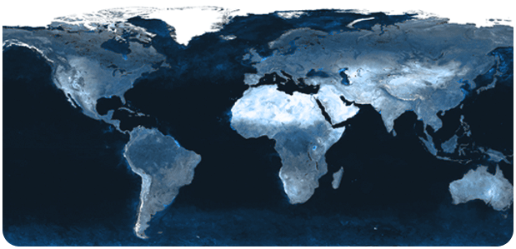
Struggles in Obeying the Great Commission
Matthew 28:11-20

Slide 2
INTRODUCTION
David Banning

Slide 3
INTRODUCTION
David Banning
The Great Commission
As contrasted with the Limited Commission
Scope
Time
Subjects

Slide 4
INTRODUCTION
David Banning
The Great Commission
As contrasted with the Limited Commission
Scope
Time
Subjects
Easy to understand (Go)
Teach
Baptize
Teach

Slide 5
INTRODUCTION
If the problem is not on God’s side…
Authority is established
Instructions are clear

Slide 6
INTRODUCTION
If the problem is not on God’s side…
Authority is established
Instructions are clear
Parameters are set
The process is spelled out

Slide 7
INTRODUCTION
If the problem is not on God’s side…
Authority is established
Instructions are clear
Parameters are set
The process is spelled out
The expected outcome is defined
Help is available

Slide 8
INTRODUCTION
If the problem is not on God’s side…
Authority is established
Instructions are clear
Parameters are set
The process is spelled out
The expected outcome is defined
Help is available
…then, it must be on our side

Slide 9
4 Things
There are probably many more that people could think of

Slide 10
4 Things
There are probably many more that people could think of
But, I want us to consider these four things today
Consideration
Preparation
Courage
Care

Slide 11
Consideration
Many people have the idea that the Great Commission is a suggestion

Slide 12
Consideration
Many people have the idea that the Great Commission is a suggestion
It is not; it is a command
In the original Greek, “Being gone, then…”

Slide 13
Consideration
Many people have the idea that the Great Commission is a suggestion
It is not; it is a command
In the original Greek, “Being gone, then…”
Originally, to His followers
Ultimately, to His followers

Slide 14
Consideration
Many people have the idea that the Great Commission is a suggestion
It is not; it is a command
In the original Greek, “Being gone, then…”
Originally, to His followers
Ultimately, to His followers
John 14:15; 1 Cor. 9:16-18; Romans 1:14-16
2 Tim. 2:2; James 4:17

Slide 15
Consideration
Others think this is a general goal we should strive for
Almost like a good byproduct

Slide 16
Consideration
Others think this is a general goal we should strive for
Almost like a good byproduct
Rather than a commission (order with authority)
A commission to paint/build something
A human rights commission

Slide 17
Consideration
Others think this is a general goal we should strive for
Almost like a good byproduct
Rather than a commission (order with authority)
A commission to paint/build something
A human rights commission
“There are preachers out there, I’ll encourage them.” (Good, but not enough)
Difference between being rel./being Christian

Slide 18
Preparation
Ecclesiastes 9:10 – “Whatever your hand finds to do, do it with all your might…”

Slide 19
Preparation
Ecclesiastes 9:10 – “Whatever your hand finds to do, do it with all your might…”
Dress for the occasion
Ephesians 6:10-18; Romans 13:12; Galatians 3:27

Slide 20
Preparation
Ecclesiastes 9:10 – “Whatever your hand finds to do, do it with all your might…”
Dress for the occasion
Ephesians 6:10-18; Romans 13:12; Galatians 3:27
Be diligent…
2 Timothy 2:15; Hebrews 5:14
1 Peter 3:15 – Always being prepared…

Slide 21
Preparation
Ecclesiastes 9:10 – “Whatever your hand finds to do, do it with all your might…”
Dress for the occasion
Ephesians 6:10-18; Romans 13:12; Galatians 3:27
Be diligent…
2 Timothy 2:15; Hebrews 5:14
1 Peter 3:15 – Always being prepared…
How can you preach what you haven’t studied?

Slide 22
Courage
2 Timothy 1:7 – God has not given us the spirit of fear, but…

Slide 23
Courage
2 Timothy 1:7 – God has not given us the spirit of fear, but…
Some tips to help us with fear
Prepare (see previous)

Slide 24
Courage
2 Timothy 1:7 – God has not given us the spirit of fear, but…
Some tips to help us with fear
Prepare (see previous)
Confront them – what are you afraid of?
Rejection? Humiliation? Confrontation? Harm?

Slide 25
Courage
2 Timothy 1:7 – God has not given us the spirit of fear, but…
Some tips to help us with fear
Prepare (see previous)
Confront them – what are you afraid of?
Rejection? Humiliation? Confrontation? Harm?
See what others have done (Bible, brethren)
Go with others
Experience (Just do it!)

Slide 26
Care
Sad to say, but this may be the most common reason – people simply do not care!
Not just outright apathy
They don’t care enough!
There are too many “more important” things in their lives
Too many urgent things
Life is too cluttered/priorities are skewed
We must care as Jesus cared

Slide 27
CONCLUSION
As you may notice, these are inter-related
2 Corinthians 13:5 – examine yourself
Ask yourself –
Have I been slacking?
Have I been dedicating my time to things that won’t matter?
If Jesus came right now, would I be ashamed of my efforts? Would there be anything to rest from?
Hebrews 4:9

Slide 28
Are YOU a Christian?
Hear
Believe
Repent
Confess
Be Baptized
Continue Faithfully
Romans 10:17
Mark 16:16
Acts 2:38
Acts 22:16
Mark 16:16
Hebrews 10:38

