Slide 1
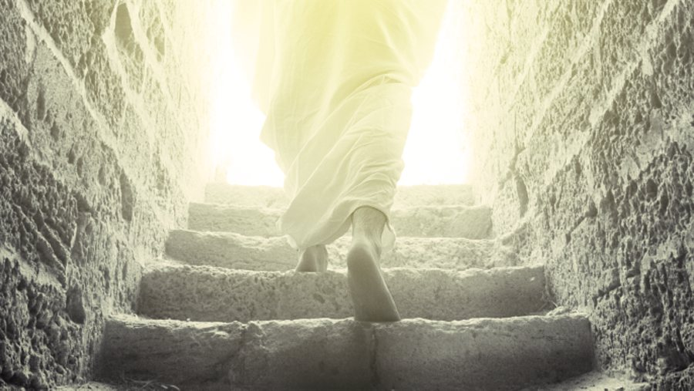
Strength Through Sorrow
Psalm 119:25-32

Slide 2
INTRODUCTION
Too many people expect that life as a follower of God should be without pain or sorrow

Slide 3
INTRODUCTION
Too many people expect that life as a follower of God should be without pain or sorrow
This is
Unrealistic, and
Unsupported in Scripture

Slide 4
INTRODUCTION
Too many people expect that life as a follower of God should be without pain or sorrow
This is
Unrealistic, and
Unsupported in Scripture
Often, when something bad occurs, they fall away
We wonder “Does Jesus care?” - Hymn answers us

Slide 5
INTRODUCTION
Too many people expect that life as a follower of God should be without pain or sorrow
This is
Unrealistic, and
Unsupported in Scripture
Often, when something bad occurs, they fall away
We wonder “Does Jesus care?” - Hymn answers us
Today, we will briefly consider what God does say about this

Slide 6
Saying
God didn’t promise:
Days without pain
Laughter without sorrow
Nor sun without rain

Slide 7
Saying
God didn’t promise:
Days without pain
Laughter without sorrow
Nor sun without rain
But He did promise:
Strength for the day
Comfort for the tears
And, light for the way

Slide 8
Saying
God didn’t promise:
Days without pain
Laughter without sorrow
Nor sun without rain
But He did promise:
Strength for the day (Philippians 4:13)
Comfort for the tears (2 Corinthians 1:2-4)
And, light for the way (Ephesians 5:8-10)
– anonymous

Slide 9
INTRODUCTION
Stumbling blocks or stepping stones?
The “floodwaters” principle

Slide 10
INTRODUCTION
Stumbling blocks or stepping stones?
The “floodwaters” principle
The same waters that lifted the ark, killed sinners
The same word that saves us (Romans 1:16), will judge us (John 12:48)
The same Jesus Who is our Chief Corner Stone (1 Peter 2:6) is also a rock of offense (vv 7-8)

Slide 11
INTRODUCTION
Stumbling blocks or stepping stones?
The “floodwaters” principle
The same waters that lifted the ark, killed sinners
The same word that saves us (Romans 1:16), will judge us (John 12:48)
The same Jesus Who is our Chief Corner Stone (1 Peter 2:6) is also a rock of offense (vv 7-8)
Today, we will see that the same problems that could overwhelm us, can strengthen us!

Slide 12
INTRODUCTION
Stumbling blocks or stepping stones?
The “floodwaters” principle
The same waters that lifted the ark, killed sinners
The same word that saves us (Romans 1:16), will judge us (John 12:48)
The same Jesus Who is our Chief Corner Stone (1 Peter 2:6) is also a rock of offense (vv 7-8)
Today, we will see that the same problems that could overwhelm us, can strengthen us!
The difference is God

Slide 13
The Donkey in the Hole
A story is told of a donkey that fell in a deep hole
The donkey cried/struggled, but couldn’t get out

Slide 14
The Donkey in the Hole
A story is told of a donkey that fell in a deep hole
The donkey cried/struggled, but couldn’t get out
Try as he might, the owner couldn’t get him out
He asked for help
He tried a rope, etc.
Finally, the owner gave up.
He had done his best; the animal was old; etc.

Slide 15
The Donkey in the Hole
A story is told of a donkey that fell in a deep hole
The donkey cried/struggled, but couldn’t get out
Try as he might, the owner couldn’t get him out
He asked for help
He tried a rope, etc.
Finally, the owner gave up.
He had done his best; the animal was old; etc.
He and his friends decided to fill in the hole
So that no children/other animals would fall in.
The donkey was still at the bottom, braying

Slide 16
The Donkey in the Hole
A story is told of a donkey that fell in a deep hole
They had given up (but the donkey had not)
As they shoveled dirt into the hole, the donkey
would shake off the dirt
tamp it down with its feet and take a step up

Slide 17
The Donkey in the Hole
A story is told of a donkey that fell in a deep hole
They had given up (but the donkey had not)
As they shoveled dirt into the hole, the donkey
would shake off the dirt
tamp it down with its feet and take a step up
As the dirt accumulated, the donkey got closer to the top
As the people saw what the donkey was doing, they threw MORE dirt on it
a few threw rocks – not appreciated

Slide 18
The Donkey in the Hole
A story is told of a donkey that fell in a deep hole
Pretty soon, the donkey was near the top
Then, it was finally able to jump out and trot off

Slide 19
The Donkey in the Hole
Morals
As long as the donkey was kicking/complaining, nothing was solved

Slide 20
The Donkey in the Hole
Morals
As long as the donkey was kicking/complaining, nothing was solved
When others gave up, it didn’t

Slide 21
The Donkey in the Hole
Morals
As long as the donkey was kicking/complaining, nothing was solved
When others gave up, it didn’t
The “solutions” of others may not be the best for you

Slide 22
The Donkey in the Hole
Morals
As long as the donkey was kicking/complaining, nothing was solved
When others gave up, it didn’t
The “solutions” of others may not be the best for you
If it had done nothing, the dirt soon would have buried it

Slide 23
The Donkey in the Hole
Morals
As long as the donkey was kicking/complaining, nothing was solved
When others gave up, it didn’t
The “solutions” of others may not be the best for you
If it had done nothing, the dirt soon would have buried it
There’s plenty of dirt out there, make the best use of it
Physical, emotional, social, spiritual…

Slide 24
Some Principles that God uses
Muscles
Resistance = growth

Slide 25
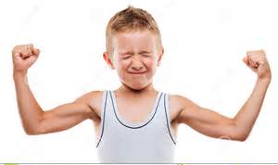
Some Principles that God uses
Muscles
Resistance = growth
Too much, too soon = injury (God knows)

Slide 26
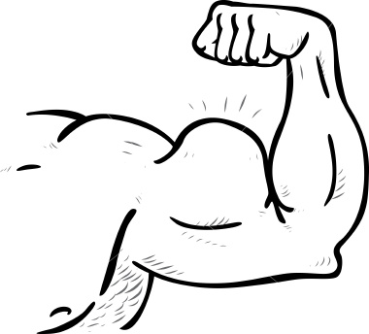
Some Principles that God uses
Muscles
Resistance = growth
Too much, too soon = injury (God knows)
Bigger muscles use bigger weights

Slide 27
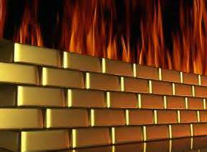
Some Principles that God uses
Muscles
Resistance = growth
Too much, too soon = injury (God knows)
Bigger muscles use bigger weights
Fire refines gold, silver, brick, clay

Slide 28
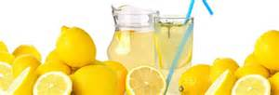
Some Principles that God uses
Muscles
Resistance = growth
Too much, too soon = injury (God knows)
Bigger muscles use bigger weights
Fire refines gold, silver, brick, clay
Lemons make lemonade

Slide 29
I Walked a Mile With Pleasure
“I walked a mile with Pleasure; She chatted all the way; But left me none the wiser For all she had to say. I walked a mile with Sorrow; And ne’er a word said she; But, oh! The things I learned from her, When Sorrow walked with me.”
– Robert Browning Hamilton

Slide 30
Godly Sorrow
2 Corinthians 7:8-11
Paul uses “sorry,” “sorrow,” & “sorrowed” 7x
Notice: “…godly sorrow produces repentance that leads to salvation.”

Slide 31
Godly Sorrow
2 Corinthians 7:8-11
Paul uses “sorry,” “sorrow,” & “sorrowed” 7x
Notice: “…godly sorrow produces repentance that leads to salvation.”
Ecclesiastes 7:1-4
Death, mourning, sorrow
Better, better, better – Why?

Slide 32
Godly Sorrow
2 Corinthians 7:8-11
Paul uses “sorry,” “sorrow,” & “sorrowed” 7x
Notice: “…godly sorrow produces repentance that leads to salvation.”
Ecclesiastes 7:1-4
Death, mourning, sorrow
Better, better, better – Why?
Hebrews 12:4-11

Slide 33
Remember…
God did not create a fallen world, He simply uses its principles to our benefit

Slide 34
Remember…
God did not create a fallen world, He simply uses its principles to our benefit
His Son dying on the cross
Man’s greatest sin; Satan’s “greatest triumph”
Became man’s salvation; Satan’s defeat

Slide 35
Remember…
God did not create a fallen world, He simply uses its principles to our benefit
His Son dying on the cross
Man’s greatest sin; Satan’s “greatest triumph”
Became man’s salvation; Satan’s defeat
1 Peter 1:6-7
James 1:2-4

Slide 36
Remember…
God did not create a fallen world, He simply uses its principles to our benefit
His Son dying on the cross
Man’s greatest sin; Satan’s “greatest triumph”
Became man’s salvation; Satan’s defeat
1 Peter 1:6-7
James 1:2-4
1 Cor 1:18-31 wisdom of the world v God

Slide 37
For Our Benefit
Tares, during their formative (immature) period, look just like wheat, yet mature wheat and tares do not look the same
Matthew 13:30
Over time, the tare is exposed because it does not mature like the wheat.

Slide 38
For Our Benefit
Tares, during their formative (immature) period, look just like wheat, yet mature wheat and tares do not look the same
Matthew 13:30
Over time, the tare is exposed because it does not mature like the wheat.
Interestingly, God leaves the tares among the wheat ultimately to benefit the wheat.
Verse 29

Slide 39
CONCLUSION
In this life, you will suffer anyway
Sin, fallen world, devil, others
When you suffer for Jesus…
1 Peter 4:1-2; 12-16
Romans 8:28 – will be used for good
James 1 – count it all joy
Romans 15 – patience
Hope
Fellowship – Jesus, other Christians

Slide 40
Are YOU a Christian?
Hear
Believe
Repent
Confess
Be Baptized
Continue Faithfully
Romans 10:17
Mark 16:16
Acts 2:38
Acts 22:16
Mark 16:16
Hebrews 10:38

