Slide 1
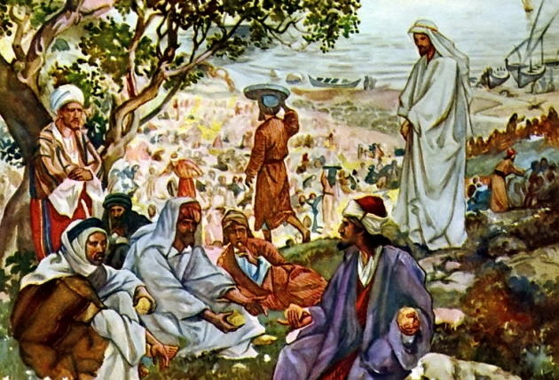
The Work That We All Can Do
Ephesian 4:11-16

Slide 2
INTRODUCTION
Over the past several weeks, we have discussed the organization of the church
Jesus is the head
Elders, Deacons, preachers, and teachers

Slide 3
INTRODUCTION
Over the past several weeks, we have discussed the organization of the church
Jesus is the head
Elders, Deacons, preachers, and teachers
Today, I want us to cinsider the work that every one of us should be doing

Slide 4
INTRODUCTION
Over the past several weeks, we have discussed the organization of the church
Jesus is the head
Elders, Deacons, preachers, and teachers
Today, I want us to cinsider the work that every one of us should be doing
Ephesians 4:11-16
Mark 13:28-36; Romans 13:11; 2 Peter 3:10-13

Slide 5
“Yet, these things are important…”
There is so much to do that we could hold classes on what our responsibilities are, however I want to briefly consider the following seven:

Slide 6
“Yet, these things are important…”
There is so much to do that we could hold classes on what our responsibilities are, however I want to briefly consider the following seven:
Pray for the church
Assemble
Draw others to church
Protect the good name of the church

Slide 7
“Yet, these things are important…”
There is so much to do that we could hold classes on what our responsibilities are, however I want to briefly consider the following seven:
Contribute to the collection of the saints
Help/encourage as the need arises
Impart/teach your knowledge to others

Slide 8
1. Pray for the church
Prayer is first for 2 reasons
It can be done anywhere
It helps us perform the other responsibilities better

Slide 9
1. Pray for the church
Prayer is first for 2 reasons
It can be done anywhere
It helps us perform the other responsibilities better
Pray generally (the model prayer-Matt 6:9-13)
Church growth, lost sinners, 2nd coming, maturity

Slide 10
1. Pray for the church
Prayer is first for 2 reasons
It can be done anywhere
It helps us perform the other responsibilities better
Pray generally (the model prayer-Matt 6:9-13)
Church growth, lost sinners, 2nd coming, maturity
Pray specifically (1 Samuel 1 – Hannah)
Those that request for specific situations
Our own growth in areas needed
James 5:16-18

Slide 11
2. Assemble
Three basic reasons
We demonstrate God’s worthiness in our lives
We obey a commandment of God (Heb 10:25)
We edify our brethren

Slide 12
2. Assemble
Three basic reasons
We demonstrate God’s worthiness in our lives
We obey a commandment of God (Heb 10:25)
We edify our brethren
It is the only time that we are authorized to observe the Lord’s Supper (1 Cor. 11)

Slide 13
2. Assemble
Three basic reasons
We demonstrate God’s worthiness in our lives
We obey a commandment of God (Heb 10:25)
We edify our brethren
It is the only time that we are authorized to observe the Lord’s Supper (1 Cor. 11)
Notice John 4:24; 1 Peter 2:5

Slide 14
3. Bring others to church
We must all have an evangelistic attitude
This shows that we love our neighbor
This also demonstrates that we believe what we claim
This shows that our faith is living – James 2:18ff

Slide 15
3. Bring others to church
We must all have an evangelistic attitude
This shows that we love our neighbor
This also demonstrates that we believe what we claim
This shows that our faith is living – James 2:18ff
Acts 20:26-27
Paul was innocent because he didn’t shrink back
We will all stand before God (2 Cor. 5:10; Heb. 9:27), let them have a good start

Slide 16
4. Protect it’s good name
Not like zealots or radicals who hurt others
The Crusades
Modern crazies in the news

Slide 17
4. Protect it’s good name
Not like zealots or radicals who hurt others
The Crusades
Modern crazies in the news
By our behavior
1 Corinthians 13

Slide 18
4. Protect it’s good name
Not like zealots or radicals who hurt others
The Crusades
Modern crazies in the news
By our behavior
1 Corinthians 13
By our words
1 Peter 3:15

Slide 19
5. Contribute
We all have to deal with budgets, unexpected expenses, family responsibilities, etc.
God knows this and wants to bless us in this area of our lives
He does this by multiplying what we give freely and returning it to us – Luke 6:38, etc
Satan wants you to “do it on your own”
Who’s principles are you following?

Slide 20
5. Contribute
We all have to deal with budgets, unexpected expenses, family responsibilities, etc.
God knows this and wants to bless us in this area of our lives
He does this by multiplying what we give freely and returning it to us – Luke 6:38, etc
Satan wants you to “do it on your own”
Who’s principles are you following?
This does not take the place of “alms”

Slide 21
6. Help/Encourage the needing
Galatians 6:1-2
We have a spiritual responsibility
…if you consider yourself spiritual

Slide 22
6. Help/Encourage the needing
Galatians 6:1-2
We have a spiritual responsibility
…if you consider yourself spiritual
Brethren who make their needs known should not be ignored
The times that you are in need, you will want help

Slide 23
6. Help/Encourage the needing
Galatians 6:1-2
We have a spiritual responsibility
…if you consider yourself spiritual
Brethren who make their needs known should not be ignored
The times that you are in need, you will want help
1 Thessalonians 5:10-15

Slide 24
7. Teach others
Teaching imparts knowledge/experience
2 Timothy 2:2
Titus 2:2-6, etc.

Slide 25
7. Teach others
Teaching imparts knowledge/experience
2 Timothy 2:2
Titus 2:2-6, etc.
There are many benefits
To the one being taught
To yourself
Learn/retain more
Please God
Follow God’s example

Slide 26
CONCLUSION
From this lesson, I believe we should all be able to see that WE (not THEY) have work to do
God expects it of us
We will be rewarded/punished accordingly
It proves our love fro God
And our neighbor

Slide 27
CONCLUSION
From this lesson, I believe we should all be able to see that WE (not THEY) have work to do
God expects it of us
We will be rewarded/punished accordingly
It proves our love fro God
And our neighbor
Not everyone is an eye, but we are all part of the body of Christ

Slide 28
Are YOU a Christian?
Hear
Believe
Repent
Confess
Be Baptized
Continue Faithfully
Romans 10:17
Mark 16:16
Acts 2:38
Acts 22:16
Mark 16:16
Hebrews 10:38

