Slide 1
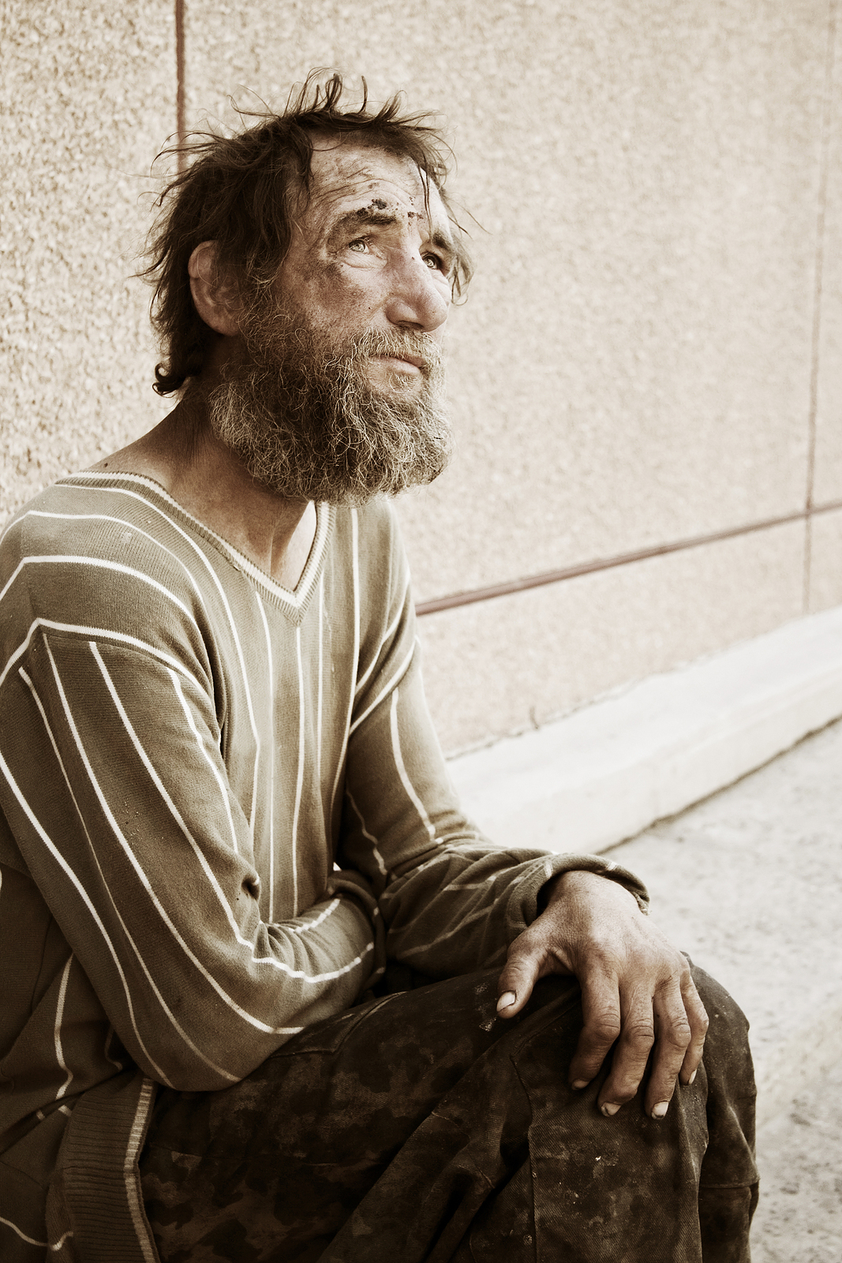
The Opposite of Love
Part 2
John 3:16-17

Slide 2
INTRODUCTION
Recap
Last week – part 1
Study a subject by looking at its opposite
Good/evil; Heaven/hell, loyalty/betrayal
Some quotes
“…not hate, but indifference.”
“…apathy.” “…fear” “…ignorance…”
What is the opposite of love?
Hate? Yes
Something else? Yes.

Slide 3
INTRODUCTION
Recap
Love is multi-faceted
A basis for our lives
A reason for our being
A goal to strive after
Study 1 Corinthians 13
v 1-3 – fundamentals/necessity
v 4-5 – positive/negative descriptors

Slide 4
Verse 6
“…does not…but…”
This seems to be an obvious characteristic.
But, do you believe that gossip about someone?
When something bad happens to someone that, maybe, deserved it?
When someone does bad to another? (riots, robbing)
Romans 1:32 – Evil people do this
Love takes no pleasure in…
The contemplation/consideration of unrighteousness
The acts of unrighteousness
The results of it

Slide 5
Verse 6
“…rejoices with the truth.”
“Truth” is used as the opposite of “unrighteousness”
By filling ourselves with good we drive out evil
Philippians 4:8, etc.
Matthew 12:43-45 evil spirit returns
“Love” is personified as rejoicing with “Truth”
2 John 4; 3 John 3
Evil opposes truth
2 Tim 3:8; Romans 2:6-8; Proverbs 17:15, etc.

Slide 6
Verse 7
“All things” is limited by context
Bears… (endures, covers) – notice v 4, again
1 Peter 4:8
1 Corinthians 9:12
Are you giving up on someone? Check your love
Believes…
Does not mean that we are gullible
We use God’s wisdom – 1 Corinthians 1
Matthew 10:16 – wise…innocent
Attitude of believing the best as a 1st choice-are you?

Slide 7
Verse 7
Hopes…
For the best in everyone and all occasions
…all things spiritual, personal, future, etc
Hope sustains us (Romans 8:25)
Endures…
Because it is tied to the previous qualities
Because love comes from God, it doesn’t run out.
If you have “run out of love,” for someone, it’s probably not love that you had to begin with

Slide 8
Verse 7
Hopes…
For the best in everyone and all occasions
…all things spiritual, personal, future, etc
Hope sustains us (Romans 8:25)
Endures…
Because it is tied to the previous qualities
Because love comes from God, it doesn’t run out.
If you have “run out of love,” for someone, it’s probably not love that you had to begin with

Slide 9
CONCLUSION
Because (agape) love is multi-faceted, it has many opposites.
The aspects of love are distinctive and
They overlap to form a whole
The opposites, therefore, are also many
And, they help us understand this basic, multi-faceted aspect of God as we strive to imitate Him
God is love; …for God so loved the world

Slide 10
Are YOU a Christian?
Hear
Believe
Repent
Confess
Be Baptized
Continue Faithfully
Romans 10:17
Mark 16:16
Acts 2:38
Acts 22:16
Mark 16:16
Hebrews 10:38

