Slide 2
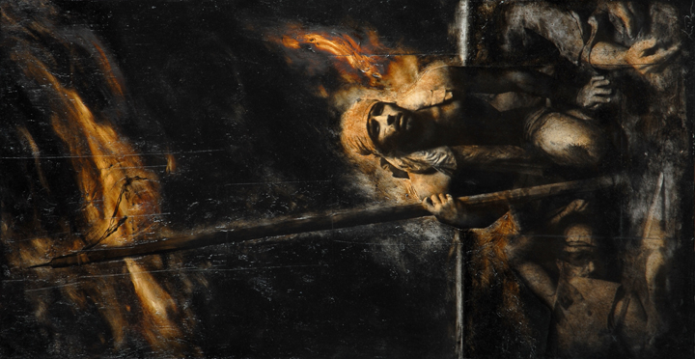
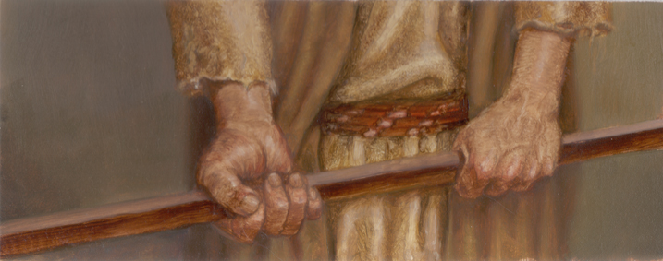
Shamgar
Judges 3:31

Slide 3
INTRODUCTION
Who?!?
Judges 3:31
After Ehud, before Deborah/Barak

Slide 4
INTRODUCTION
Who?!?
Judges 3:31
After Ehud, before Deborah/Barak
Son of Anath
Name means “sword”

Slide 5
INTRODUCTION
Who?!?
Judges 3:31
After Ehud, before Deborah/Barak
Son of Anath
Name means “sword”
The first time the Philistines are mentioned as troublesome neighbors

Slide 6
INTRODUCTION
Who?!?
Judges 3:31
After Ehud, before Deborah/Barak
Son of Anath
Name means “sword”
The first time the Philistines are mentioned as troublesome neighbors
Very little else known-not like some of the giants of the Bible (David, Abraham, Paul, etc.)

Slide 7
CONTEXT
Israel had finally come in to the promised land
Beginning of the era: Conquest of Canaan

Slide 8
CONTEXT
Israel had finally come in to the promised land
Beginning of the era: Conquest of Canaan
Deuteronomy 20:16-18
Destroy all peoples
They have been judged by God
Detestable
Don’t learn their sins

Slide 9
CONTEXT
Israel had finally come in to the promised land
Beginning of the era: Conquest of Canaan
Deuteronomy 20:16-18
Destroy all peoples
They have been judged by God
Detestable
Don’t learn their sins
Era lasted about 400 years

Slide 10
Judges
After Joshua died

Slide 11
Judges
After Joshua died
They were warned to finish the conquest
Or, the inhabitants would be a thorn in their sides
No earthly kings in Israel, yet – God was their King

Slide 12
Judges
After Joshua died
They were warned to finish the conquest
Or, the inhabitants would be a thorn in their sides
No earthly kings in Israel, yet – God was their King
They were only partially successful
The Israelites were being oppressed by people who shouldn’t have been there
7 cycles of sin, oppression, repentance, del., peace

Slide 13
EHUD
Israel sinned
Eglon, king of Moab (with Ammonites & Amalekites) attacked, took over Jericho
Notice: all from the East

Slide 14
EHUD
Israel sinned
Eglon, king of Moab (with Ammonites & Amalekites) attacked, took over Jericho
Notice: all from the East
After 18 years, Israel repented
God raised up Ehud, from Benjamin, left handed

Slide 15
EHUD
Israel sinned
Eglon, king of Moab (with Ammonites & Amalekites) attacked, took over Jericho
Notice: all from the East
After 18 years, Israel repented
God raised up Ehud, from Benjamin, left handed
80 years of peace

Slide 16
DANGER FROM THE WEST
Apparently, there was danger from the Philistines (to Israel’s west), also
Either during the same period or soon after
Judges 5:6-8 – Deborah’s Song-roads dangerous

Slide 17
DANGER FROM THE WEST
Apparently, there was danger from the Philistines (to Israel’s west), also
Either during the same period or soon after
Judges 5:6-8 – Deborah’s Song-roads dangerous
2 kinds of Judges
National – Othniel, Ehud, Deborah/Barak, Gideon, Jephthah, Samson
Local – Tola, Jair, Ibzan, Elon, & Abdon
Shamgar seems to be a local Judge

Slide 18
LESSONS
1. Start wherever you are
“What can I do?”
Didn’t wait for “better opportunity”
Many are immobilized by worries/stress/”what-if”
God strengthens positions of weakness
Shamgar didn’t use “endless preparation” as an excuse to do nothing

Slide 19
LESSONS
2. Use whatever is available to you
A “pokey-stick”; no sword/spear
Too many things we think we need – we don’t
Money, education, youth, etc.
Ex: Moses’ excuses (he had a staff)
David – a sling, widow in Jesus’ day – 2 pennies
Widow in Elijah’s day – a little oil/flour
Samson – jawbone of a donkey
If you already have it…

Slide 20
LESSONS
3. Do everything you can
Too many defeat themselves by worrying that what they can contribute is insignificant – it is
… a cup of cold water… Mark 9:41
God took notice of the widow’s pennies
David took 4 stones too many
Gideon’s army had to be pared down to “blessing-ready” size

Slide 21
LESSONS
3. Do everything you can
Too many defeat themselves by worrying that what they can contribute is insignificant – it is
… a cup of cold water… Mark 9:41
God took notice of the widow’s pennies
David took 4 stones too many
Gideon’s army had to be pared down to “blessing-ready” size
God makes the difference

Slide 22
LESSONS
Shamgar was ready and willing to be used of God when called
His previous occupation is unknown (farmer?)
Used the weapon available
He didn’t wait for someone else, he WAS that “someone else”
He did not retreat, because “the battle belongs to the Lord”

Slide 23
CONCLUSION
Precious little is known of Shamgar
God knows
He wrote about him in His book
He will reward him on the Judgment Day

Slide 24
CONCLUSION
Precious little is known of Shamgar
God knows
He wrote about him in His book
He will reward him on the Judgment Day
We know enough
Many other “Shamgar”s
Widow with her two pennies

Slide 25
CONCLUSION
How many of us can be “Shamgar”?
Not everyone can be a Paul, or a John the Baptist or a Peter
We can all be a Shamgar
Every time we fight for the Lord in a small, obscure place
Every time we confront the local enemy

Slide 26
Are YOU a Christian?
Hear
Believe
Repent
Confess
Be Baptized
Continue Faithfully
Romans 10:17
Mark 16:16
Acts 2:38
Acts 22:16
Mark 16:16
Hebrews 10:38

