Slide 1
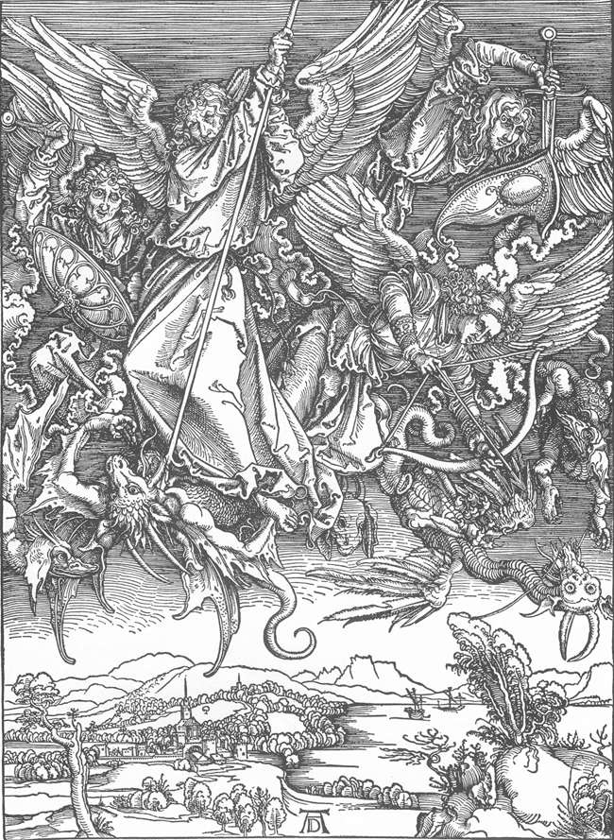
The Power of the Air
Ephesians 2:1-7

Slide 2
INTRODUCTION
2 Kings 6:8-18
Aram battles against Israel
Israel knows the locations of Aram’s camps, traps & avoids them
The King of Aram suspects a spy

Slide 3
INTRODUCTION
2 Kings 6:8-18
Aram battles against Israel
Israel knows the locations of Aram’s camps, traps & avoids them
The King of Aram suspects a spy
He is told that it is because of the prophet Elisha
He encircles the city of Dothan

Slide 4
INTRODUCTION
2 Kings 6:8-18
Aram battles against Israel
Israel knows the locations of Aram’s camps, traps & avoids them
The King of Aram suspects a spy
He is told that it is because of the prophet Elisha
He encircles the city of Dothan
Next morning, Elisha’s servant sees them & fears
Verses 16 and 17

Slide 5
INTRODUCTION
2 Kings 6:8-18
Aram battles against Israel
Israel knows the locations of Aram’s camps, traps & avoids them
The King of Aram suspects a spy
He is told that it is because of the prophet Elisha
He encircles the city of Dothan
Next morning, Elisha’s servant sees them & fears
Verses 16 and 17
God opens our eyes/minds through the Scriptures

Slide 6
Angels and Politics
Angelic battles have consequences on earth
Daniel 10-12
Governments rise, fall; politics, etc.
Romans 13:1 – God is over all

Slide 7
Angels and Politics
Angelic battles have consequences on earth
Daniel 10-12
Governments rise, fall; politics, etc.
Romans 13:1 – God is over all
We can be active participants
We are not like ants in a battlefield; God hears us
Prayers – James 5:16; Ephesians 3:20-21; etc.
Gospel – 2 Corinthians 4:4; Romans 1:16
1 Timothy 2:1-2 – Pray for those in authority

Slide 8
Angels vs. Demons
Ephesians 2:2 – Satan is the prince of the power of the air
He works (influences) the wicked; opposes good
1 Peter 5:8 – Roaring lion

Slide 9
Angels vs. Demons
Ephesians 2:2 – Satan is the prince of the power of the air
He works (influences) the wicked; opposes good
1 Peter 5:8 – Roaring lion
Ephesians 6:16 – Flaming arrows (distance)
Matthew 25:41 – Over evil angels (demons)

Slide 10
Angels vs. Demons
Ephesians 2:2 – Satan is the prince of the power of the air
He works (influences) the wicked; opposes good
1 Peter 5:8 – Roaring lion
Ephesians 6:16 – Flaming arrows (distance)
Matthew 25:41 – Over evil angels (demons)
Angels care for us
Acts 8:26; 10:3; Luke 16:22 – Beginning, end

Slide 11
Angels vs. Demons
Ephesians 2:2 – Satan is the prince of the power of the air
He works (influences) the wicked; opposes good
1 Peter 5:8 – Roaring lion
Ephesians 6:16 – Flaming arrows (distance)
Matthew 25:41 – Over evil angels (demons)
Angels care for us
Acts 8:26; 10:3; Luke 16:22 – Beginning, end
Luke 15:10 – Joy at our repentance
Hebrews 1:14 – Ministering spirits

Slide 12
We Are Involved
1 Corinthians 6:3 – We will judge angels
“Do you not know that we will judge angels? How much more matters of this life?”

Slide 13
We Are Involved
1 Corinthians 6:3 – We will judge angels
“Do you not know that we will judge angels? How much more matters of this life?”
Ephesians 6:10-13 – We wrestle against evil
For our struggle is not against flesh and blood, but against the rulers, against the powers, against the world forces of this darkness, against the spiritual forces of wickedness in the heavenly places.

Slide 14
We Are Involved
1 Corinthians 6:3 – We will judge angels
“Do you not know that we will judge angels? How much more matters of this life?”
Ephesians 6:10-13 – We wrestle against evil
For our struggle is not against flesh and blood, but against the rulers, against the powers, against the world forces of this darkness, against the spiritual forces of wickedness in the heavenly places.
Ephesians 4:26-27 – Anger gives Satan a place

Slide 15
The Cross
An apparent victory…
Luke 22:53; John 14:29-31 – Satan’s hour
1 Corinthians 2:7-8 – Behind, Judas, Jews, rulers…

Slide 16
The Cross
An apparent victory…
Luke 22:53; John 14:29-31 – Satan’s hour
1 Corinthians 2:7-8 – Behind, Judas, Jews, rulers…
Was a resounding defeat!
Genesis 3:15 – Bruise His heal/bruise his head
John 12:31-33 – The cross became Satan’s defeat

Slide 17
The Cross
“Come down from there!”

Slide 18
The Cross
“Come down from there!”
Matthew 27:39-40 – Strangers
“Those passing by”

Slide 19
The Cross
“Come down from there!”
Matthew 27:39-40 – Strangers
“Those passing by”
Matthew 27:41-43 – The religious leaders
Chief priests
Scribes
Elders

Slide 20
The Cross
“Come down from there!”
Matthew 27:39-40 – Strangers
“Those passing by”
Matthew 27:41-43 – The religious leaders
Chief priests
Scribes
Elders
Matthew 27:44 – The robbers
Originally, both; then just one (Luke 23:39-43)

Slide 21
The Cross
“Come down from there!”
Matthew 27:39-40 – Strangers
“Those passing by”
Matthew 27:41-43 – The religious leaders
Chief priests
Scribes
Elders
Matthew 27:44 – The robbers
Originally, both; then just one (Luke 23:39-43)
Luke 23:36-37 – The soldiers: “Save yourself.”

Slide 22
The Two Kingdoms
Acts 26:16-18 – God/Satan; light/darkness

Slide 23
The Two Kingdoms
Acts 26:16-18 – God/Satan; light/darkness
Colossians 1:13 – domain of darkness to the kingdom of His Beloved Son

Slide 24
The Two Kingdoms
Acts 26:16-18 – God/Satan; light/darkness
Colossians 1:13 – domain of darkness to the kingdom of His Beloved Son
Satan tries to hide the truth
2 Corinthians 4:3-4; Matthew 13:19

Slide 25
The Two Kingdoms
Acts 26:16-18 – God/Satan; light/darkness
Colossians 1:13 – domain of darkness to the kingdom of His Beloved Son
Satan tries to hide the truth
2 Corinthians 4:3-4; Matthew 13:19
We are the ground troops – 2 Cor 10:3-5
Matthew 28:18-20 – “Go.”
The more we influence, the less Satan can

Slide 26
CONCLUSION
Angels are fighting for us – will you join?
God is calling – will you answer?

Slide 27
CONCLUSION
Angels are fighting for us – will you join?
God is calling – will you answer?
No neutrality – Where do you stand?
God wins/ Satan loses – who’s side are you on?

Slide 28
CONCLUSION
Angels are fighting for us – will you join?
God is calling – will you answer?
No neutrality – Where do you stand?
God wins/ Satan loses – who’s side are you on?
2 Peter 3:9 – God’s patience – Don’t abuse it.
2 Corinthians 6:2 – Today is the day

Slide 29
Are YOU a Christian?
Hear
Believe
Repent
Confess
Be Baptized
Continue Faithfully
Romans 10:17
Mark 16:16
Acts 2:38
Acts 22:16
Mark 16:16
Hebrews 10:38

Slide 30
AN INVISIBLE ENEMY Kyle Campbell
Doubled over and choking, they staggered to hospitals by the thousands, crying for help and refuge from a colorless cloud of gas that turned Bhopal, India into a tomb on a terrible December day in 1984. "We have been working nonstop to treat the people and still they are coming," said one volunteer who tried to help doctors and nurses cope with streams of injured at five jammed hospitals. The official death toll was 2,259 at the Union Carbide plant surrounding areas, many never fully aware of what hit them.

Slide 31
AN INVISIBLE ENEMY Kyle Campbell
No enemy is harder to fight than an invisible one. Christians also face an unseen adversary, who leads the forces arrayed against us in spiritual conflict. Paul wrote, "Put on the whole armour of God, that ye may be able to stand against the wiles of the devil. For we wrestle not against flesh and blood, but against principalities, against powers, against the rulers of the darkness of this world, against spiritual wickedness in high places" (Ephesians 6:11-12).

Slide 32
AN INVISIBLE ENEMY Kyle Campbell
Just because the devil walks around "as a roaring lion" (1 Peter 5:8) doesn't mean that he sounds like one. He is cunning and crafty (Genesis 3:1; 2 Corinthians 11:3), and he can transform himself (2 Corinthians 11:14). So we need to diligently watch and pray (Matthew 26:41; Mark 14:38; Luke 22:46).

